Slide 1
3-10 Gauss’ Law in Differential Form
Total charge
Charge density

Slide 2
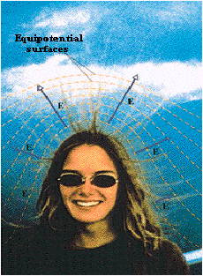
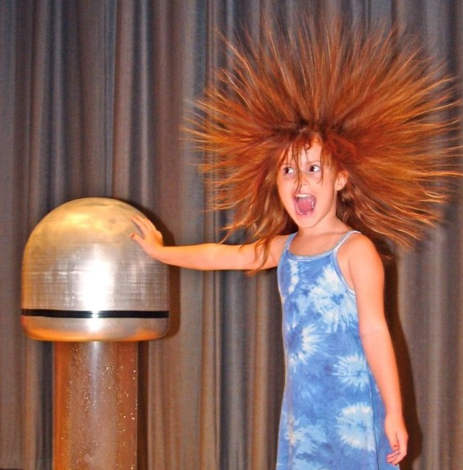
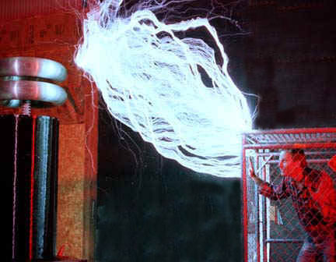
4 電位
What is the danger if your hair suddenly stands up?
Notes:
Sequoia 紅杉

Slide 3
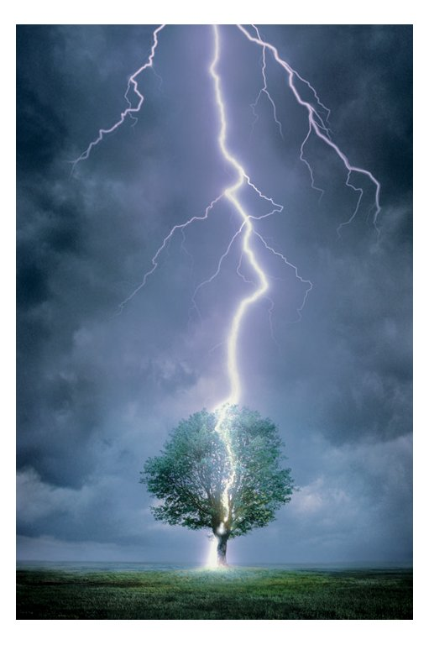
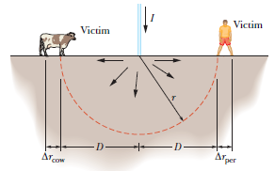
Lightning bolt and ground current
Notes:
Sequoia 紅杉

Slide 4

4-1 電位能
F_{e} and F_{g} are mathematically identical
F_{e} is a conservative force

Slide 5
4-2 電位
U_{e} depends on q, but V_{e} does not

Slide 6
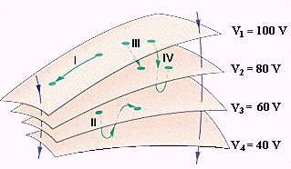
4-3 等位面
Four Equipotential Surfaces

Slide 7
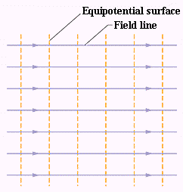
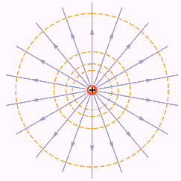
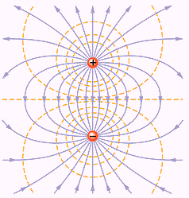
等位面3例
E.S. for a uniform field, a point charge, and an electric dipole

Slide 8
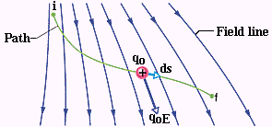
4-4 由電場算電位
The differential work done by F

Slide 9
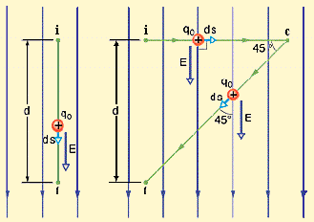
Ex. 1 均勻電場
(a) Along path (a)

Slide 10
Ex. 1 均勻電場︰路徑(a)

Slide 11
Ex. 1 均勻電場︰路徑(b)

Slide 12
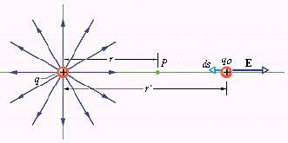
4-5 點電荷的電位

Slide 13
點電荷的電位

Slide 14
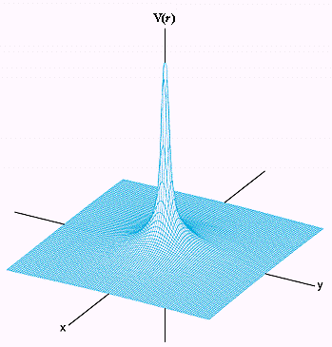
點電荷的電位圖

Slide 15
4-6 一組點電荷的電位
The principle of superposition

Slide 16
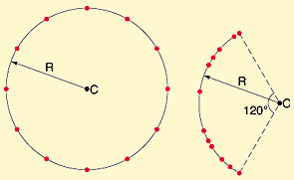
Ex.2 V_{c} and E_{c} for 12 electrons
on a circle
on an arc

Slide 17
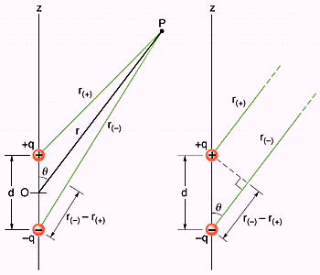
4-7 電雙極的電位

Slide 18
雙極矩 p = qd
p 由負電荷指向正電荷

Slide 19
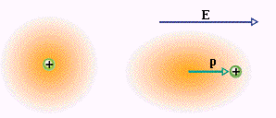
Induced Dipole Moment
感應雙極矩
極化 (polarization)

Slide 20
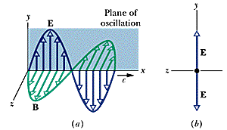
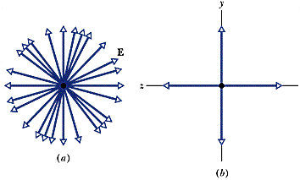
6-5 Polarization (偏振)
Polarized Light
The Plane of Polarization
Linear, Circular and Elliptical
polarization

Slide 21
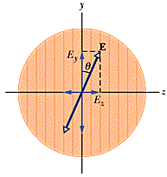
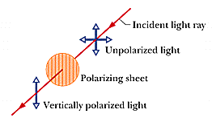
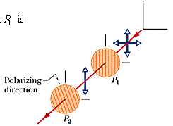
偏振片
Notes:
1932 polaroid Edwin Land

Slide 22
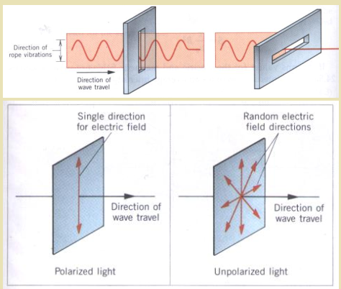
Polarization of Light

Slide 23
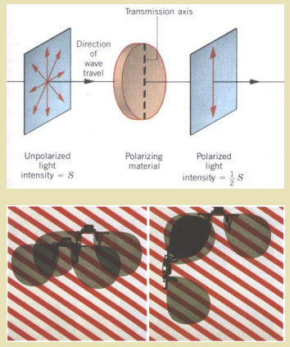
偏振與太陽眼鏡

Slide 24
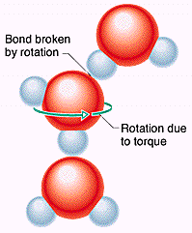
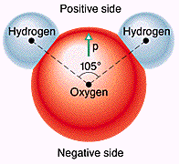
水分子與微波爐

Slide 25
4-8 連續電荷分佈的電位

Slide 26
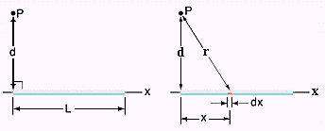
Line of Charge

Slide 27
計算

Slide 28
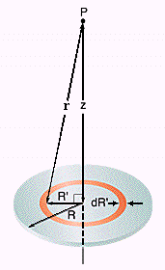
Charged Disk

Slide 29
計算

Slide 30
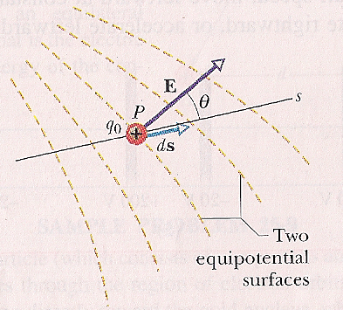
4-9 由電位算電場
The work done by the
electric field

Slide 31
4-10 The gradient operator 梯度運算子

Slide 32
The Laplacian operator

Slide 33
The Laplace Equation
For 2 dimensional
problems

Slide 34
Solving Laplace Equation by separation of variables

Slide 35
The Solution

Slide 36
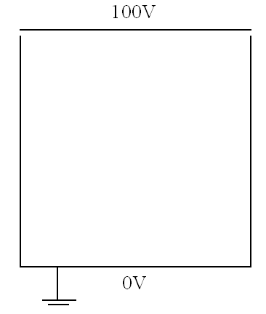
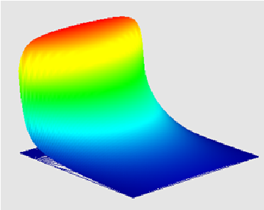
A boundary value problem

Slide 37
Ex.3 The charged disk

Slide 38
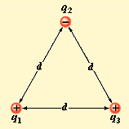
4-11一組點電荷的電位能
For charges q₁ and q₂
Ex.4 Three charges

Slide 39
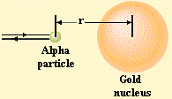
Ex.5 An alpha particle and a gold nucleus
Notes:
Femto 10-15

Slide 40
4-12 Potential of a charged isolated conductor
導體內部及表面為一等位面(equipotentail surface)

Slide 41
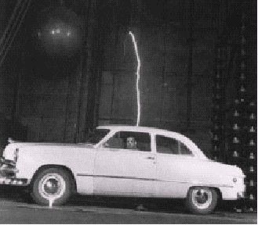
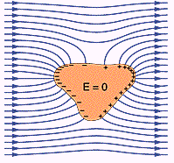
Discharge

Slide 42
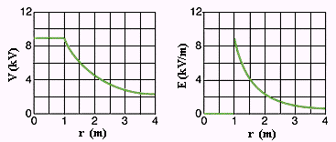
Plots of E (r) and V(r)

