Slide 1
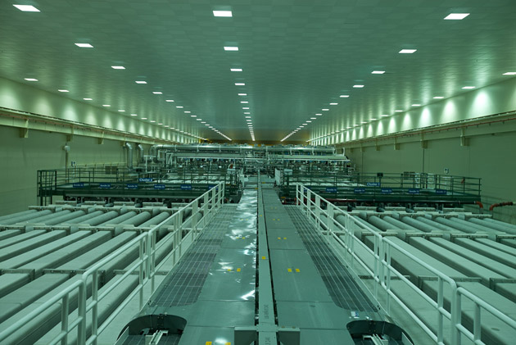
5 電容 Capacitance
National Ignition Facility
Notes:
http://www.wired.com/science/discoveries/news/2009/05/gallery_nif?currentPage=4

Slide 2
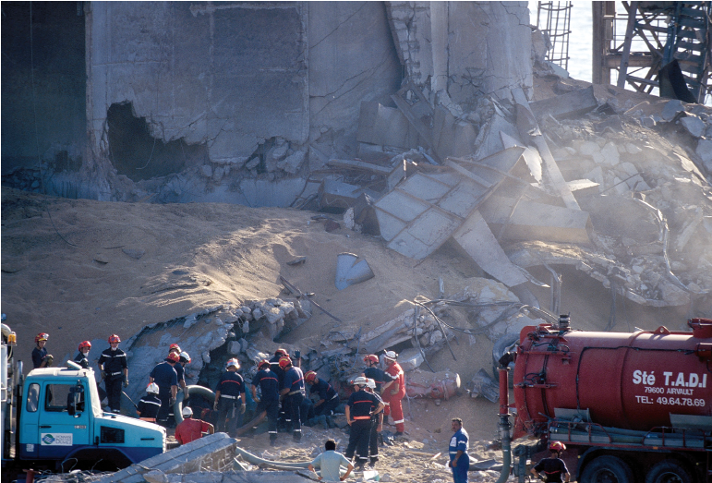
Explosions in Airborne Dust
Notes:
http://www.wired.com/science/discoveries/news/2009/05/gallery_nif?currentPage=4

Slide 3
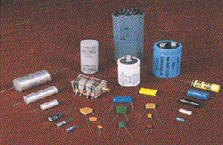
5-1電容與電容器
電容（Capacitance）
平行板電容器
C = ( F 法拉 )
K: 介電常數，真空 = 1
ε₀: 真空電容率 A: 板面積 d : 兩板距離

Slide 4
The Uses of Capacitors
As storehouses of electric potential energy
As vital elements in tuned circuits (radio and TV) and RAM chips

Slide 5
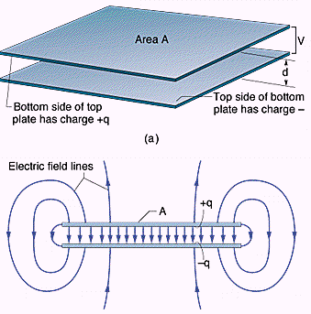
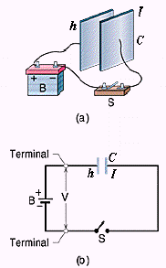
Charging a capacitor

Slide 6
5-2 Calculating the Capacitance
Put a charge q on the plates
Find E using Gauss’s Law
Find V between the plates
Calculate C by its definition

Slide 7
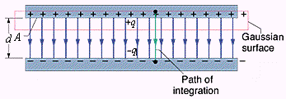
Calculating the electric field

Slide 8
Calculating the potential difference

Slide 9
A parallel-plate capacitor

Slide 10
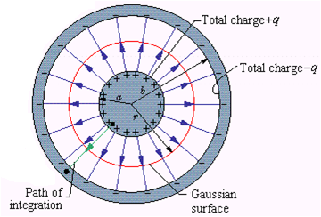
A cylindrical capacitor

Slide 12
A spherical capacitor

Slide 13
An Isolated Sphere – the missing plate is a conducting sphere of infinite radius

Slide 14
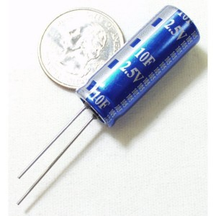
Ex.1 1.0 F 電容器
d = 1.0mm

Slide 15
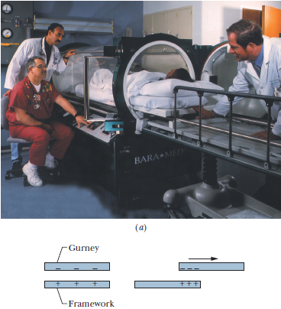
Ex.2 a hyperbaric chamber
Spark：> 2000V
fire：> 0.20 mJ
→
V_{f}：> 6000V
U_{f}：> 0.45 mJ

Slide 16
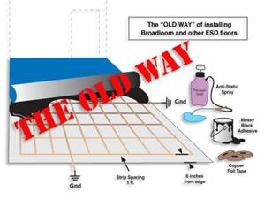
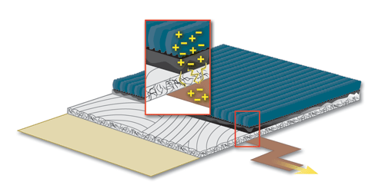
Conducting floor

Slide 17
Ex.3 the threshold value U_{t} ( 150 mJ) required to ignite airborne grains.

Slide 18
5-3 Capacitors in parallel

Slide 19
等效電容

Slide 20
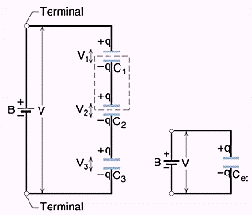
5-4 Capacitors in series

Slide 21
等效電容

Slide 22
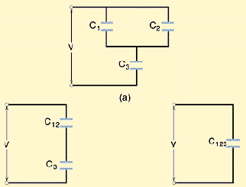
Ex.4 Finding eq. capacitor

Slide 24
5-5 Storing Energy in an Electric Field

Slide 25
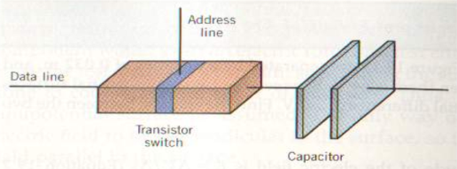
Ex.4 A RAM Chip
C = 55fF（10⁻¹⁵） V = 5.3 volt
Notes:
A charged capacitor means that a “one” has been stored.
http://computer.howstuffworks.com/question452.htm

Slide 26
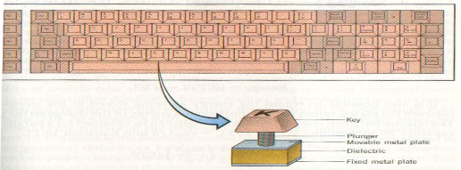
Ex.5 電容式鍵盤

Slide 27
Ex.5 (cont)
A = 9.50 × 10⁻⁵m² ; k = 3.50
按鍵後d由5.00mm減為0.150mm
按鍵前 C = 0.589PF

Slide 28
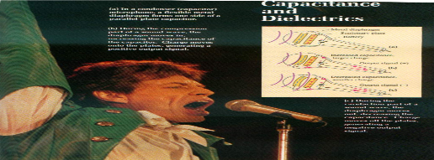
電容式麥克風

Slide 29
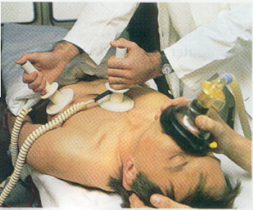
Ex.6 defibrillator (除纖顫機)

Slide 30
心跳停止病人之急救
盡快求助
盡快給予先進的救命治療
盡快實行心肺復甦術(CPR)
盡快除纖顫

