Slide 1
10 Magnetism of Matter 磁 性 Electromagnetic Waves 電磁波
How can a clay-walled kiln reveal Earth’s magnetic field of the past?
Notes:
磁鐵礦(magnetite 0.3μm, domain walls shift in size)和赤鐵礦(hematite 1mm, domains rotate)

Slide 2
10-2.7 Find B(r)
Notes:
Both increasing

Slide 3
10-2.8 Displacement Current

Slide 4
10-2.9 Maxwell’s Equations

Slide 5
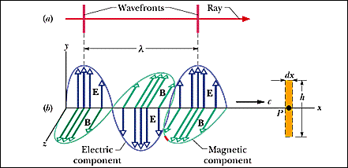
10-3 Electromagnetic Waves
The oscillating E and B Fields
A Most Curious Wave
–The ether (以太)

Slide 6
34-3 The Traveling Electromagnetic Wave
The induced electric field:

Slide 9
․The induced magnetic field:

Slide 11
10-3.3.1 Radiation Pressure
Momentum change
energy change
Notes:
Glass sphere (starlik) lifted by 1cm

Slide 12
․The Force Exerted by Radiation

Slide 13
․The size of comet particles

