Slide 1
A renormalization-group analysis
of the magnetic catalysis
Based on
KH, K. Itakura, S. Ozaki, [hep-ph/1706.04913] (To appear in PLB)
Koichi Hattori
Workshop of Recent Developments in QCD and Quantum Field Theories
@ National Taiwan Univ., Nov. 10, 2017

Slide 2
Outline
1
The origin of the magnetic catalysis of χSB in a strong B
Analogy to superconductivity:
Effective dimensional reduction in high density and in a strong B
-- Scaling argument on the basis of RG
2
The RG equation for a weak-coupling gauge theory
-- Screening effect in QED
3
Perspective for the MC in QCD at zero and finite T.
Cf., KH, T. Kojo, N. Su, NPA, (2016).

Slide 3
BCS theory
Superconductivity occurs no matter how weak the attraction is.
“Dimensional reduction” in dense systems
-- (1+1)-dimensional low-energy effective theory
+ Low energy excitations along the radius [(1+1) D]
+ Degenerated states in the tangential plane [2D]
Quantum correction
Phase space volume ~ p^{D-1} dp
Enhanced IR dynamics induces nonperturbative physics,
such as superconductivity and Kondo effect.

Slide 4
IR scaling dimensions
Kinetic term
Four-Fermi operators for superconductivity
Polchinski (1992)
In general momentum config.
In the BCS config.

Slide 5
Landau-level quantization
and “Dimensional reduction”
in a strong magnetic field

Slide 6
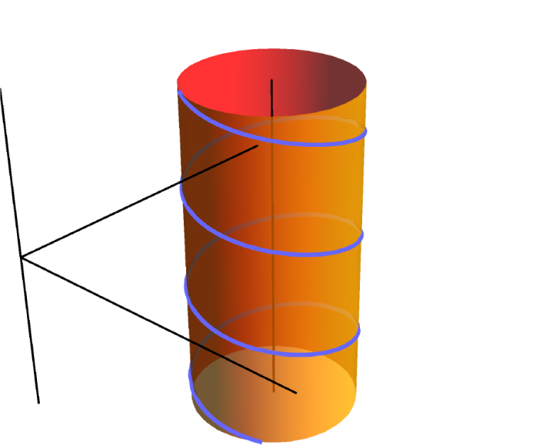
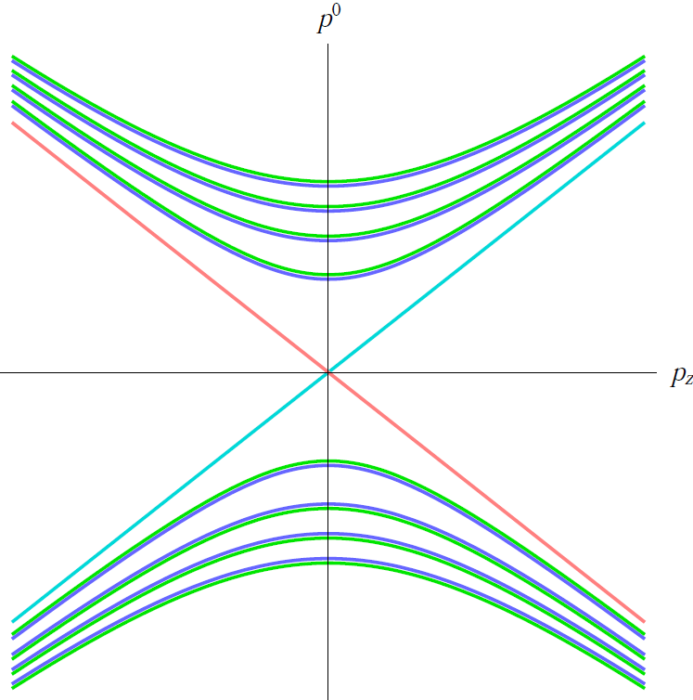
Landau level discretization
due to the cyclotron motion
“Harmonic oscillator” in the transverse plane
Nonrelativistic:
B
Cyclotron frequency
Relativistic:
In addition, there is the Zeeman effect.
L↑
R↑

Slide 7
Analogy btw the dimensional reduction in a large B and μ
(1+1)-D dispersion relations
Large Fermi sphere
Strong B
2D density of states

Slide 8
Scaling dimensions in the LLL
Kinetic term
A four-Fermi operator for the LLL
(1+1)-D dispersion relation → d_{ψ} = - 1/2
Always marginal irrespective of the interaction type and
the coupling constant thanks to the “dimensional reduction” in the LLL.

Slide 9
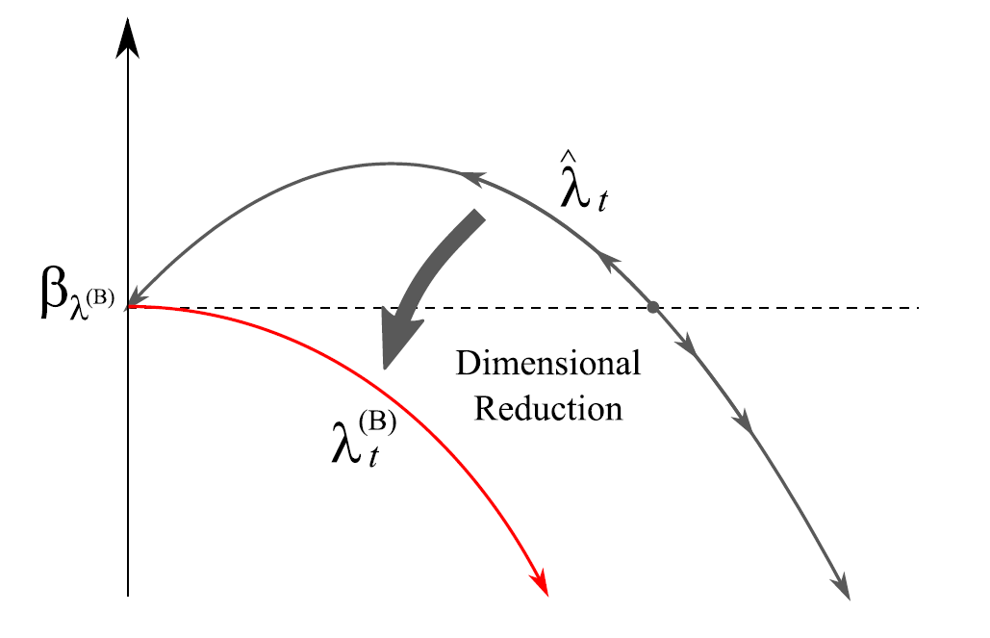
RG flow driven by the logarithmic quantum corrections
Fukushima & Pawlowski
λ
Solution:
Emergent scale in the IR !
Cf., Similarity to Λ_{QCD}

Slide 10
Magnetic catalysis
Chiral symmetry breaking occurs solely for the dimensional reason
as a consequence of the dimensional reduction in a strong B-field.
Chiral symmetry is broken even in QED in a strong B-field.
Gusynin, Miransky, and Shovkovy.

Slide 11
Example 1: NJL model
Even when G(Λ_{UV}) = G_{NJL} is small, the smallness can be
compensated by the large degeneracy ~ |eB|.
-- Chiral sym. can be broken for any G when |eB| is sufficiently large.
The m_{dyn} explicitly depends on the coupling constant in NJL model,
implying the dependence on the interaction type.
The dimensionless combination, eB*G, appears
because of the dimensionful coupling constant in NJL model.
What form of the gap appears in QED,
and ultimately in QCD or any other strongly coupled system?
More specifically, how the differences can be described by the RG?

Slide 12
Interactions in an underlying theory
--- “Intrinsic” energy dependence
E.g.,
Underlying theory may have a hierarchy of the energy scales.
Energy scales
in QED in B
Higher Landau levels
Region I
In case of QCD,
we have Λ_{QCD ,} which
separates pertub. and
non-pertub. regions!!
Screening mass
Region II
?
Landau pole

Slide 13
Effective (1+1)-dimensional interaction in QED
0
Increment from the LO diagram
The LO diagram provides a log, and drives the RG in part.
NB) The unscreened magnetic gluon changes the color-superconducting gap. D.T.Son

Slide 14
RG eqs. and the solutions
Region I
Region II
Higher Landau levels
Region I
Screening mass
Region II
Landau pole
Final result with the appropriate screening effect

Slide 15
Effective coupling
Example 1: NJL model revisited
Solution is formally same as
→ Recovers the aforementioned result
Example 2: Unscreened QED
Solution is formally same as
A Landau pole at tan(・・・) = ∞.

Slide 16
Example 3: Many-flavor QED with α*Nf >> 1
Ordinary QED (α*Nf <<1)
Many-flavor QED
Screening mass
Higher Landau levels
Higher Landau levels
Region I
Screening mass
Region II
Landau pole
Landau pole
In many-flavor QED
We have
Therefore,

Slide 17
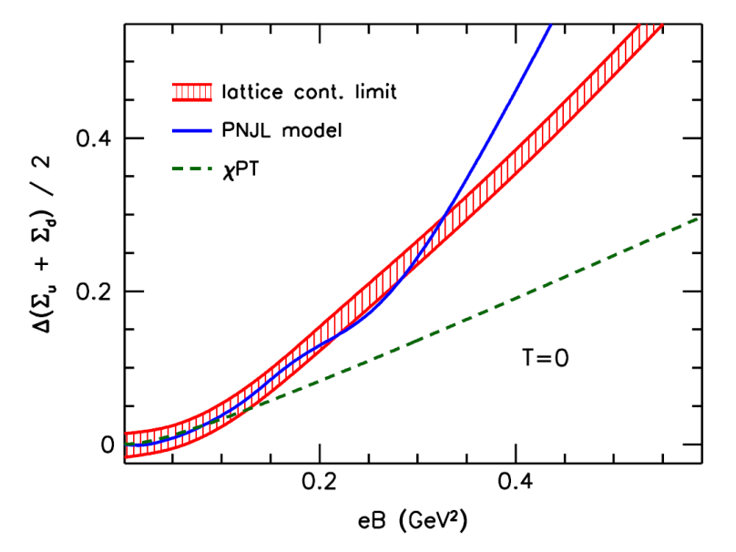
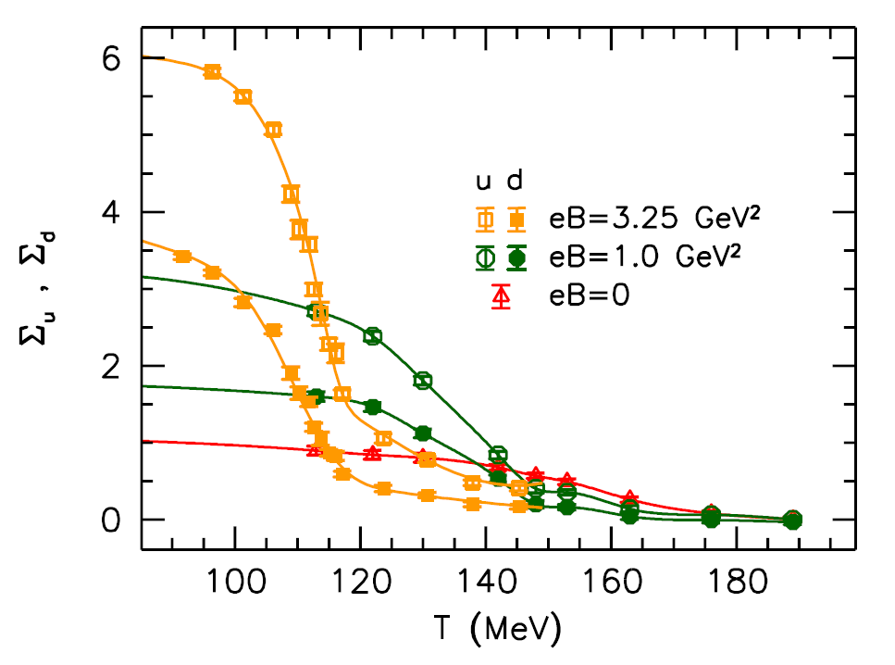
QCD perspective
Endrodi, JHEP07(2015)
T = 0
+ At T= 0, an enhancement of the chiral condensate was
observed in lattice QCD simulations.
→ Qualitative agreement with the magnetic catalysis.
+ However, the chiral restoration occurs at a lower T
in a stronger B-field, called the “inverse magnetic catalysis.”
Typical model calculations fail to reproduce the linear growth at T = 0 and the inverse magnetic catalysis at finite T.

Slide 18
Possible hierarchies in QCD
Higher Landau levels
Perturbative region
Region 0
Intrinsic energy dep.
in the low-energy QCD
Region I
Screening mass
Region II
Landau pole
A strong screening.
In a stronger B:
Higher Landau levels
Perturbative region
Region 0’
A strong screening.
Screening mass
Intrinsic energy dep.
in the low-energy QCD
Region I’
Region II’
Landau pole

Slide 19
Typical models fail to reproduce
the linear growth in the lattice result.
T = 0
q
q
q
q
q
q
$$\overline{q}$$
q
$$\overline{q}$$
q
$$\overline{q}$$
q
$$\overline{q}$$
q
$$\overline{q}$$
$$\overline{q}$$
$$\overline{q}$$
$$\overline{q}$$
$$\overline{q}$$
$$\overline{q}$$
Cf., Studies by the Schwinger-Dyson equation in
T. Kojo and N. Su (2013), and KH, T. Kojo, N. Su (2016).
q
q
q
q
q
$$\overline{q}$$
$$\overline{q}$$
$$\overline{q}$$
$$\overline{q}$$
$$\overline{q}$$
From this observation at T = 0, it seems that m_{dyn} ~ O( (eB)⁰ ).
If the m_{dyn} does not grow with eB, thermal fluctuations
will be enhanced by the large degeneracy factor ~ eB.
(If the gap is m_{dyn}~ eB^{1/2}, Tc ~ eB^{1/2}.)
A possible scenario for consistent description of
the MC at T = 0 and the inverse MC at finite T.

Slide 20
How can we get the saturation of m_dyn by the RG?
Higher Landau levels
Perturbative
Region 0
Region I
Intrinsic non-perturbative region in QCD
Screening mass
Region II
Landau pole

Slide 21
Summary
We explicitly saw the dimensional reason for the occurrence
of the magnetic catalysis on the basis of the scaling argument.
However, the precise form of gap depends the interaction.
We discussed the implementation of the screening
effect from the RG point of view.
More generally, this is a diagnosis of the RG method (or EFT)
to include the interaction properties of the underlying theory.
To explain the lattice results [or m_{dyn} ~ O( (eB)⁰ )],
an interaction beyond the four-Fermi (NJL) is important.
Cf., T. Kojo and N. Su (2013), and KH, T. Kojo, N. Su (2016).

