Slide 1
Molecular Structure Imaging and
Site-resolved Analysis
by Cs-corrected STEM
M. Haruta, H. Kurata
Institute for Chemical Research, Kyoto University, Uji, Kyoto, Japan
and S. Isoda
Institute for Integrated Cell-Material Sciences (iCeMS),
Kyoto University, Yoshida-Ushinomiya, Kyoto, Japan

Slide 2

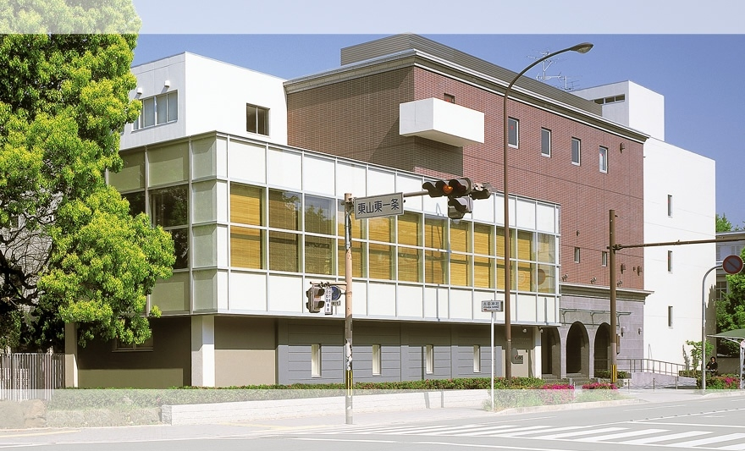
Institute for Integrated Cell-Material Sciences (iCeMS)
World Premier International Research Center Initiative
by MEXT Japan;
“Globally visible” research centers.
Kyoto University
Founded October 2007

Slide 3
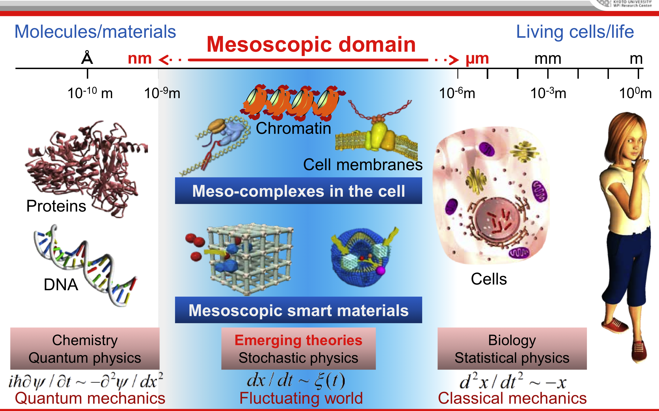
Interaction of cells and materials at mesoscopic domain

Slide 4
Today’s outline
Cs correction for electron microscopy
STEM imaging with Cs correction for organic molecule
Site resolved STEM-EELS with Cs correction for brownmillerite
Cs; Spherical aberration
STEM; Scanning transmission electron microscopy
EELS; Electron energy-loss spectroscopy

Slide 5
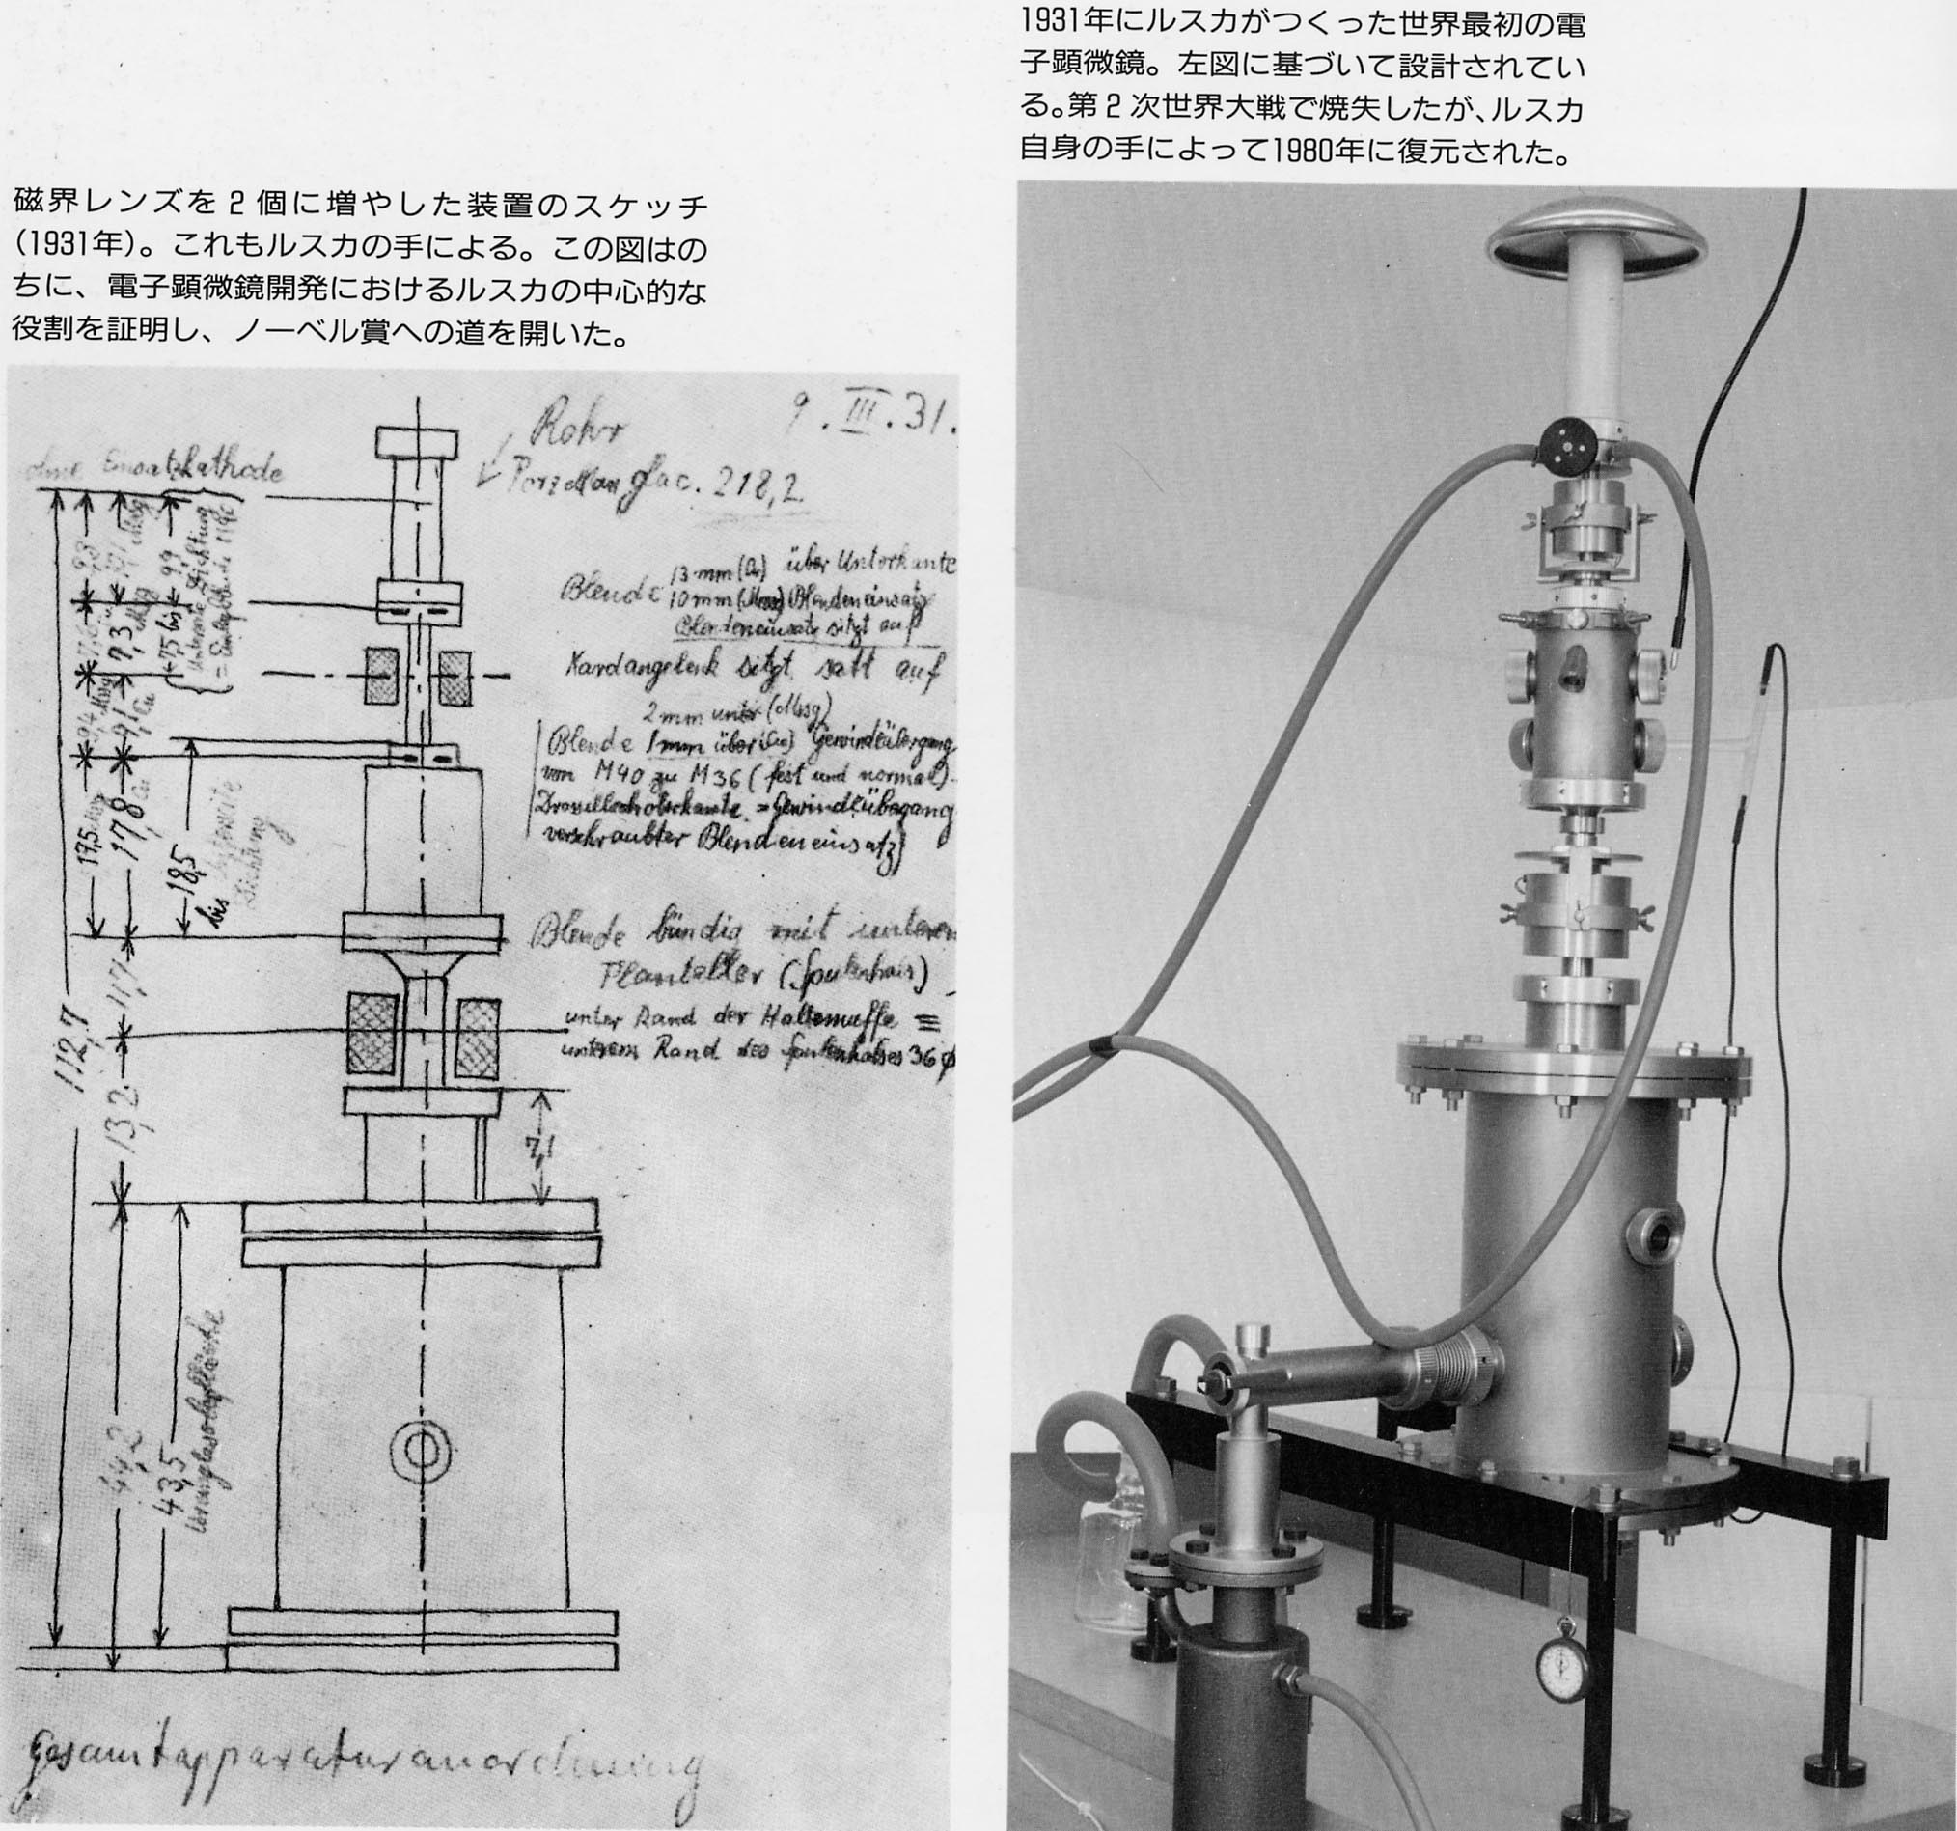
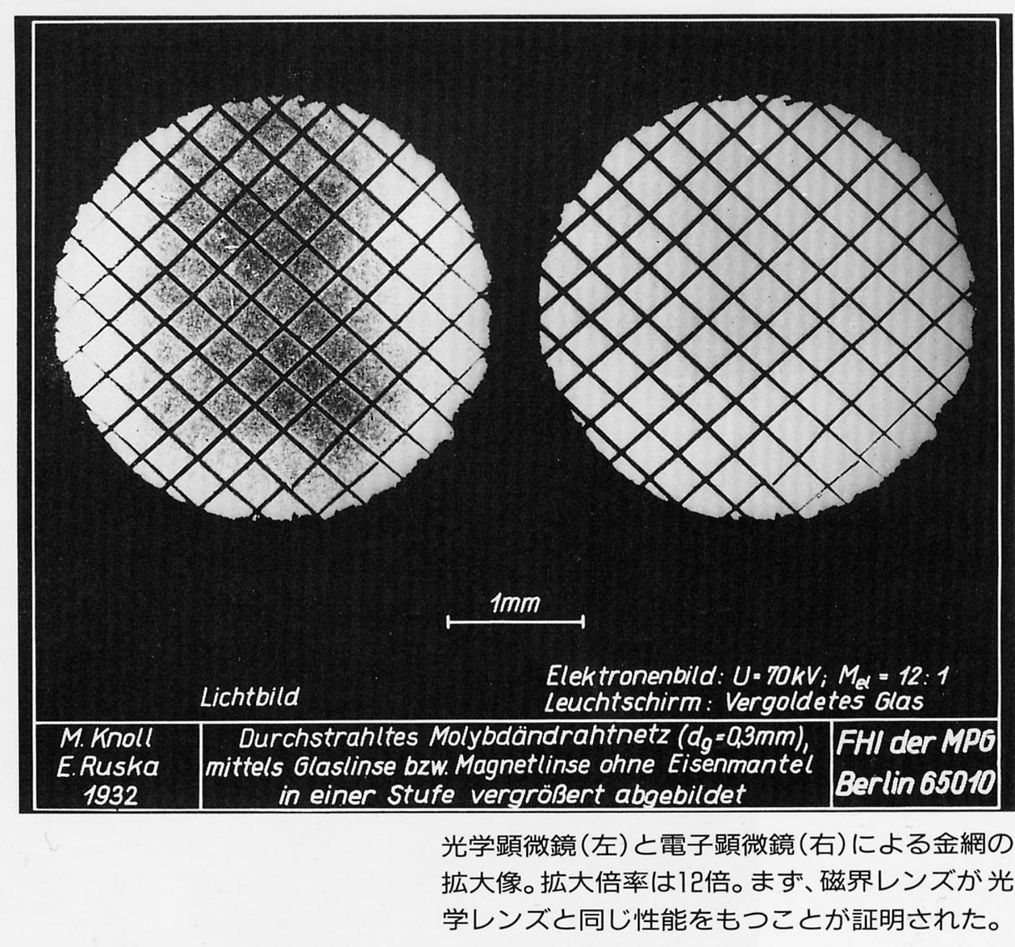
Short historical background of
high resolution imaging
The first TEM by E. Ruska and M. Knoll in 1931
The first TEM
(restored by Ruska in 1980)
TEM design sketch
Optical and electron microscopy images at 12 mag.

Slide 6
Improvement of spatial resolution (point-to-point)
TEM; Optimizing lens
100
(nm)
10
1
TEM; High voltage
TEM & STEM; Cs correction
Resolution
Cs; Spherical
aberration
0.1
TEM
STEM
Resolution has reached at 0.05 nm recently.

Slide 7
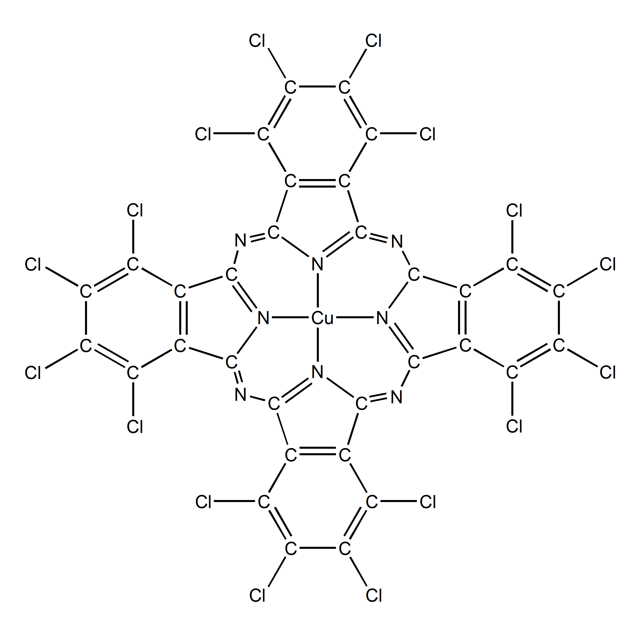
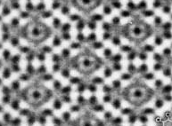
From TEM to STEM
In 1979, high-resolution TEM was successfully applied to take atomic images in Cl₁₆-CuPc by N. Uyeda.
TEM image
Chemica Scripta, 14, 47-61, (1979)
Can ADF-STEM be applied for organic materials?
There have been no application of ADF-STEM to organic materials.
STEM has been believed to be inconvenient for taking images of organic materials, because of its strongly focused beam.

Slide 8
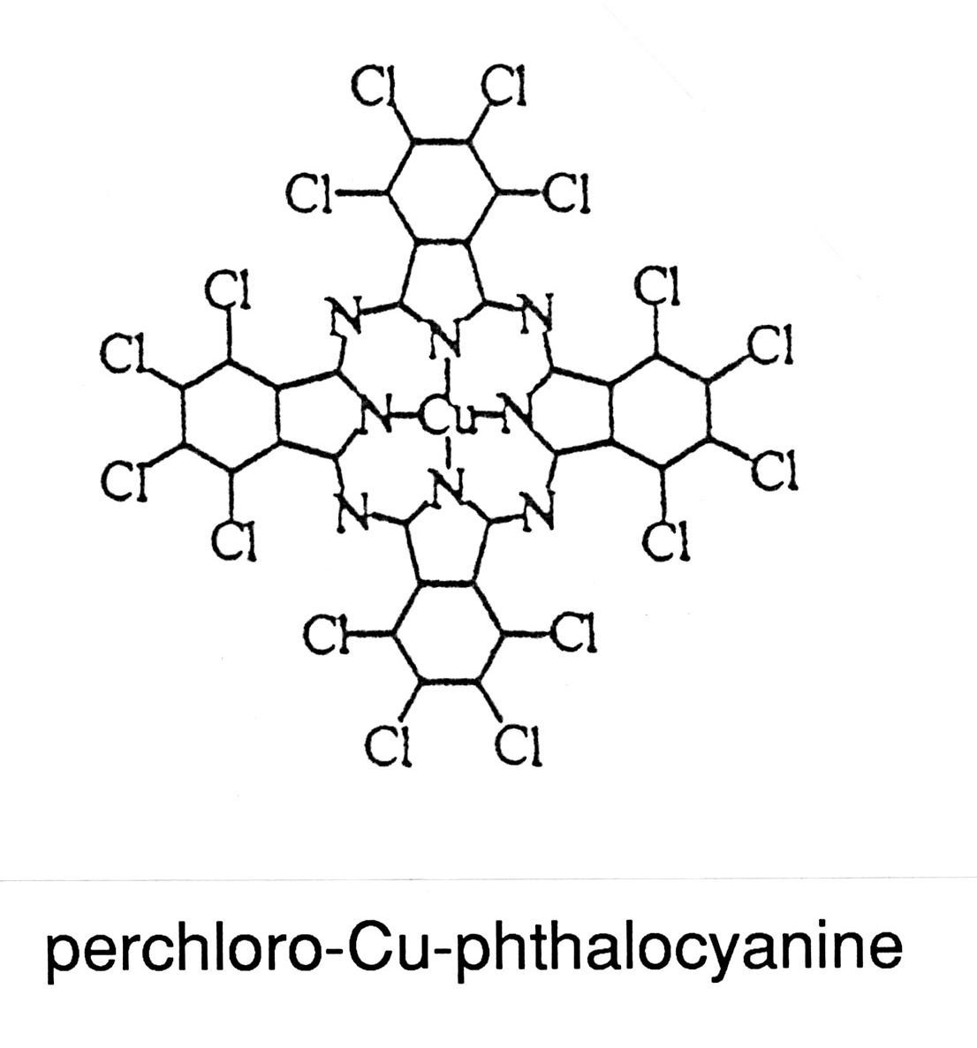
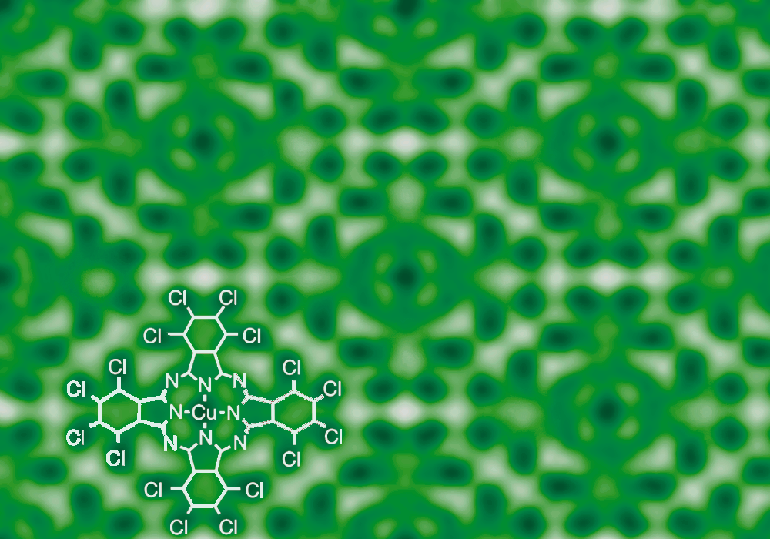
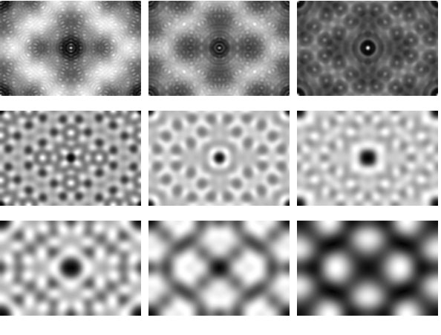
Image variation in HR-TEM
The TEM images are very much variable depending on focus and thickness owing to the interference in TEM, because of the coherent imaging.
not quantitative,
almost no contrast of light elements
too sensitive to experimental conditions.
2.6 nm
-100 nm -80 nm -60 nm
Scherzer focus
-40 nm -20 nm 0 nm
Computer simulated
images for 1000kV
20 nm 40 nm 60 nm
Notes:
This shows an image taken for chlorinated-Cu-phthlocyanine thin crystal.
In the image, you can identify the atoms in the molecule, especially heavy atoms of Cu and Cl.
→
However, the TEM image depends largely on the value of defocus as shown in these image-simulations at different defocus values,
and the most reliable image is produced only at the Scherzer focus due to coherent interference of scattered electron waves.
This special defocus is originated from the spherical aberration.

Slide 9
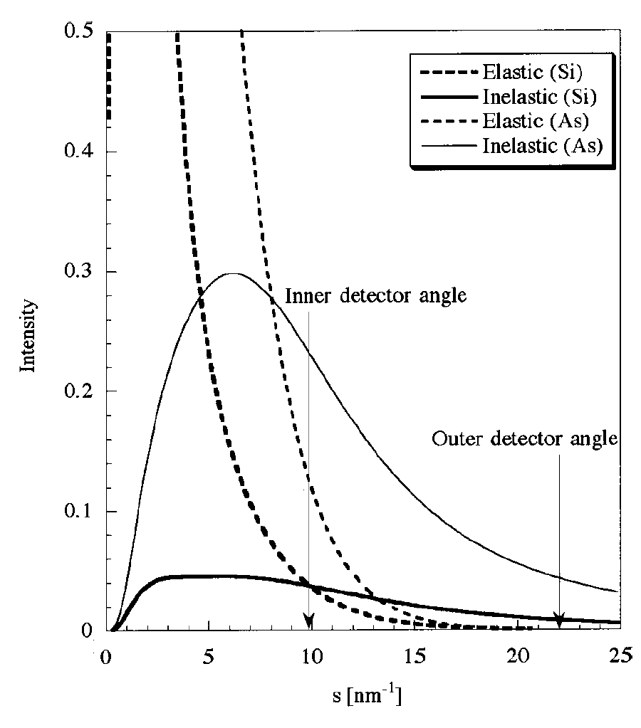
ADF-STEM
(Annular Dark-Field Scanning Transmission EM)
Si
As
Atomic scattering
Atomic scattering
Scanning coils
Objective lens
・High resolution
・Z-contrast (≈Z^{n}), atomic structure
・EELS analysis
However, it is usually more difficult to take images of radiation-sensitive specimens than TEM.
Probe scanning
LAADF HAADF
Specimen
(Atomic arrays)
As
TDS
High angle scattered electrons by TDS at wider than 50 mrad
Si
30
50
(mrad)
100
TDS
Stronger TDS, but some contribution from elastic.
Transmitted wave
Bright-Field (BF) image 【coherent】
Low Angle Annular Dark Field (LAADF) image 【coherent+incoherent】
below 50 mrad
High Angle Annular Dark Field (HAADF) image 【incoherent】
above 50 mrad
to collect only TDS
Diffracted waves
Notes:
As; arsenic , Si; silicon
As you know, HAADF-STEM of ADF-STEM creates images by collecting high-angle scattered electrons, typically above 50 mrad.
In this case, the scattering is originated by TDS, which realizes high resolution imaging with Z-contrast.
This provides us quantitative analysis of atomic structure.
However, it is usually more difficult to take images of radiation-sensitive specimens than TEM.
We notice eventually another imaging of ADF-STEM, that is LAADF-STEM as an alternative method.
As shown in this scattering profiles, above 50 mrad, the scattering happens mainly by TDS.
Since LAADF-condition below 50 mrad gives strongest TDS than HAADF-condition, it would be more suitable for imaging of radiation-sensitive materials.
But, in this case, one needs to be careful in interpretation of images taken because the images contain some contribution from elastically scattered electrons.

Slide 10
Quantitative LAADF images ? → Yes
Experimental image
Intensity profiles
Cl
Cl
Cu
Intensity ratio between Cu and Cl columns is 2.5.
↓
I ∝Z^{1.7} dependence
Simulated image
a’-axis
(c)
(a)
(b)
b-axis
Notes:
Intensity is proportional to Z to the power 1.7

Slide 11
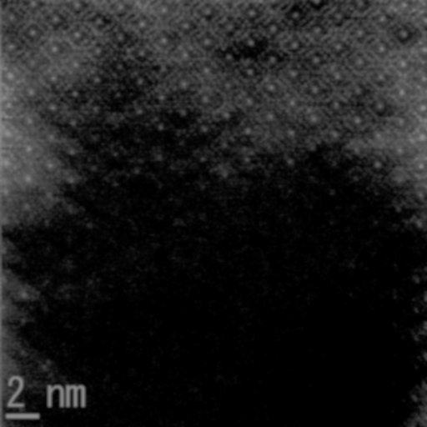
Problems in STEM
Radiation damage, low magnification
LAADF-STEM image (Cl₈Br₈-CuPc)
6 M mag
1st scan
2nd scan
3rd scan
low mag
Particularly strong damage
at the lower image

Slide 12
Radiation damage due to the broadening of the incident beam
STEM probe
Imaging condition (6,000,000 mag)
Probe size : 0.18 nm (FWHM)
Probe current : 5 pA
Dwell time : 60 μsec/pix
Pixel size : 0.05 nm
Dose : ~ 12 C/cm²
0.18 nm
~ 0.35 nm
Probe size on scan area
Probe position
pixel size < probe size
(over sampling)
FWHM
Scan
direction
The lower image part is particularly damaged.
0.35 nm
In order to decrease the damage,
a finer probe is required.
0.05 nm
Pixels irradiated before the probe arriving.

Slide 13
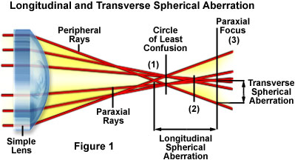
A factor to prevent to form a fine probe;
Spherical aberration
In optical microscopes and commercial photo cameras, the spherical aberration has been compensated by combining the concave and convex lenses.
However, in electron microscopes (convex lens), there were no way to overcome the aberration until recently.
Cs correction → Fine probe → Low damage & high magnification
Notes:
This shows again how does the spherical aberration affect the image formation.
All rays could not come onto a Gaussian image plane, but instead a relatively sharp image is formed at the defocus of Scherzer (least confusion).
The spot size at the least confusion determines the resolution of image.

Slide 14
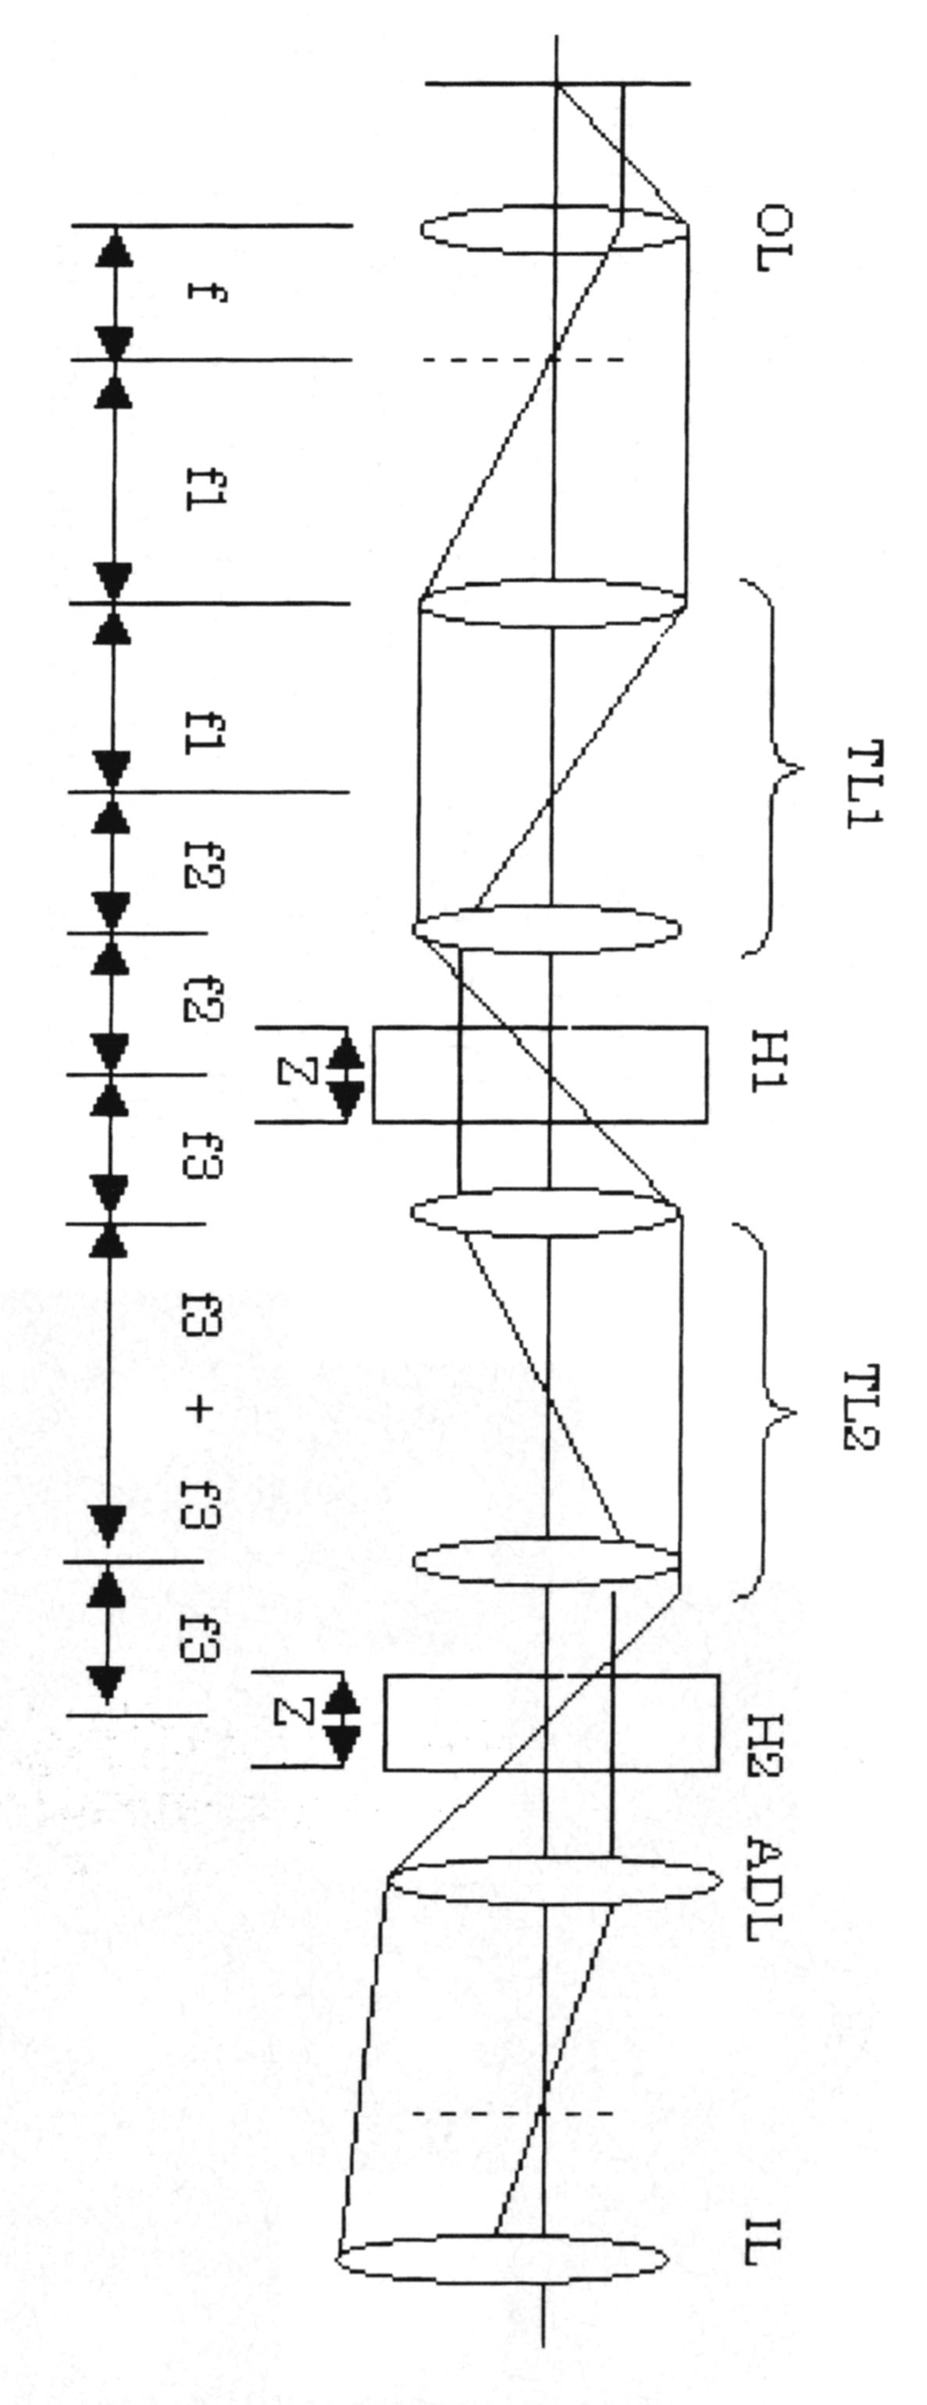
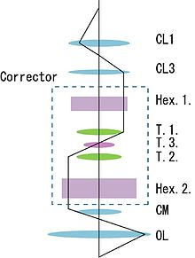
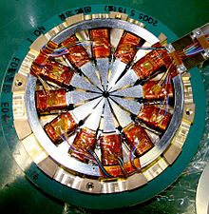
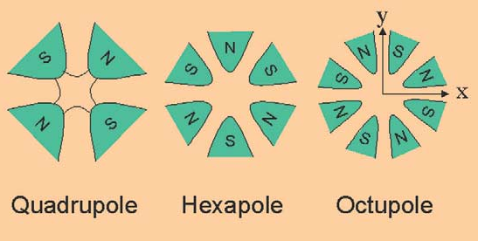
Aberration correction
Maximilian Haider, Stephan Uhlemann, Eugen Schwan,
Harald Rose, Bernd Kabius & Knut Urban;
“Electron microscopy image enhances”.
Nature, 1998;392:768-769. doi:10.1038/33823
Produce negative spherical aberration
Multipole lenses.
＋
Combine with positive aberration
||
Give a total of zero spherical aberration
http://www.superstem.org/cs-correction

Slide 15
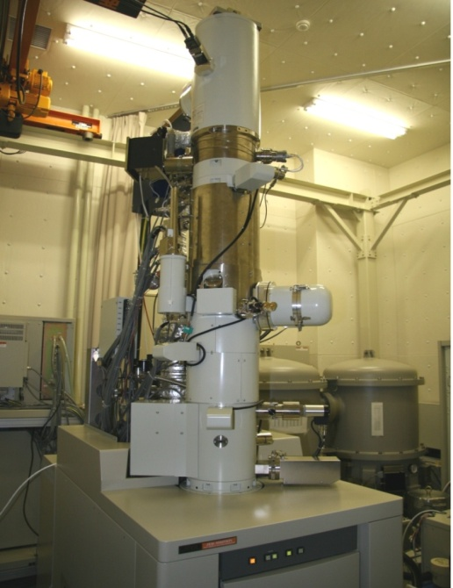
Cs-corrected STEM in Kyoto Univ
JEM 9980TKP1
Incident energy : 200 keV
Convergent semi-angle : 23 mrad
Spherical aberration : −0.025 mm
Fifth order spherical aberration : 15 mm
Probe size : 0.07 nm (FWHM)
ADF Detection angle : 39-104 mrad
ABF Detection angle : 11-23 mrad
EELS detection angle : 10 mrad
Probe current : ＜1 pA
Dose : ＜ 2.4 C/cm²
Cs-Corrector

Slide 16
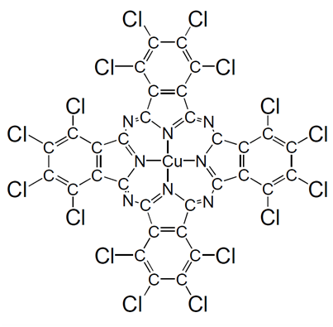
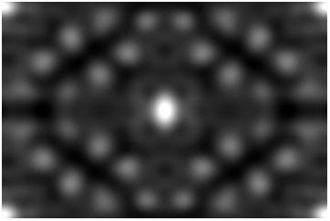
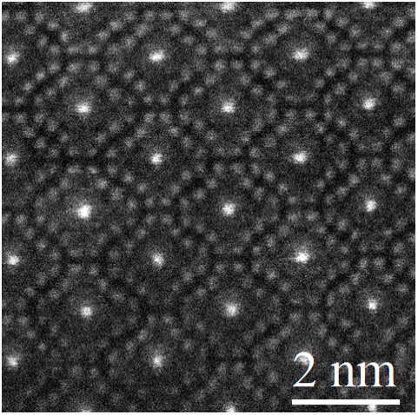
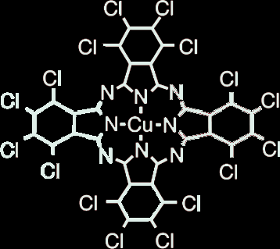
Cs-corrected LAADF-STEM image
filtered images
White contrasts are atoms
Spatial resolution ~ 0.18 nm
Less damaged, higher magnification →
Detectable images of N and C, but weak.
Observation at 25 M mag.
(scan step = 0.01 nm）

Slide 17
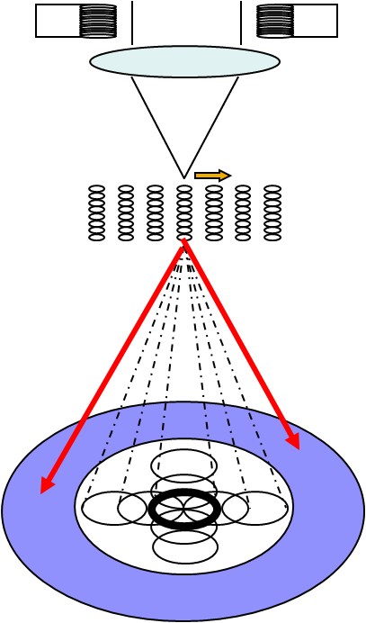
Cs-corrected STEM + ABF-STEM
(Annular Bright-Field
Scanning Transmission Electron Microscopy)
α = 23 mrad
More mixture of coherent and incoherent imagings.
beam scan
specimen
LAADF
（detection angle≧20 mrad）
Direct Beam
ABF
（detection angle =12 - 23mrad）
Notes:
17

Slide 18
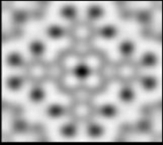
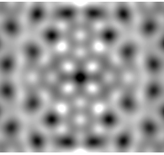
Profiles in TEM and STEM
TEM
STEM
Slightly better in contrasts

Slide 19
Short summary on imaging
Possible to observe light elements in organic crystals by using Cs-corrected STEM, particularly combined with ABF-STEM,
due to increase S/N ratio, decrease radiation damages.
Unfortunately, this can be applied only for a few molecules with tough structure for strong electron bombardment.
→ Application of Cs-correction for site-resolved EELS analysis.

Slide 20
O K-edge ELNES of
FeO₆ octahedron and FeO₄ tetrahedron
in the brownmillerite
by using site-resolved STEM-EELS
with Cs corrector
Cs corrected STEM-EELS method
FeO₆ octahedra and FeO₄ tetrahedra
in the Sr₂Fe₂O₅ and Ca₂Fe₂O₅
→ detection of local chemical bonding
relating to periodic oxygen deficiency
3. Summary
JAP, 110, 033708 (2011)

Slide 21
Principle of STEM-EELS method
(Scanning transmission electron microscopy
with electron energy-loss spectroscopy)
Gun
EDXS
(X-ray analysis)
HAADF of Si <110>
Aperture
Illumination lens
Scan coil
Scan
0.135 nm
Specimen
High angle scattered electrons
High-Angle Annular Dark- Field (HAADF) Image
（Structural analysis）
Annular detector
Elastically & inelastically scattered electrons
Energy Analyzer
Electron Energy-Loss Spectroscopy
（Elemental and state analyses）
Notes:
This figure shows the principle of STEM-EELS method.
In STEM, the finely focused electron probe is scanned on a sample surface and the electrons scattered to the high angular region are detected by an annular detector. This signal is acquired from each scanning point to form an image, which is called high-angle annular dark-field imaging.
From this image, we can do the structural analysis of local area.
On the other hand, the energy of electrons scattered in small angular region are measured to obtain the EELS, which is used for elemental and state analyses.
HAADF and EELS signals can be acquired simultaneously, because of the different detection angle.
If the spectra are measured from each scanning point, we can construct elemental maps.
21

Slide 22
EELS (Electron Energy-Loss Spectroscopy)
① zero loss
③ core-excitation
Core-loss spectrum
Inelastic scattering
② valence-electron excitation
Value of energy-loss and its intensity
Chemical composition analysis
Energy-Loss Near Edge Structure
(ELNES)
Partial Density of State (PDOS) of unoccupied band → chemical properties
Extended Electron Loss Fine Structure
(EXELFS)
incident electron
→ excitations
Radial distribution function
Notes:
And then,
This is a schematic diagram of EELS.
By using Core-loss spectrum, we can analyze these things
Especially, ELNES is related to the transition from atomic core state to the unoccupied state lying above the Fermi level,
which reflect the nature of chemical bonds around the excitation atom.
22

Slide 23
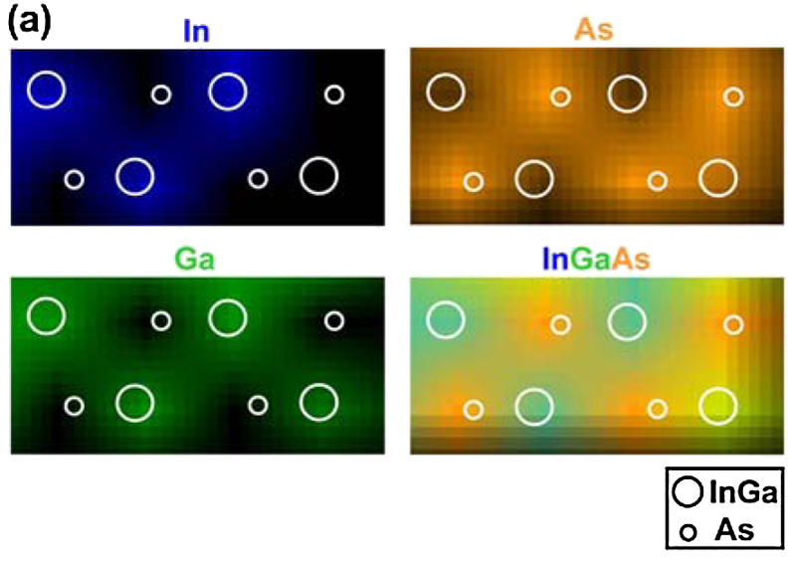
Elemental mapping
EELS Elemental mapping of Sr₂Fe₂O₅ / SrTiO₃
→ Electronic state mapping
interface
SrTiO₃
Sr₂Fe₂O₅
Red : Fe
Green : Ti
Blue : Sr
“STEM-EDX chemical mapping of In, As and Ga”.
Ming-Wen Chu, Cheng-Hsuan Chen; PRL 104, 196101 (2010)

Slide 24
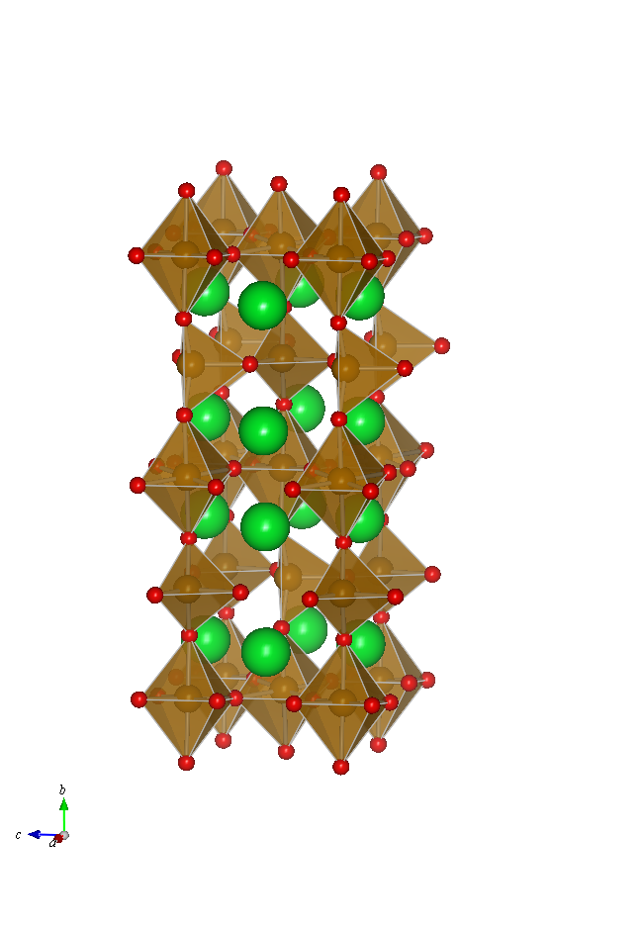
Ca(Sr)_{２}Fe₂O₅ (Ca(Sr)FeO_{2.5})
Antiferromagnet : type G
T_{N} = 720 K, 700 K for Ca, Sr
b
CaFeO_{2.5}
a
Brownmillerite oxide
Orthorhombic
Space group : Pcmn
layer structure
3 kinds of oxygen atom
a = 0.5946 nm
b = 1.48273 nm
c = 0.54307nm
FeO₆ octahedron
FeO₄ tetrahedron
O1
SrFeO_{2.5}
O2
Brownmillerite oxide
Orthorhombic
Space group : Icmm
O3
including a randomly-oriented tetrahedral chains
→ calculation for Ibm2
a = 0.566850 nm
b = 1.55823 nm
c = 0.52653 nm
Acta Cryst. B 31, 641 (1975)
Notes:
In the present research,
Our aim is to investigate the local electric structure using site resolved EELS spectrum for brownmillerite structure of Sr₂Fe₂O₅ .
Crystal structure for bulk crystal are indicating here.
In this crystal, the FeO₆ octahedra and FeO₄ tetrahedra are arranged in layers.
Therefore , there are 3 kind of oxygen atom in the unit cell.
And this is antiferromagnetic material type G.
Sr₂Fe₂O₅ thin film can be grown on SrTiO₃ substrate using pulsed Laser Deposition.
24

Slide 25
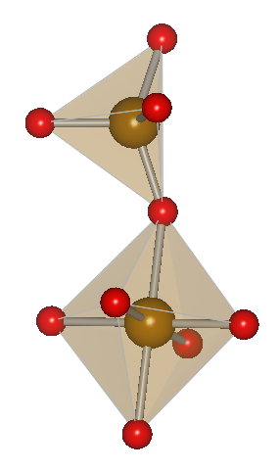
Aim
Distortion of FeO₆ octahedra, even though non Jahn-Teller ion of Fe³⁺ ?
Effect of substitution Ca by Sr ?
1.82Å
2.04Å
2.217Å
1.94Å
Understand the origin of the distortion by using site-resolved ELNES, mainly examined by O K-edge.
CaFeO_{2.5}
Simulation WIEN2k + TELNET.2;
Full-potential linear augmented pale wave plus local orbital (LAPW+LO) method.
Spin-polarized generalized-gradient approx. for exchange-correlation potential.
Core-hole is included.

Slide 26
Sample preparation
SrFeO_{2.5}
CaFeO_{2.5}
PLD (Pulsed Laser Deposition)
Solid state stoichiometric reaction of CaCO₃ and Fe₂O₃
Substrate | SrTiO₃ (001)
Substrate temperature | 800℃
Oxygen pressure | 1.0E-5 Torr
Laser fluence | 101 mJ
Laser repetition rate | 10 Hz
Film thickness | 120 nm

Slide 27
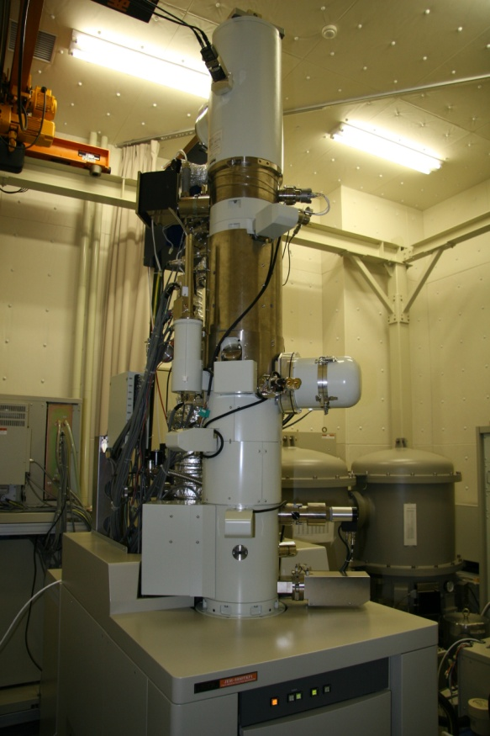
C_{s} corrected STEM equipped with a nanotip FEG
Nanotip cold-FEG (field-emission gun)
・Acceleration voltage：200 kV
・Emitter：W<111>
・Build-up of emitter：Thermal-field treatment
・Pressure： < 5 x 10⁻⁹ Pa
C_{s} corrector
・Convergent semi-angle：23 mrad
・Probe size：0.07 nm
Omega filter
・Energy resolution：0.4～0.5 eV
・Collection angle：10 mrad → dipole transition
HAADF-STEM
Detection angle : 70 - 170 mrad
CCD camera
Nanotip-FEG
Cs corrector
Double tank
Ω-filter
ABF-STEM ;
JEM-ARM200F (200 kV, detection angle= about 11.5 – 23 mrad)
Notes:
The experiment was performed using this microscope.
The spherical aberration corrector is incorporated, which forms the fine electron probe less than 0.1 nm in diameter.
EELS spectrum is measured by an omega type of filter.
The energy resolution is 0.4 to 0.5 eV owing to the cold field emission gun.
27

Slide 28
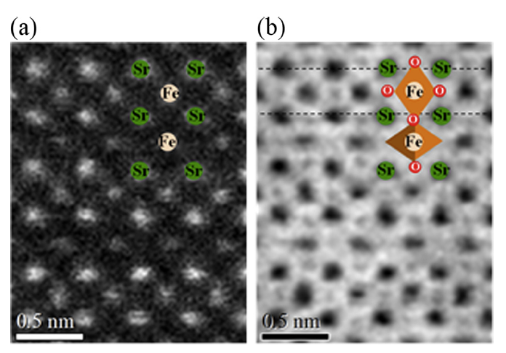
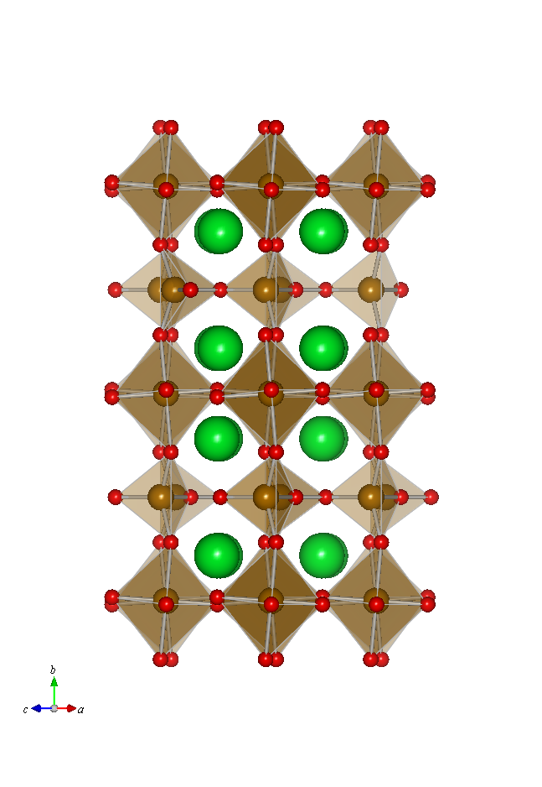
ABF-STEM image of SrFeO_{2.5} [101] projection
Probe electron
Shift of O
stronger
b
HAADF-STEM
ABF-STEM
HAADF-STEM
ABF-STEM
octa
hedral
tetra
hedral
weaker due to de-channeling
0.5 nm
0.5 nm

Slide 29
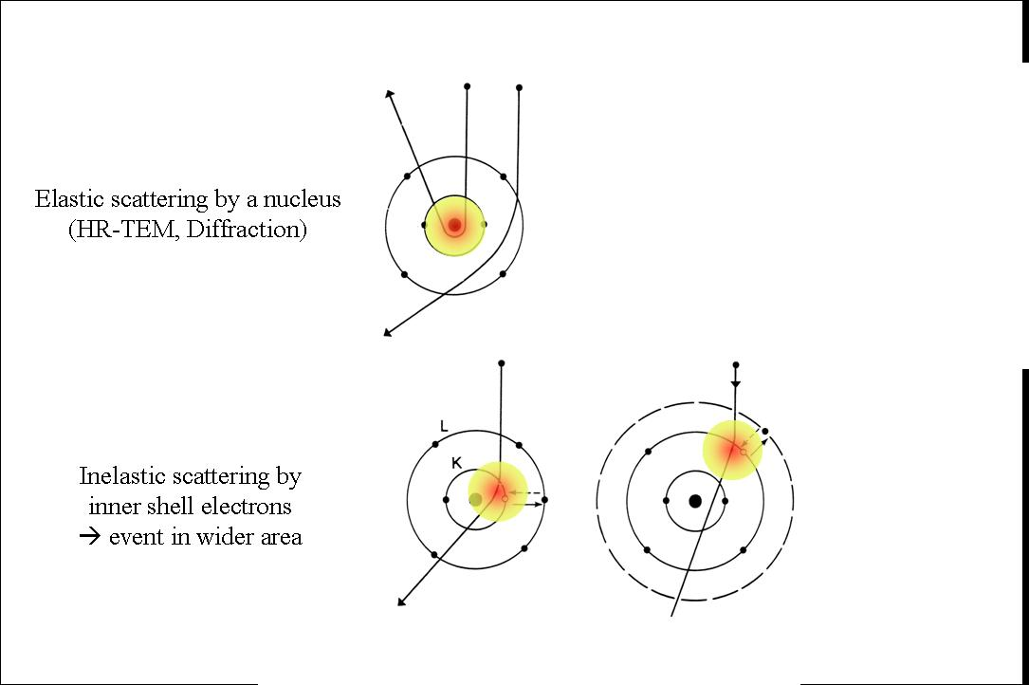
Delocalization of EELS events
elastic scattering
Coulomb interaction with nucleus → point-like
inelastic scattering (core-loss)
delocalization
Limit of spatial resolution.
Cs correction, so as not to make worse more.

Slide 30
0.5 nm
Delocalization
To keep the probe minimum by Cs correction.

Slide 31
Delocalization and Scanning
Characteristic angle
ΔE
530 or 710
θ_{E} =
=
［101]-projection model
2・E₀
2・200・10³
= 1.325 mrad for O, 1.775 mrad for Fe
λ
d_{E} =
= 0.18 nm for O, 0.14 nm for Fe
2θ_{E}^{3/4}
0.14 nm
HAADF-STEM image ［101］
Beam was scanned on Fe sites, so as to avoid damage.
ELNES of O K-edge
0.18 nm
O1
O2
O3
Sr
Sr
Sr
Fe
5 nm
Sr
Fe
Sr
Sr
Notes:
In order to realize the site-resolved EELS spectrum,
delocalization for inelastic scattering electron is important.
Delocalization means that spatial distribution for EELS signal.
And the delocalization can be defined as this equation.
Looking at the distribution of delocalization for oygen atom along the [101] projection.
It is theoretically expected that the site-resolved EELS is possible when the electron probe put on the Fe site.
This is a typical HAADF-STEM image of Sr₂Fe₂O₅.
we can easily distinguish the octahedra site and tetrahedra site from the image contrast.
Experimentally EELS spectra were acquired by scanning the electron probe on the each equivalent Fe site.
４分～15秒
31

Slide 32
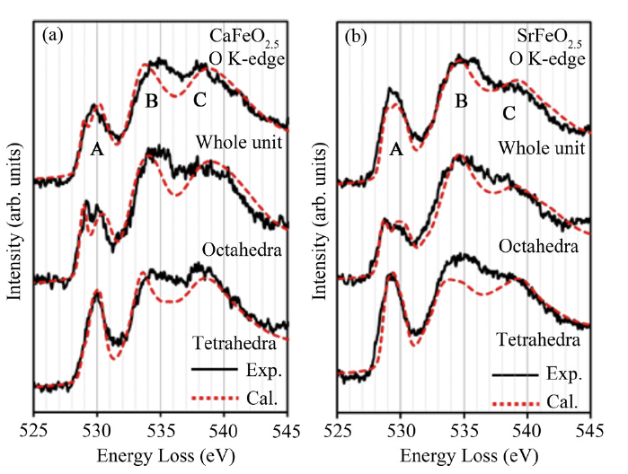
O K ELNES of CaFeO_{2.5} and SrFeO_{2.5}
Basically both spectra are very similar.
Pre-peak-A; from O 1s to unoccupied O 2p hybridized with Fe 3d near Fermi level.
significantly different for tetra (non-split) and octa (split)
← splitting of Fe 3d band by crystal field.
Peak-B and Peak-C; to unoccupied O 2p with Ca(Sr) 3d(4d) and Fe 4s/4p, respectively.
In simulation, all relevant oxygens in delocalization are included.
Experimental (blue solid line) and calculated (red dotted line) O K-edge ELNES of (a) CaFeO_{2.5} and (b) SrFeO_{2.5} measured over the whole unit cell, and at the individual FeO₆ octahedral and FeO₄ tetrahedral sites.

Slide 33
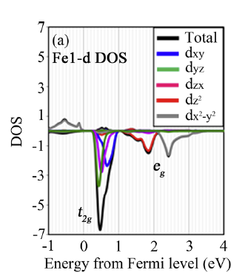
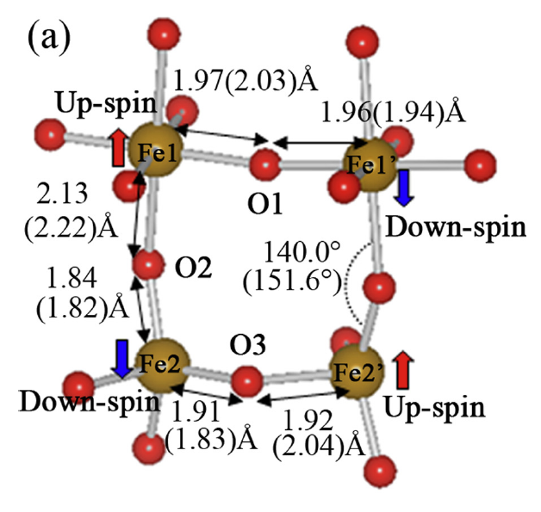
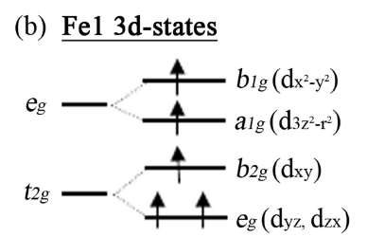
Spin-polarized Fe1-3d DOS
Ground state calculation
Simulation for CaFeO_{2.5}
without orientation disorder.
If 5 electrons in Fe1 is up-spin at occupied band, strong down-spin at unoccupied one.
ELNES splitting ;
distortion in FeO₆ octahedron from cubic by periodical ordered oxygen vacancy as observed in ABF-STEM.
3 peaks
dz²
dx²-y²
Schematic crystal-field splitting
dxy, dyz and dzx

Slide 34
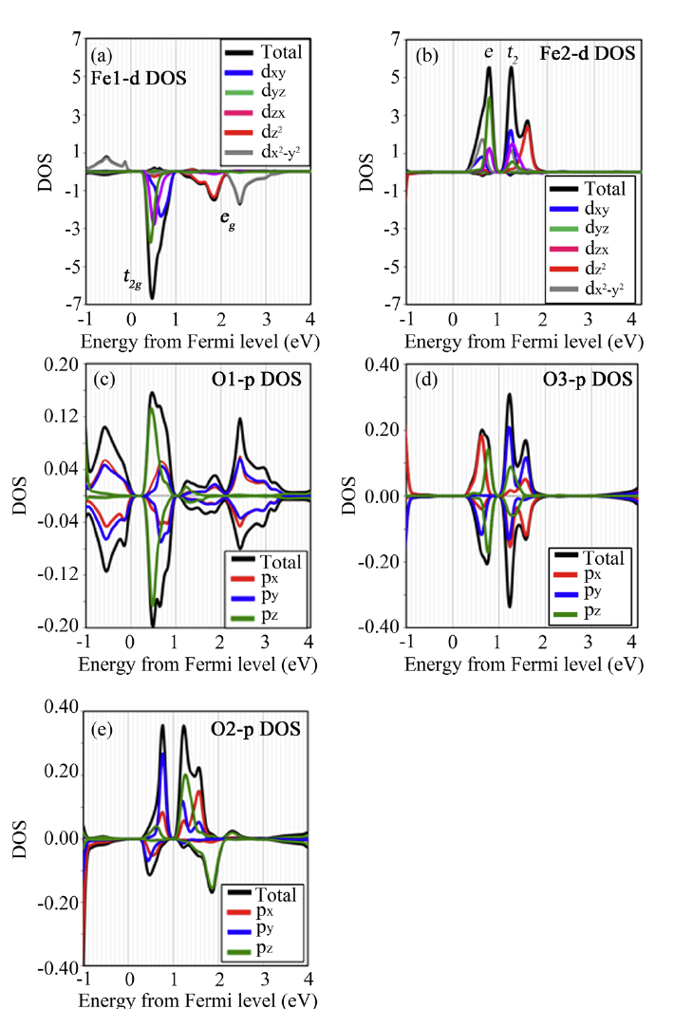
Whole spin-polarized Fe 3d- and O 2p-DOS
antiferromagnetic of Type-G
Super-exchange interaction (e.g. Fe1 and Fe2 through O2)
Asymmetry for up- and down-spin bands of O2.
Spin-polarized partial DOS of CaFeO_{2.5} at the ground state.
Unoccupied Fe 3d-DOS at (a) the Fe1 octahedral site, and (b) the Fe2 tetrahedral site.
Unoccupied O 2p-DOS at (c) the O1 site, (d) the O3 site, and (e) the O2 site.

Slide 35
Core-hole effect in simulation
O K-edge
real final state
Ground
state
Transition
state
Excited
state
A-atom
E_{F}
DOS of electron
B-atom
E_{F}
O-1s
Simulation WIEN2k + TELNET.2 ;
Full-potential linear augmented pale wave plus local orbital (LAPW+LO) method.
Spin-polarized generalized-gradient approx. for exchange-correlation potential.
Core-hole is included. for a primitive cell
1s
1s
1s
no hole
0.5 hole
1 hole
Notes:
There are some experimental investigations of local electronic structures at internal interfaces and defects such as dislocations. It is, however, hard to analyze directly the local electronic state from an experiment, so we need to simulate ELNES from a model to say something about p-DOS of specimens.
So far, unfortunately, we had no appropriate simulation tools to understand fine structures correctly, because so-called core-hole effect should be taken into account in the calculations. The core-hole effect is an effect changing electronic states due to hole-formation in deep energy level after excitation. The core-hole effect requires us to perform calculation in a larger unit cell so as to avoid artificial interaction between excited atoms.
Recently, owing to the development of calculation techniques, the ELNES can be simulated by first principles band calculations, which providing a better understanding of the local electronic structures. There are several methods to incorporate the core-hole effect in the calculation. From our experience, the best agreement with the experimental spectrum was achieved with the excited state calculation. That is fully excited approximation as shown here schematically.
( This figure shows the three types of calculation including a core-hole effect together with ground state calculation disregarding the core-hole effect,
that is, the excited state calculation with a 1s core-hole, Z+1 approximation with an introduction of Al instead of Mg (not shown in the slide), and the transition state calculation with a half of core-hole. )

Slide 36
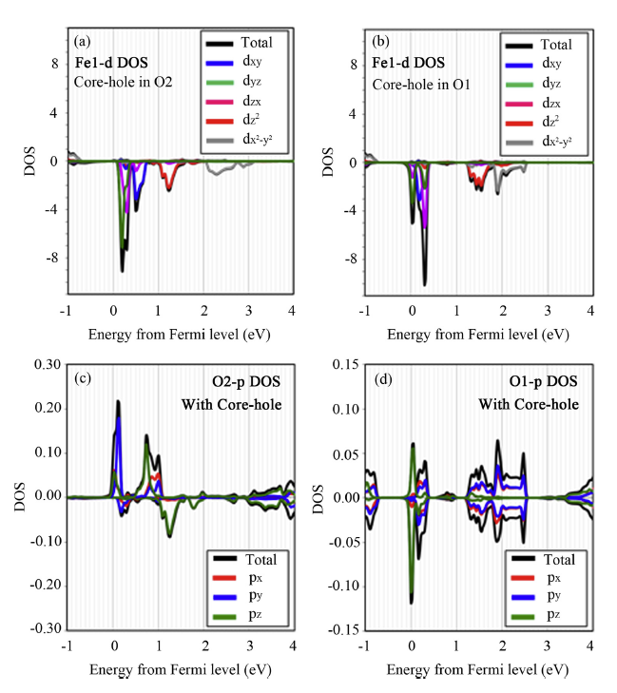
Unoccupied 3d-DOS with core-hole
for down-spin at octahedral Fe1
Core-hole on O2
Core-hole on O1
Large shift toward E_{F};
dz², dyz, dzx
Smaller shift;
dx²-y², dxy
Fe2 3d DOS depends on location site of core-hole.
These changes come from different screening of core-hole potential at each O site

Slide 37
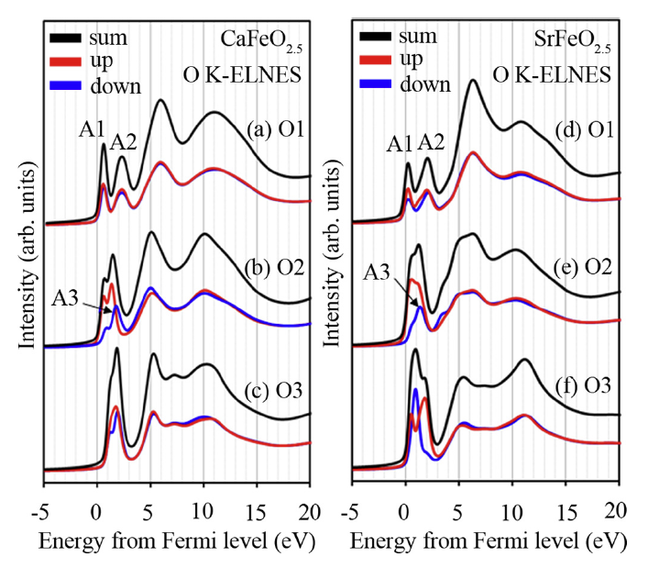
Individual spin-polarized O K-edge ELNES
Simulation WIEN2k + TELNET.2
assuming Ibm2 symmetry for SrFeO_{2.5}
without orientation disorder.
As a result, the peaks A1, A2, and A3 (blue line) in the pre-peak region.
→ The transitions to the O 2p band hybridized mainly with the Fe1eg/b2g, b1g and a1g states, respectively.

Slide 38
O K-edge ELNES simulation
from PDOS with core-hole
Here the oxygen atom (O2) linking FeO₆ and FeO₄ contributes to both site-resolved spectra.
The simulation can explains well the specific features of ELNES.
O1&O2
O3
The pre-peak splitting of the experimental spectra at the octahedral site
The local electronic structure of the Fe-3d band around the distorted FeO₆ through hybridization between the O 2p and Fe 3d bands.
In contrast, the crystal field splitting at the FeO₄ site is smaller.
O2
O2&O3
O1

Slide 39
What is happening in CaFeO_{2.5}
Pre-peaks → not purely ionic, but some covalent.
The integrated intensity of the pre-peak of O2;
up-spin spectrum > down-spin spectrum, → Asymmetric interaction
The number of holes in the O2 2p band hybridizing with the 3d band of;
tetrahedral Fe2 site > octahedral Fe1 site
indicating that charge transfer;
from O2 to Fe2 > from O2 to Fe1 → asymmetrical charge transfer
→ covalent nature of Fe2-O2
→ shorter bond length (distortion) of Fe2-O2
→ distortion in FeO₆ octahedron

Slide 40
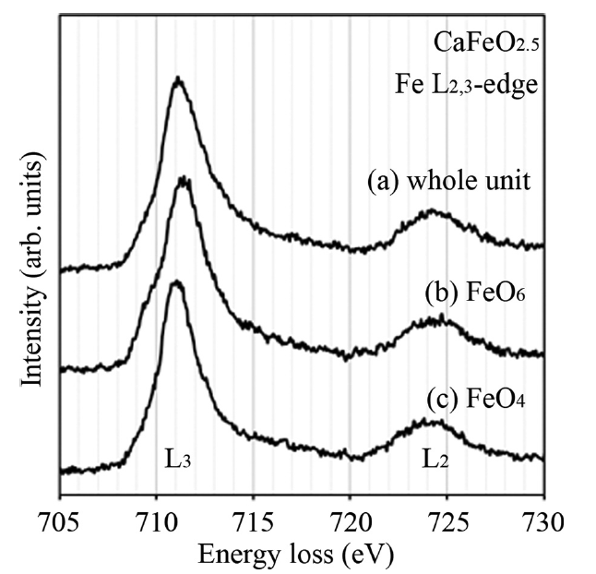
Experimental Fe L2,3-edge ELNES of CaFeO2.5
The Fe1 octahedral site is similar to a typical Fe³⁺ spectrum from hematite, which shows a shoulder peak at the low energy side of the L3 peak.
The transition energy from the Fe 2p level to the Fe 3d band is lowered at the Fe2 tetrahedral site by the increase in Coulomb repulsion between the 2p electrons and valence electrons due to charge transfer from O2.
Different amounts of valence charge are localized at Fe1 and Fe2 ions, as shown by calculation.
0.5 eV
Fe1
Fe2
(a) the whole unit cell, and at the (b) FeO6 octahedral. and (c) FeO4 tetrahedral sites.

Slide 41
Story for SrFeO_{2.5}
CaFeO_{2.5}
SrFeO_{2.5}
small in O1
larger in O3
By substitution from Ca to Sr,
larger charge transfer from O3 to Fe2.
Tetragonal site has stronger covalent than that in CaFeO_{2.5}
and then shorter length of Fe2-O3.
Result into big difference in bonding of Fe2-O3 and Fe2’-O3.
Total intensity is nearly the same for Fe1 and Fe2.
Different for Fe1 and Fe2.

Slide 42
Summary
The site-resolved ELNES was applied to FeO₆ octhahedra and FeO₄ tetrahedra in Sr(Ca)FeO_{2.5} crystal.
The splitting observed in the pre-peak of the O K-edge, indicating transition to an unoccupied O-2p band hybridized with the Fe-3d band, demonstrated the strong crystal field of the octahedral site as compared to the tetrahedral site.
The charge transfer from O2 to the tetrahedral Fe2 atom is larger than that to the octahedral Fe1 atom in Ca(Sr)FeO_{2.5}.
The bonding character between O2 and the tetrahedral Fe2 atoms is more covalent than that between the O2 and Fe1 atoms, which leads to the observed difference in bond length between O2-Fe2 and O2-Fe1.
Asymmetrical charge transfer at the O3 atom linking the tetrahedral Fe atoms in SrFeO2.5. The difference in bond length between O and the tetrahedral Fe atoms in the ac plane was caused by an asymmetrical charge transfer.
Notes:
以上まとめますと、
42

Slide 43
Acknowledgements
Mr. Kawasaki, Dr. Otsuka and Ms. Nishimura of TRC for preparing the cross-section samples.
Dr. Okunishi for observing the ABF images with 200 kV microscope (JEM-ARM200F) in JEOL company.
This work was partly supported by Grants-in-Aid for Scientific Research Grants Nos. 19GS0207 and 19310071 and for JSPS Fellows No. 20–145 from MEXT (Ministry of Education, Culture, Sports, Science and Technology, Japan).
Notes:
43

Slide 44

Than you for your kind attention
Dr. M. Haruta
Prof. H. Kurata
Finally, really have to say that I would like to express the appreciation from the people of Japan for your enormous supports on the occasion of terrible earthquake in eastern Japan in this March.

Slide 46
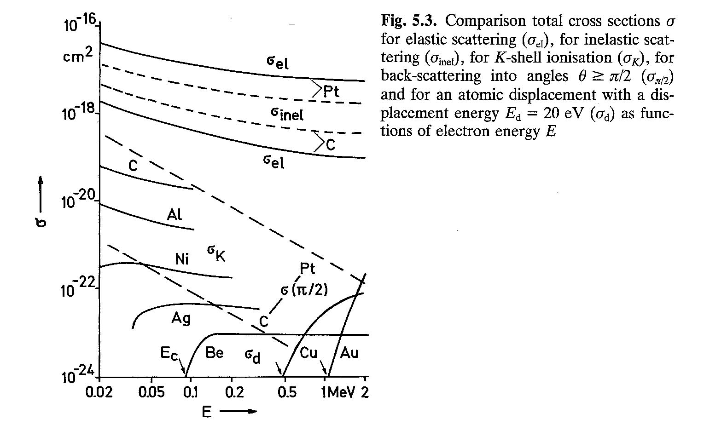
Radiation damages of organic and inrganic materialsa
（difference in oraganic or carbon materials）
Change in electronic states
(Ionization)
Elastic cross-section ；σ_{el}
Inelastic ；σ_{inel}
Backscattering ；σ_{π/2}
Ionization ；σ_{k}
Knock-on ；σ_{d}
Displacement of atoms
(Knock-on)
100 keV
L. Reimer; “Transmission Electron Microscopy”, Springer-Verlag

Slide 47
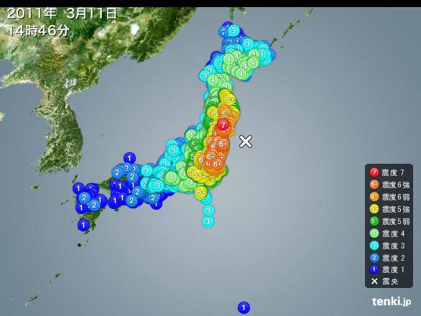

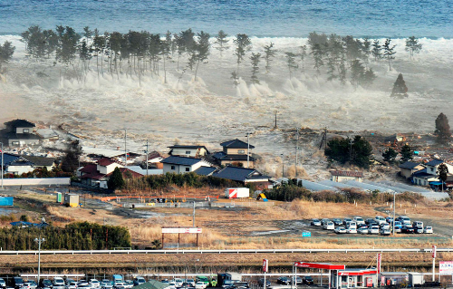

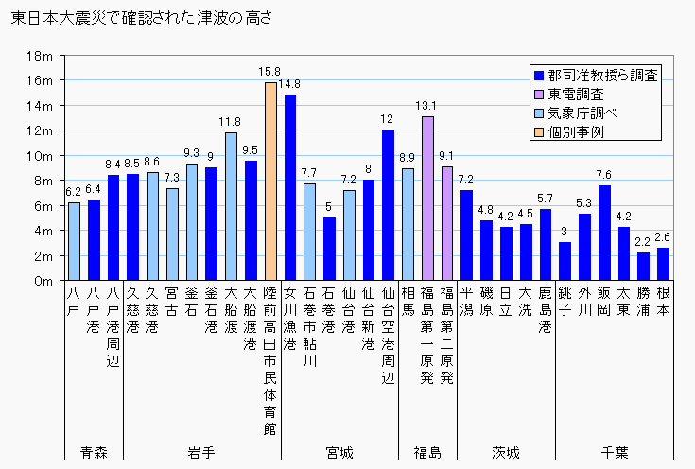
3.11 Huge earthquake in eastern Japan
quake distribution (震度分布)
flooded near Sendai–city,
about 5 km from seashore
仙台市
Mw=9.0
相馬市
max quake > 7

Slide 48




Helping hand from Taiwan
Our future issue
Nuclear Power Station in Fukushima
在福島核電站
感謝來自台灣的援助
義援金; 150億円以上
Notes:
First of all, really have to say that I would like to express the appreciation from the people of Japan for your enormous supports on the occasion of big earthquake in eastern Japan in this March.

Slide 49
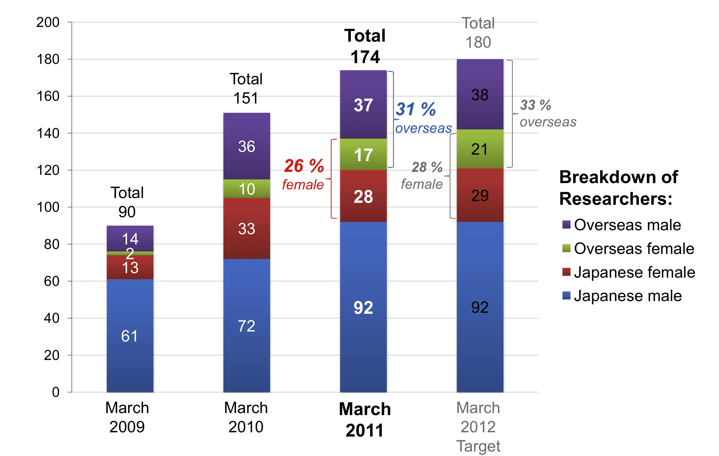
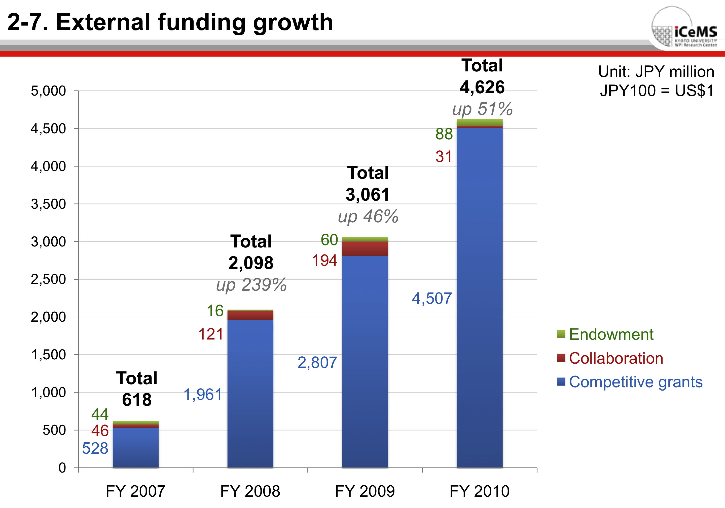
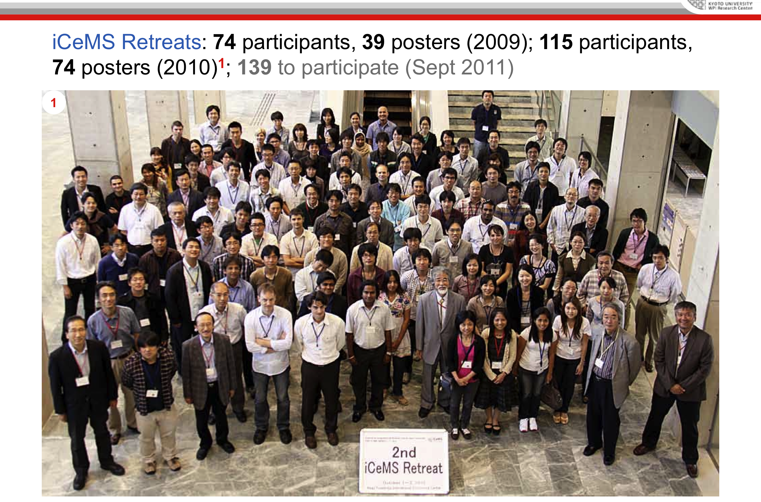
Members of iCeMS

Slide 50
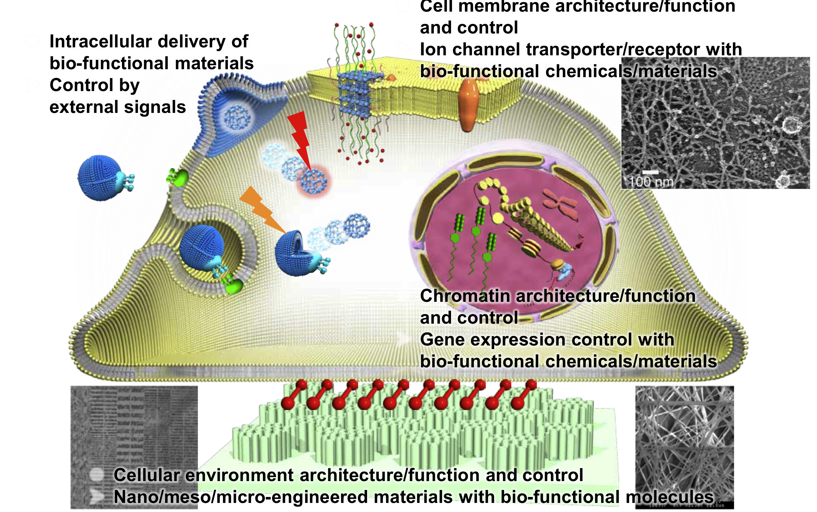
Graphical examples

Slide 51
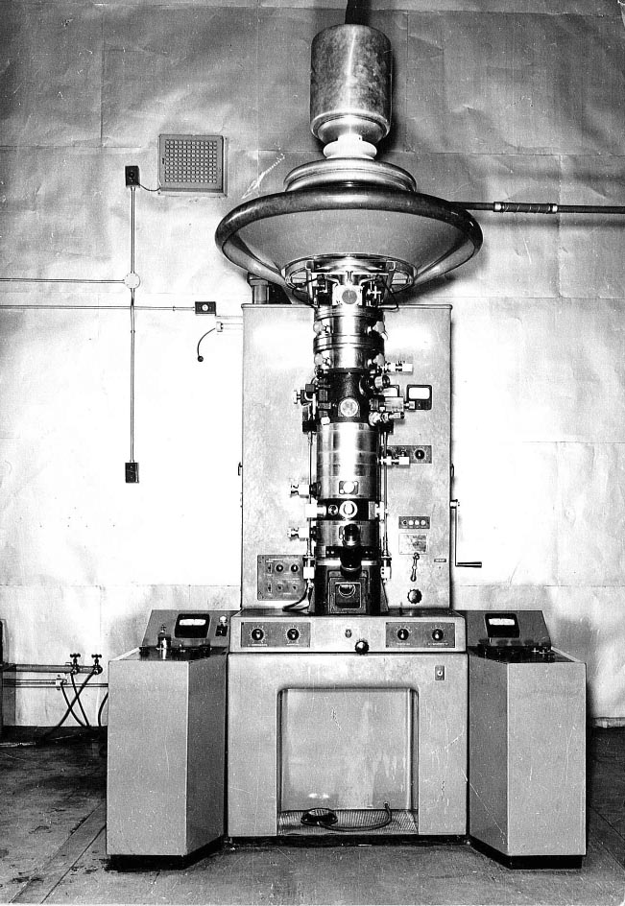
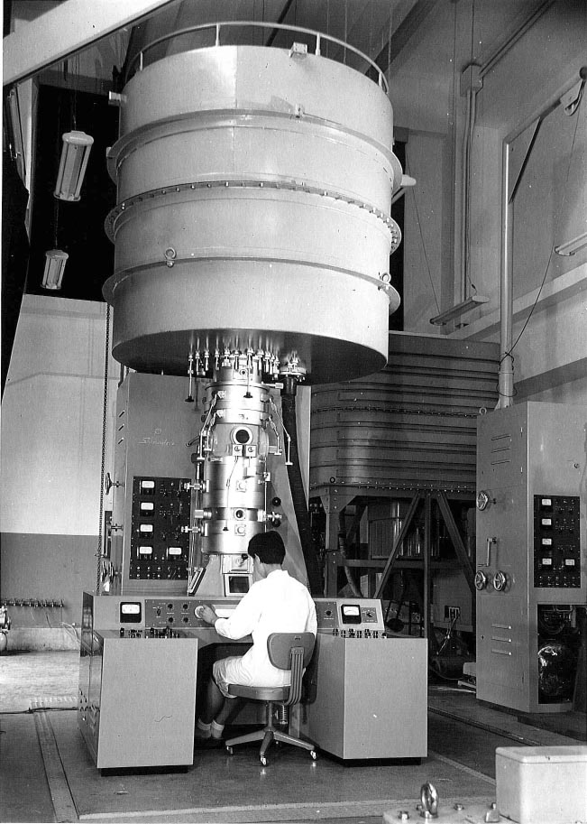
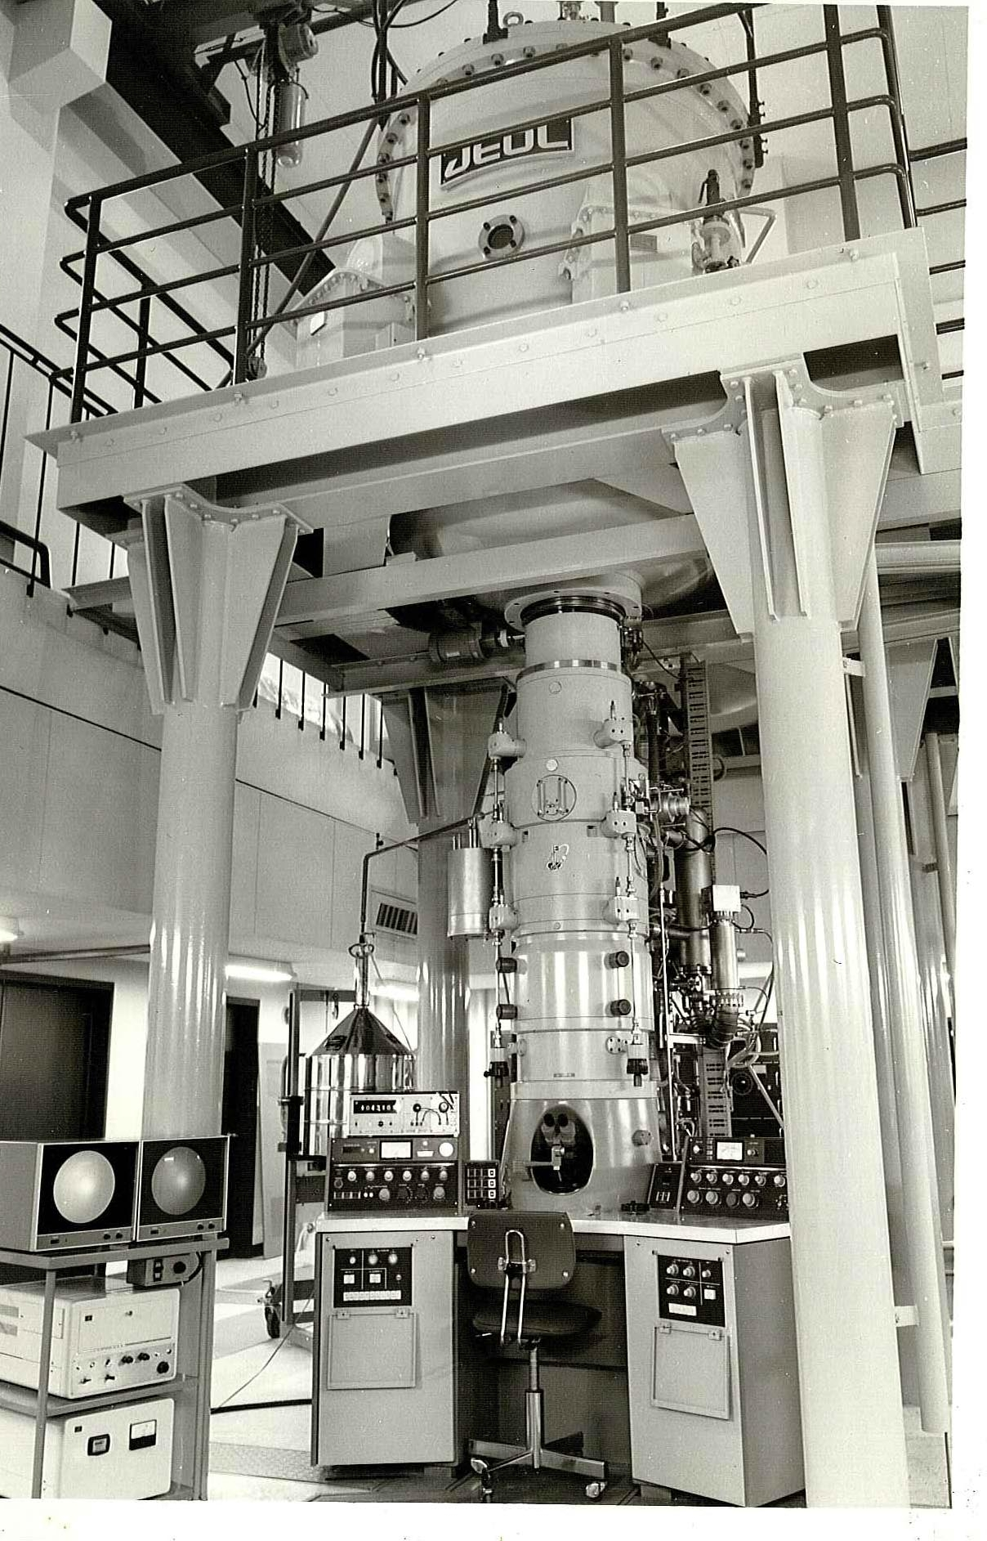

High voltage TEMs in Kyoto University
Shorter wavelength realizes better resolution.
→ High voltage TEMs
Shimadzu 300kV, 1957
Shimadzu 500kV, 1964
JEOL 500kV, 1971
JEOL 1000kV, 1989
Notes:
This shows our own history on improving high voltage electron microscopes.
About 50 years ago, Kyoto University started high voltage electron microscopy which accelerating voltage increased up to 1MV.
The main aim is to improve the resolution by using shorter electron wavelength.
Another aim was to decrease the radiation damage, in particular for organic, polymeric and biological specimens.
The damage could make smaller due to lower cross-section for high voltage electron beam.
However, at the same time, detection efficiency of detector became worse due to again the lower cross-section, even when we employed various detectors; such as high sensitive photographic films, image intensifier, imaging plate and CCD camera.

Slide 52


Microscopy by lens or scanning
1. Microscopy with lens | 2. Scanning microscopy
Conventional optical microscopy TEM | Scanning probe microscopy (AFM, STM) SEM, STEM
Incident beam
Incident probe
Output signals
Sample
Lens
Scan
Transmitted signals
Image
Sample

Slide 53
C_{s} corrected STEM equipped with a nanotip FEG
Nanotip cold-FEG (field-emission gun)
・Acceleration voltage：200 kV
・Emitter：W<111>
・Build-up of emitter：Thermal-field treatment
・Pressure： < 5 x 10⁻⁹ Pa
C_{s} corrector
・Convergent semi-angle：23 mrad
・Probe size：0.07 nm
Omega filter
・Energy resolution：0.4～0.5 eV
・Collection angle：10 mrad
CCD camera
Nanotip-FEG
Cs corrector
Double tank
Ω-filter
Stability : 0.2 nm/min (spatial)
0.04 eV/min (energy)
Notes:
The experiment was performed using this microscope.
The spherical aberration corrector is incorporated, which forms the fine electron probe less than 0.1 nm in diameter.
EELS spectrum is measured by an omega type of filter.
The energy resolution is 0.4 to 0.5 eV owing to the cold field emission gun.
53

Slide 54


HR-TEM for an organic crystal
of phthalocyanine
Crystal structure of Cl₁₆CuPc;
Monoclinic (C2/c)
a = 1.962 nm
b = 2.608 nm
c = 0.376 nm
β = 116.5°
Critical dose ≈ 30 C/cm²
electron beam
c
26.5°
a
基板

Slide 55



EM specimen preparation
thermocouple
・Vacuum-deposition on a cleaved KCl (001)
・Pretreatment of substrate at 670 K for 1 hr
・Deposition at 590 K
・Thickness measurement by AFM (30-49 nm)
・Thin support layer by carbon deposition
・Floating off from the substrate on water
heater
substrate
quartz oscillator
shutter
quartz crucible
1
2
carbon support layer
Mo-wire heater
TMP
3
4
AFM
30nm
AFM image

Slide 56



Previous TEM images of the phthalocyanines
1970 - 79 Uyeda, et al.
Molecular image
improved atomic image
No molecular image.
but lattice image of 1.3 nm.
1958 Menter
1993 Kobayashi, et al.
Notes:
This shows the improvement of such images.
At present, one can see directly the molecular arrangement in a crystal and even atomic arrangement in the molecule.

Slide 57

Recent improvement in TEM imaging
高分解能分子像（フタロシアニン分子）
Cs-corrected HR-TEM image
HR-TEM Image taken at 1000 kV

Slide 58
LAADF-STEM observation
of organic materials
Camera length of 12cm in JEOL 2200FS (detection angle of 20～53 mrad); LAADF-STEM condition
Diffracted waves
LAADF detector
For organic crystals, diffracted waves are concentrated at lower angles due to their large lattice dimensions.
Small contribution from elastic.
Inner diameter of LAADF detector of 12 cm
The Z-contrast HR could be expected even in LAADF-condition.
The higher TDS intensity can be used for imaging so as to minimize radiation damage.
CBED-pattern
Notes:
We adopted the camera length of 12 cm as a LAADF-STEM condition in JEOL 2200FS, which corresponds to the detection angle of 20～53 mrad);
For the typical organic crystals, diffracted waves are concentrated at lower angles due to large lattice dimensions.
In such cases, the elastic contribution might be small, so that the high resolution could be expected even in LAADF-condition.
Of course, highest TDS intensity can be used for imaging so as to minimize radiation damage.

Slide 59
Cl₁₆-CuPc
The critical dose is about 30 C / cm²
Crystal structure
monoclinic
a = 1.949 nm b = 2.596 nm
c = 0.376 nm β = 116.5°
a = 19.49Å
a=1.962 nm
a=1.962 nm, b=2.604 nm, c=0.376 nm, β=116.5 °
b = 25.96Å
b=2.604 nm
electron beam
c
26.5°
a
substrate
SAED
Notes:
Firstly, I would like to present the usefulness of LAADF-STEM for molecular imaging.
The specimen is C16-CuPc whose critical dose is about 30 C/cm2.
The electron beam is introduced along its c-axis.
And these kind of image is expected.

Slide 60

HAADF-STEM
(High-Angle Annular Dark-Field Scanning Transmission Electron Microscopy)
0.30
Debye-Waller factor : 0.5Å²
0.25
elastic
0.20
Intensity
【coherent】
Ratherford scattering
High order diffraction【incoherent】
Thermal diffuse
scattering (TDS)
0.15
Scan coil
detect a range larger than 50 mrad
Objective lens
0.10
TDS
Sample
(atomic columns)
0.05
High angular scattering electrons
0.00
0
50
100
150
200
Scattering angle (mrad)
Si単原子からの弾性散乱波とTDS波
Annular detector
s=sin(θ)/λ,
f_{x}(s) ; the atomic structure factor for electron
M_{x}(s) =Bs²; the temperature factor of each element x
B ; Debye-Waller factor

Slide 61
Application of ADF-STEM to organic crystals
Inorganic crystal
Organic crystal
HAADF inner angle
LAADF inner angle
Debye-Waller factor : 0.5Å²
Si
Br
elastic
Intensity
Intensity
Cl
Cu
TDS
C
N
Scattering angle (mrad)
Scattering angle (mrad)
Scattering from isolated atom for 200kV
s=sin(θ)/λ,
f_{x}(s) ; the atomic structure factor for electron
M_{x}(s) =Bs²; the temperature factor of each element x
B ; Debye-Waller factor
7

Slide 62
ABF
(annular bright-field )
HAADF
Sr
Sr
Sr
O
Sr
Ti
O
Ti
O
Sr
Sr
Sr
O
Sr
SrTiO₃
SrTiO₃
Sr
Sr
Sr
O
Sr
Fe
O
Fe
O
Sr
Sr
Sr
O
Sr
Fe
Fe
Sr
Sr
Sr
O
Sr
Distortion of octahedron is visible in ABF image.
Sr₂Fe₂O₅
Sr₂Fe₂O₅
Reference : Haruta et al., Proceedings of EDGE2009, 64 (2009)
Notes:
Recently, new imaging method using STEM is developing.
By using ABF image, we can observe oxygen columns.
For example, in case of STO, oxygen are observed in the center,
On the other hand, in case of SrFeO_{2.5}, distorted octahedra are observed directly.
Therefore, the Distortion of octahedron is also confirmed using ABF image.
62

Slide 63


"Direct Imaging of Hydrogen within a Crystalline Environment"
ADF
(HAADF)
Scott D. Findlay, Tomohiro Saito, Naoya Shibata, Yukio Sato, Junko Matsuda, Kohta Asano, Etsuo Akiba, Tsukasa Hirayama, and Yuichi Ikuhara
Applied Physics Express 3 (2010) 116603
ABF
Observation of hydrogen atoms !!
ABF
filtered

Slide 64
Advantage of LAADF-STEM
for high resolution of organic crystal
Cl
Cl
a = 19.49Å
Cu
b = 25.96Å
a’
b
・Z-contrasts of Cu- and Cl-columns are observed.
・C- and N-columns are not observed.
・First observation of ADF-STEM in organic materials.
M. Haruta, h. Kurata adn S. Isoda. Ultramicroscopy, 2008, 108, 545-551.

Slide 65

Beam size effect in STEM
Scherzer focus
(f)
scanning
slightly under focus
Pre-peak damages materials before imaging.
(g)
scanning

Slide 66

TEM image of stacking faults
in Cl₁₆CuPc
Ultramicroscopy ,19, 279 (1986)

Slide 67



Stacking faults in Cl₁₆CuPc
5.2Å

Slide 68

O K-edge
O-2p hybridized with
Sr-4d
Fe-3d
Fe-4s/4p
Whole unit cell
Exp
O K-edge
Cal
O-2p
FeO₆ site (oct)
unoccupied
Intensity (arb. unit)
occupied
DOS of electron
Dipole transition
Δl= ±1
FeO₄ site (tetra)
O-1s
Split & weak
for octahedron site
Energy- loss (eV)
Notes:
This is a result of O K-edge ELNES from each site.
O K-edge is transition from 1s band to unoccupied 2p band.
And the experimental spectrum from whole unit was agree well with the calculated spectrum
Site-resolved EELS is realized and
Each spectrum has different futures reflecting local electric structure.
By comparing with the theoretical PDOS result,
It was found that the each peak is attributed to these hybrid state.
Especially, pre-peak is most different.
The pre-preak in octahedra site is sprited, while that of in tetrahedra site is not sprited.
And the intensity of pre-preak in octahedra site is smaller than that in tetrahedra site.
This means the hole concentration in octahedra site is smaller than that of tetrahedra site.
It is considred ｔhese results reflect the nature of chemical bonding.
Transition metal oxide electronic properties are strongly related to the partially filled 3d
band of the transition-metal atoms, which are strongly hybridized with the O 2p bands.
The pre-peak has a strong Fe 3d band contribution and is extremely sensitive to bonding features.
68

Slide 69

FeO₄ site
O-K edge of FeO₄ site
up + down
up
down
Exp
O1&O2
Intensity (arb. unit)
O1
O1
O2
O3
O2
The crystal field splitting for FeO₄ site was smaller than that of FeO₆ site.
→ more covalent nature ??? than FeO6
Energy loss(eV)
Notes:
While in case of the O K-edge of FeO4 tetrahedron site.
69

Slide 70

FeO₆ site
O K-edge of FeO₆ site
Since the FeO₆ octahedra is distorted by periodic oxygen defect, it was expected that such a distortion from cubic symmetry leads to a splitting of the t_{2g} and e_{g} states.
← pre-peak splitting
up + down
Mangetic structure of Sr₂Fe₂O₅
up
down
1.82Å
2.04Å
2.217Å
1.94Å
Intensity (arb. unit)
Fe-3d state
b_{1g}
(d )
e_{g}
x²-y²
a_{1g}
(d )
O1
3z²-r²
O2
b_{2g}
(d )
t_{2g}
xy
e_{g}
, d )
(d
zx
O3
yz
b_{1g}
(d )
a_{1g}
(d )
x²-y²
3z²-r²
Energy loss (eV)
Notes:
Since the FeO₆ octahedra is distorted by periodic oxygen defect.
it was expected that such a distortion from cubic symmetry leads to a splitting of the t_{2g} and e_{g} states.
The b_{1g} state is extended into the in-plane, while the a_{1g} state is directed in the z direction
Therefore, a_{1g} state make the stronger hybridization with O2 2p band than that of O3.
Therefore, it was found each pre-peak are attribute to these state.
70

