Slide 1
Invisibility: Fact or Fiction?
C.T. Chan
Hong Kong University of Science and Technology
Dec 6 2011, NTU
Funding: Hong Kong RGC

Slide 2
Different ways to realize “invisibility”
Transformation optics:
  “Blow up” cloaks, optical conformal mappings…
Complementary media:
  cloaking by cancellation
Dipoles in front of a metamaterial slab:
  excitation suppression
Zero refractive index:
  absence of scattering inside channels
Active cloaking:
  Not metamaterial based, but can be useful
A brief review: Chen et al. Nature Materials 9, 387 (2010)

Slide 3
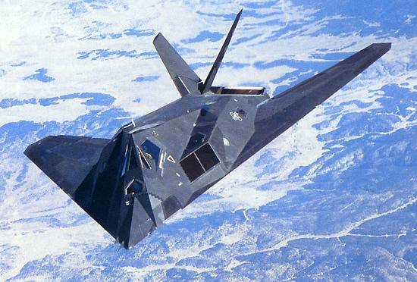
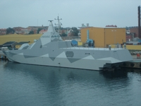
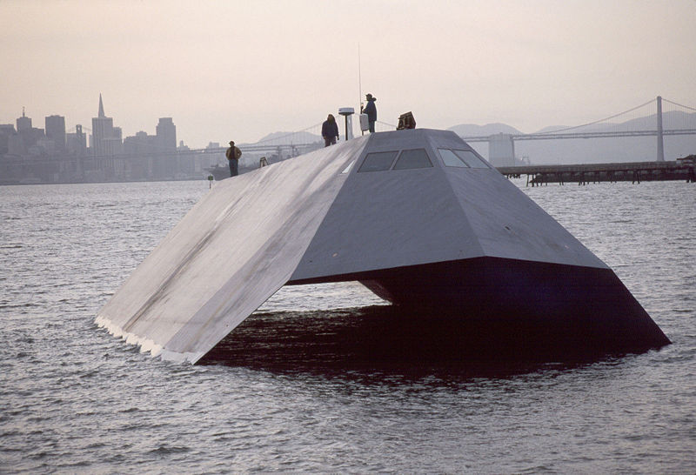
“Stealth” ≠ “Invisibility”
Stealth Technology
  absorbs light, object appears dark
  Scatters EM wave to a wrong direction
Stealth objects are “dark” or “black” objects
They are not “invisible”
Invisible means “zero extinction cross section”
F-117A Nighthawk
Swedish Stealth Ships
US Navy Sea Shadow

Slide 4
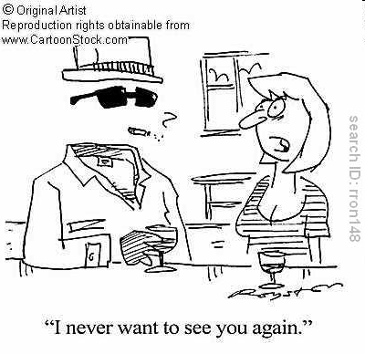
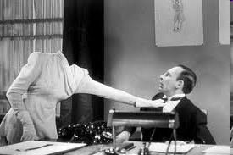
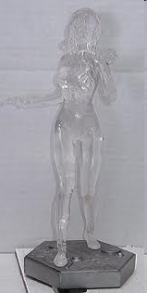
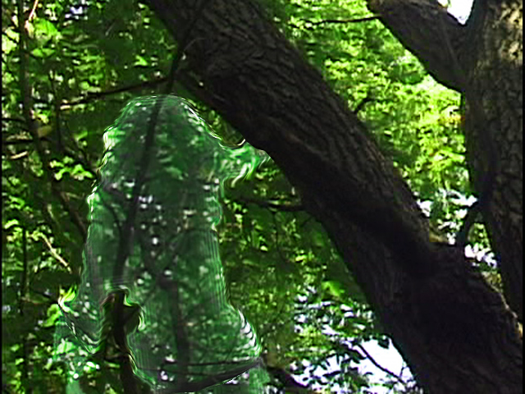

“Invisibility” means perfect transparency

Slide 5
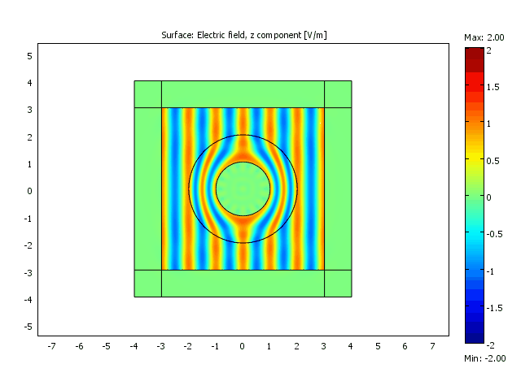
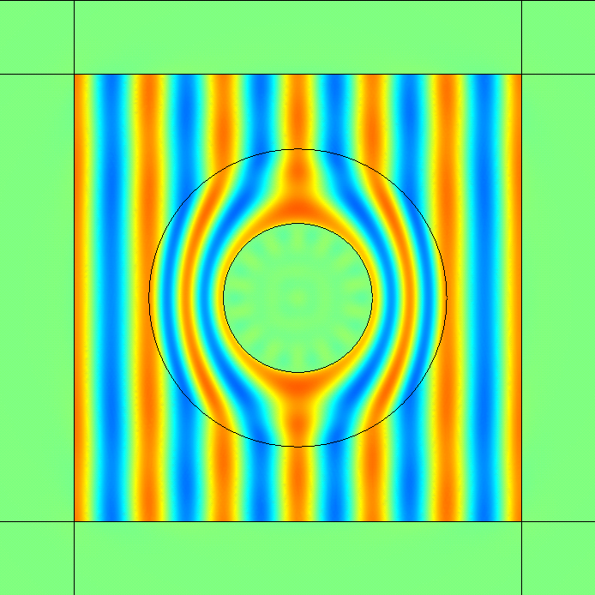
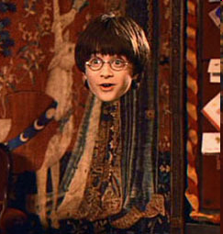
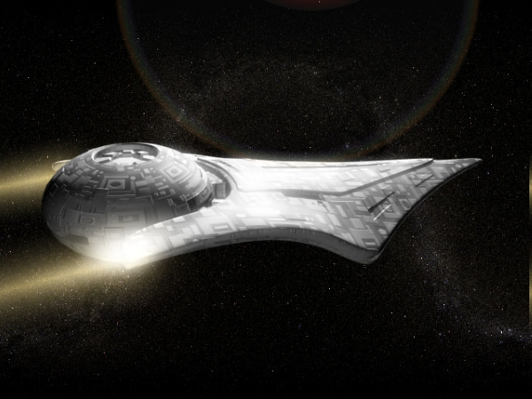

I: Transformation Optics: invisibility = perfect transparency
Making something invisible by guiding light around a domain
Harry potter’s Cloak
Star Trek, Star Wars, StarCraft
Predator
Problem: no light enters into the shell, a person inside cannot see outside.
J. B. Pendry, D. Schurig, and D. R. Smith, Science 312, 1780 (2006).
U. Leonhardt, Science 312, 1777 (2006).

Slide 6
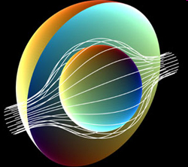
Transformation optics: Maxwell Equations are form invariant under a coordinate transformation
Maxwell’s equations at fixed frequency
J. B. Pendry, D. Schurig, and D. R. Smith, Science 312, 1780 (2006)
U. Leonhardt, Science 312, 1777 (2006).
A. Greenleaf, M. Lassas, and G. Uhlmann, Physiol. Meas. 24, 413 (2003)
L. S. Dolin, Izv. Vyssh. Uchebn. Zaved. Radiofizika 4, 964 (1961)
G. W. Milton, M. Briane and J. R. Wills, New J. Phys 8, 248 (2006).

Slide 7
A simple scale change
Even very simple transform gives complex material parameters
  Anisotropic
  Very strange values of ε and µ (less than unity)
  Generally position dependent (inhomogeneous)
  µ is required.
Such materials do not exist in nature
Realization depends on man-made metamaterials

Slide 8
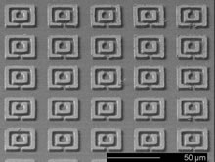
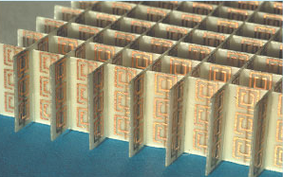

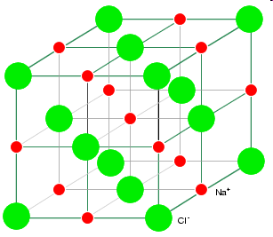
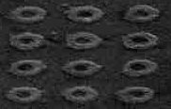
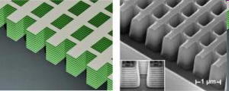
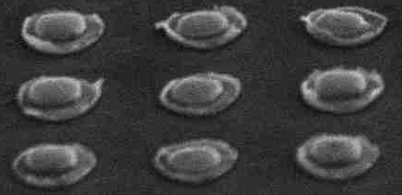
Meta-material
(Electromagnetic resonant structures)
Natural material
Atom
Resonators (“Artificial Atom”)
Optical properties given by nature
Optical properties
designed at will

Slide 9
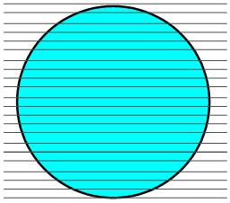
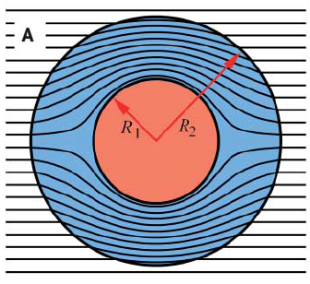
Blow up a point (“the” cloak in 2D)
ε^{ij}, μ^{ij}
ε=μ=1
Transformation Optics
Virtual space (r’,θ’)
Physical space (r,θ)
These are the equations
for the 2D invisibility cloak
(parameters in physical space).

Slide 10
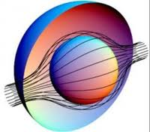
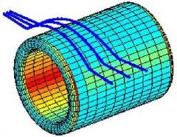
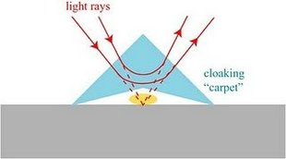
Transformation optics: “Blow up” transforms
(guide wave around a domain)
Blow up a point (“the” cloak)*
Blow up a line to a tube (wormhole)**
Blow up a plate (carpet cloak)***
  Typical problem: Singular transforms, extreme parameters, narrow band width
  Mitigation: Carpet cloak:
  less singular transformation, broader band width, but carpet cloak is a “lesser cloak”.
What we learn:
  perfectness == impractical
* Pendry et al./ Greenleaf et al./Leonhardt
** Greenleaf et al.
***Ji & Pendry / Luo et al.

Slide 11
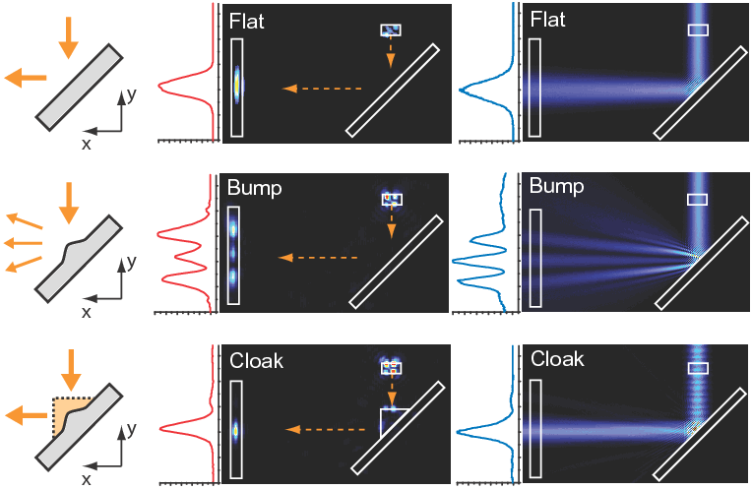
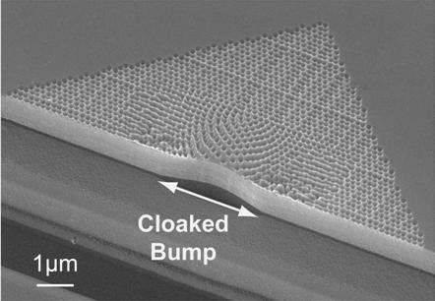
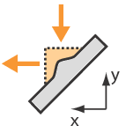


Carpet Cloak
quasi-conformal map
a less singular transformation: more friendly material parameters, easier to implement
Successful demonstration in optical frequency, broad bandwidth
Realization (Silicon SOI technology)
But still requires background to have a higher index than cloak (i.e. cannot cloak in free space)
uncloaked
cloaked
Li and Pendry, Phys. Rev. Lett. 101, 203901 (2008)
Nature Mater. 8, 568 (2009)
Expr
Theory
Notes:
11

Slide 12
Absorption is an issue
Always an issue if metals is used
  Loss compensation by gain has been demonstrated*
Use dielectrics to do “metamaterials”: How far can we go?
  Most metamaterials can be viewed as metallic photonic crystals
  Dielectric photonic crystals:
    Design dispersions and use effective medium theory to get effective ε and µ
    Example: use dielectric photonic crystals to get ε=µ=0
* See, e.g. Shalaev group, detailed analysis by Soukoulis et al, Hess et al….

Slide 13
Cloak an
Interior
Domain
Pendry, Schurig and Smith, Science, (2006)
Positive index metamaterial guides light “around” an enclosed domain:
- Cloaks anything inside that cloaking shell
- The cloaked object is surrounded by the cloak
Can we do cloaking at a distance: Cloak does not encircle object ?

Slide 14
II: Another way of “cloaking”
Cloaking at a distance, possible?
Can see
Can’t see
Incident wave
Scattered waves
Cloaking
device
“Cancels” all the
outgoing scattered waves
Notes:
It turns out there is another abnormal way of cloaking, which is cloaking an object outside the cloaking device. Is this possible?

Slide 15
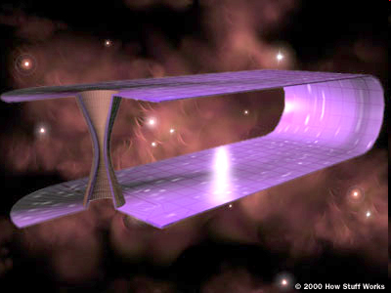
II: Complementary media: scattering cancellation
Space folding
“ (-X) + X = 0 ”
folded geometry
J. B. Pendry and S. A. Ramakrishna, J. Phys.: Condens. Matter 14, 8463 (2002).
U. Leonhardt and T.G. Philibin, New J. Phys. 8, 247 (2006).
Notes:
Our approach is based on the concept of complementary media. This is an example of complementary media. We fold a slab of space containing the object to the left side, and then we get a complementary media slab with an embedded “image” of the object. As a result, the object is optically “cancelled”. The region between –L and L will be equal to “nothing” optically. Here, by “nothing” we mean that the electromagnetic fields at –L is exactly equal to those at L. This is different from free space. For example, if a beam of light is obliquely incident on the –L surface, the light will come out here, as if there is not even free space between –L and L.

Slide 16
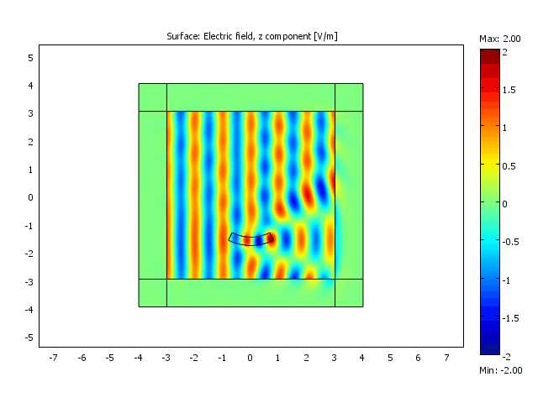
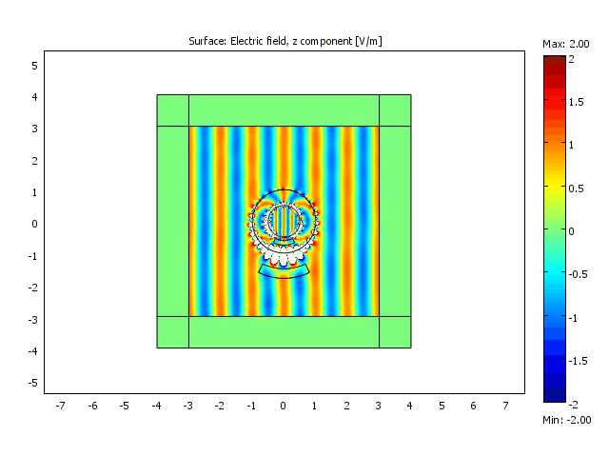
Numerical demonstration
Our remote cloaking device
“Anti-object”
Dielectric ε= 2

Slide 17
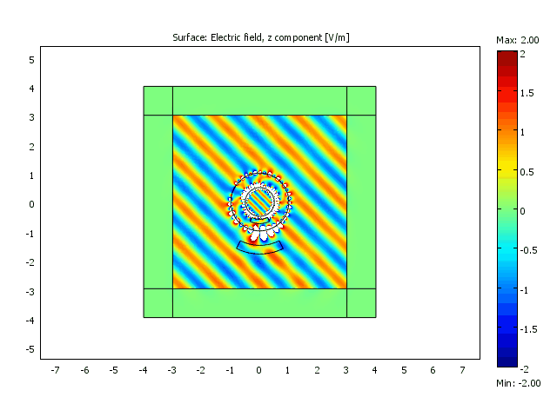
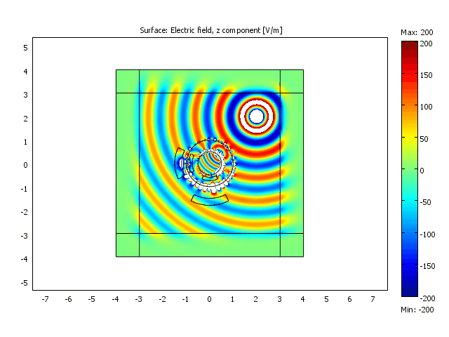
The cloaking device does not depend on incident waves, but has to be tailored to the object
Two corresponding “anti-objects”
Oblique incidence

Slide 18
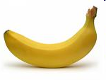
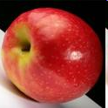
More amazing effect: Illusion Optics
Invisibility cloak is a special case of illusion
  An object is “optically transformed” by an device into “free space”, and thereby becomes invisible.
Can we have an device that “optically transform” one object into another object?
Transformation Optics ?

Slide 19
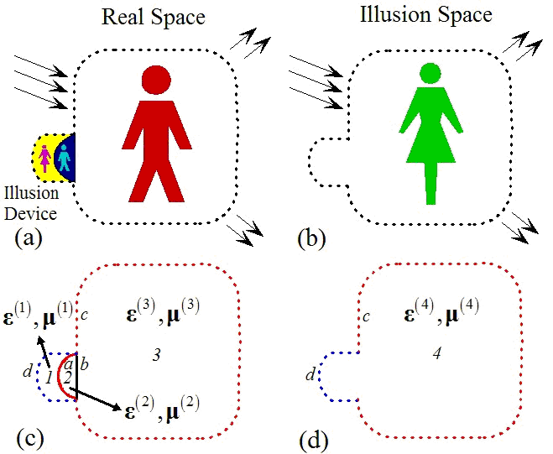
Illusion Optics
Two steps
  Optically cancel the man
  Optically project the woman
Phys. Rev. Lett. 102,
253902 (2009)

Slide 20

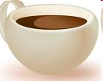
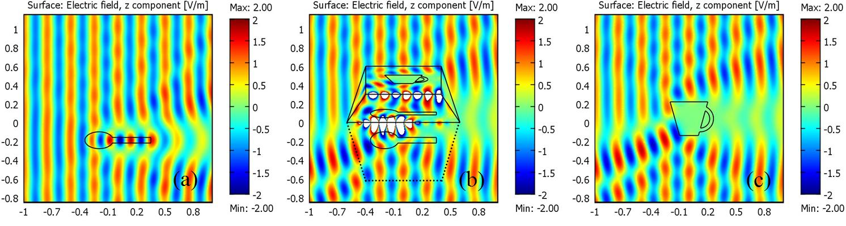
Illusion optics: Numerical demonstration:
Changing a spoon into a cup
(invisibility is a special case of illusion)
a dielectric spoon
illusion Device
a metallic cup
Notes:
So this is the numerical demonstration, in which we transform the scattered pattern of a dielectric spoon into those of a metallic cup. The left figure is the original scattering pattern of a dielectric spoon. In the middle, the scattering pattern is changed by an illusion device. And it turns out to be exactly the same as that of a metallic cup, shown in the right figure.

Slide 21
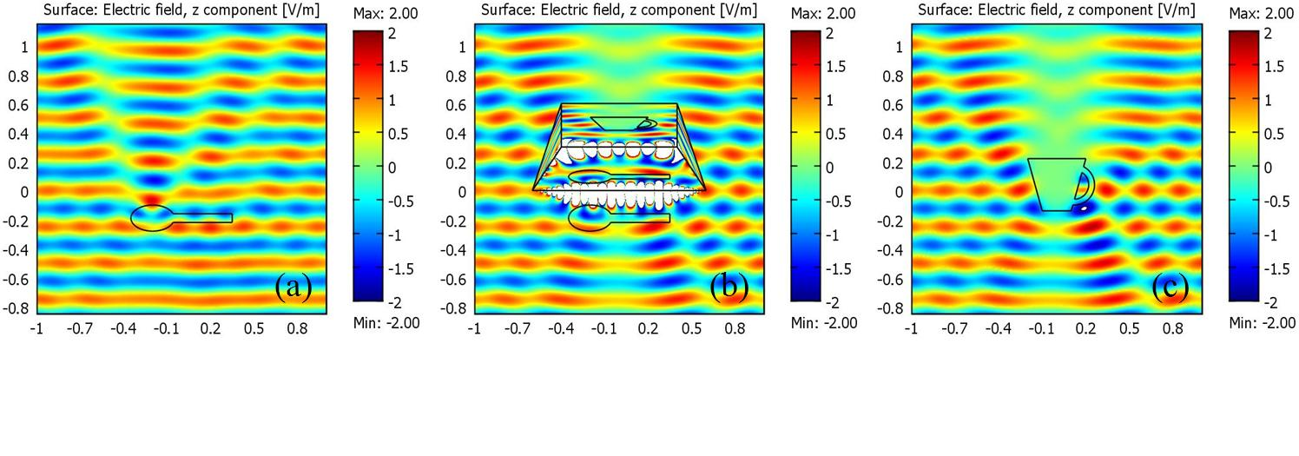
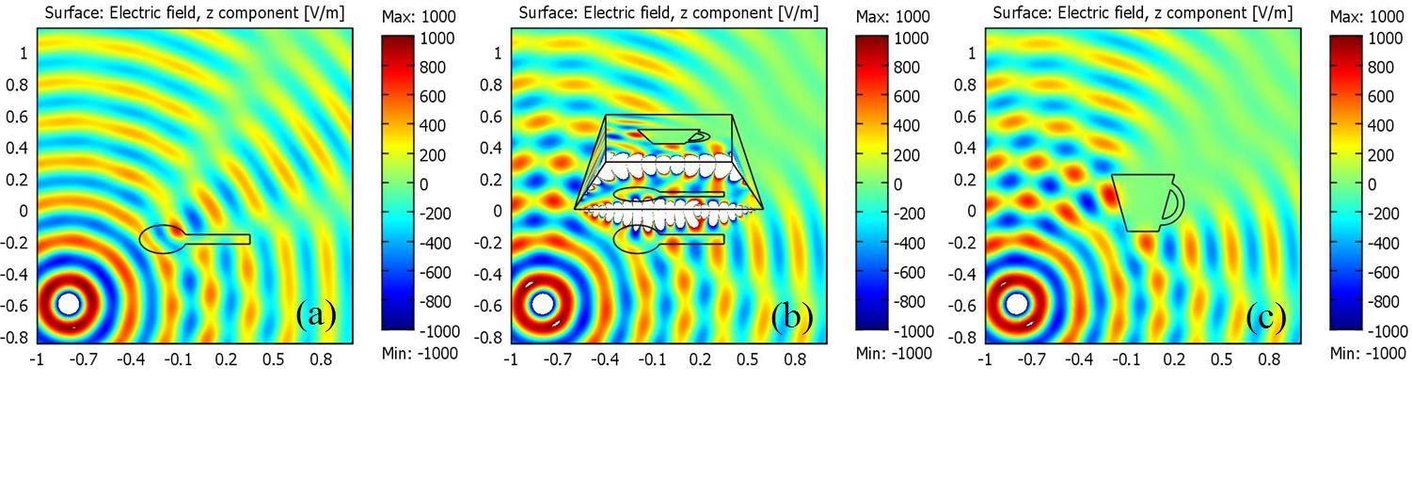
Independent of light source

Slide 22
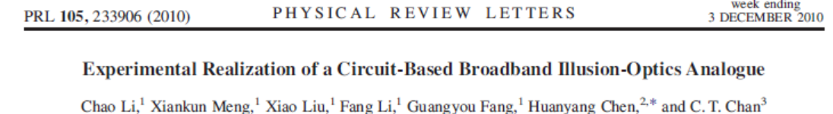
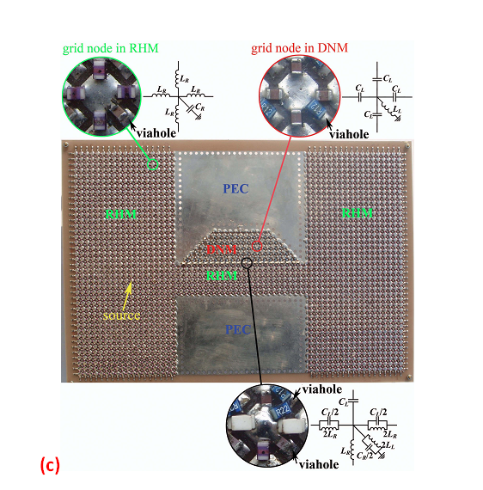
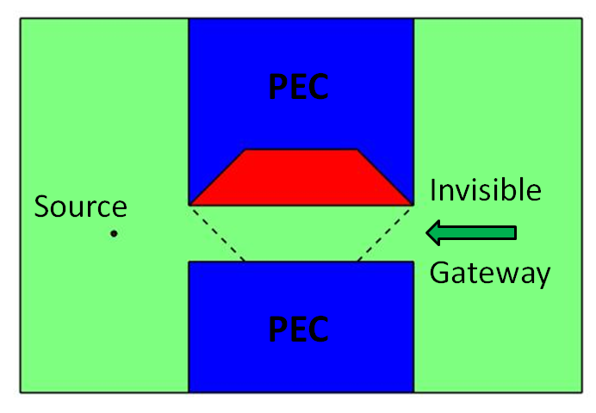
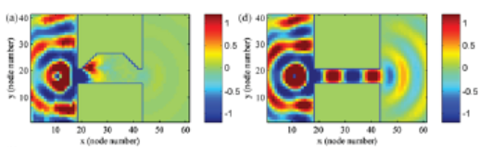
Proof of Principle Experiment

Slide 23
II: Complementary media*
Advantage:
  Works by “cancellation”, not “going around a domain”
  external cloaking**
  Can be generalized to “illusion” (~ deception)***
Disadvantage
  Non-singular but requires negative index (absorption, narrow band width…etc)
*Pendry, & Ramakrishna, J. Phys. Condens. Matter 15, 6345 (2003)
For a review: NATURE MAT 9, 387 (2010)
**Phys. Rev. Lett. 102, 093901 (2009)
***Phys. Rev. Lett. 102, 253902 (2009)

Slide 24
Other forms of Invisibility/cloaking
In a more restrictive setting, invisibility can also be achieved using other means
  In some waveguide configurations, cloaking can be achieved if we have n=0 (zero refractive index).
  For a small object, cloaking can be achieved using enhanced reflections in a metamaterial slab

Slide 25
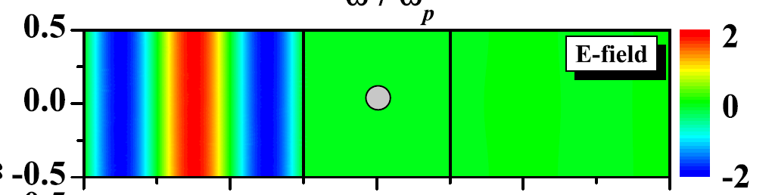
Cloaking Effect
“Zero” refractive index can do “cloaking” inside a waveguide
Cavity Resonance transmission tuning
PEC for high reflection
PMC for high transmission
Hao et al. Appl. Phys. Lett. 96, 101109 (2010)
Nguyen et al. PRL 105, 233908 (2010)
Zero index material

Slide 26
Zero-index “cloaking” effect
Disadvantage:
  Operates only under restricted conditions (inside a channel with one specific incident angle with specific boundary conditions)
  Always narrow band width
But n=0 can be realized with pure dielectrics
PMC for high transmission
n = 0
Hao et al. Appl. Phys. Lett. 96, 101109 (2010)

Slide 27
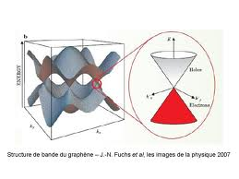
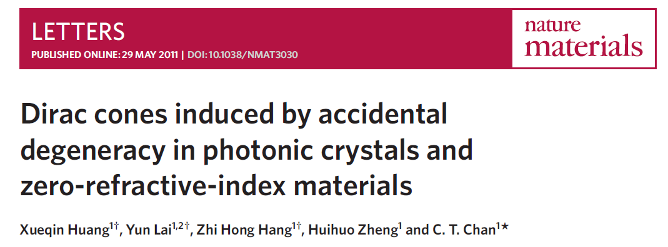
Can we get a “zero-refractive index” metamaterial?
Zero index is more “empty” than vacuum, no phase change in optical path
Use concept of “Dirac cone”

Slide 28
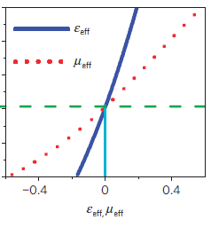
Band structure of 2D dielectric PC with square lattice:
Dirac cone at zone center
TM: electric field along cylinder axis
The frequency with is exactly the Dirac frequency in 2D PC induced by accidental degeneracy.
XQ Huang, Y Lai, ZH Hang, HH Zheng CT CHan Nature Mater. 10, 582 (2011)

Slide 29
PMC object
)
Dielectric object
Dirac cone PC can guide waves around the 90 degree bend and cloak scattering objects
Control calculation :
PC is replaced by solid dielectrics of ε=12.5. Guiding/cloaking disappeared

Slide 30
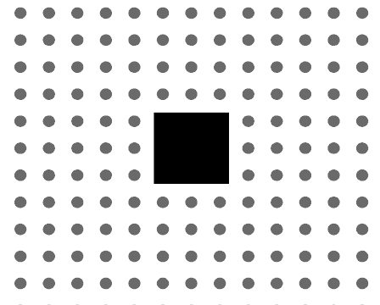
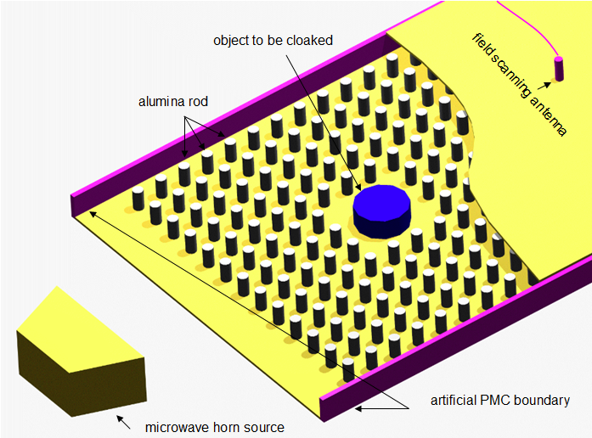
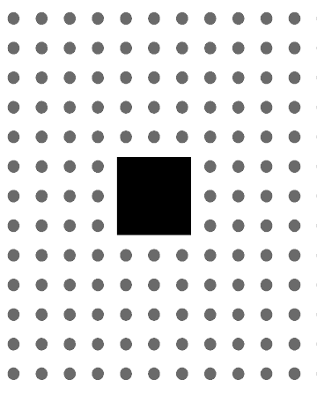
Experiment to demonstrate tunneling and cloaking for
“ε= µ=0” photonic crystal
PC with Dirac cone
Upper panel: With PC
Lower panel: Without PC

Slide 31
Can we go beyond ε=µ=0 with pure dielectrics?
Anisotropy (√)
Single negativity, double negativity (√)
Small values of ε and/or µ (√)
Graded (√)
Low absorption (√)
Large values of ε and/or µ (?)
Bandwidth (??)
How good is effective medium (?), (does it matter?)

Slide 32
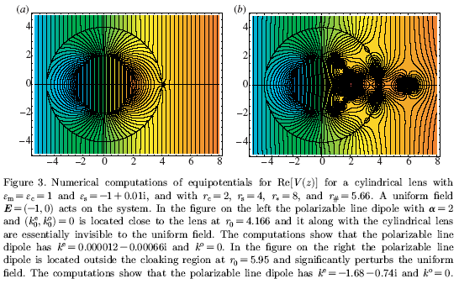
Anomalous resonance/ Strong reflection
Only for small objects
Milton and Nicorovici, Proc. R. Soc. A (2006) 462, 3027
Nicorovici, McPhedran, Milton, Phys. Rev. B 49, 8479 (1994).
For point dipoles in the quasi-static limit, negative index itself is already a cloak

Slide 33




Perfect Lens: Imaging or Cloaking
Cylinder: radius = 0.005, ε = 400
λ = 1.0
Slab: D = 1.0
dis > ½ D
Imaging
dis < ½ D
Cloaking
Total field
Scattering field

Slide 34

Finite frequency:
Any slab cloaks point dipole if it is placed close enough, but ε=µ=-1 cloaks better than others
Any slab “cloaks” a point dipole close to the surface
ε=µ=-1 cloaks better:
it has a “suppression zone” of d/2
“Cloaking” effect not restricted to ε=µ= -1, but only works for “small” objects close to surface
PRB 83, 115124 (2011)

Slide 35




Size effect - qualitative
Line: a X L
λ = D =1.0
a = 0.005 << λ
ε = 400
dis = 1/5 D < ½ D
L=0.1 << λ
Cloaking for
isolated cylinders
L=1.5 ~ λ
Imaging for a
plate
(“complementary
media”)
without slab
with slab
Cloaking or Imaging: depend on the size of the object(s).

Slide 36
Anomalous resonance/ Strong reflection “cloaking” effect
Disadvantage:
  Operates only under very restricted conditions
  Only works for small point like objects placed very close to a metamaterial slab

Slide 37
Active sources?
Cloaking: Use active source to create a “quiet zone”
  D. A. B. Miller, Opt. Express 14, 12457 (2006):
    Cloaking possible if the active sources encircle the “quiet zone”
  Vasquez, Milton, Onofrei, PRL, 103 (2009), 073901.
    Cloaking possible even if the active sources do not encircle the “quiet zone”.
    “Remote active source cloaking”
  HH Zheng, JJ Xiao, Y Lai, C.T. Chan, PRB , 81, 195116 (2010)
    Extend to remote illusion with sources
Advantage
  No bandwidth limitation, absorption compensation
Challenge
  Knowledge of the incoming wave
  Fast computer to compute the active sources…
  Fast electronics to create the source

Slide 38

“Active source illusion” using Boundary Element Method
Put active sources on the boundaries Γa that would do
  “cloaking”: create a “quiet” region Ωc which can conceal an arbitrary scatter
  “illusion”: the total system appears like another object outside the boundary Ωb.

Slide 39



Illusion by active sources
Quiet zone
Scattered wave like that of banana
(a)
(b)
(c)
Sources on boundary
Change an apple (ε=16) to a banana (ε=5) :
(a), (b) and (c) are total fields

Slide 40
Any object inside the quiet zone will be cloaked to give the same illusion effect
Quiet zone can hide anything inside
In (b) and (c), objects are hidden inside quiet zone.
The scattering remain the same (i.e. still looks like banana)

Slide 41
Beyond EM wave
Acoustics, elastic wave (?), water waves should be easier
  Wide band width quite possible
  Quite a few experimental demonstrations (…)
  Should be able to combine passive cloaking with active sources

Slide 42







2D EM cloaking ⇒ 2D acoustic cloaking:
S. A. Cummer and D. Schurig, New J. Phys 9, 45 (2007).

Slide 43
DC conductivity equations:
Acoustic eqns at fixed frequency :
A. Greenleaf, M. Lassas and G. Uhlmann, Physiol. Meas. 24, 413 (2003).
G. W. Milton, M. Briane and J. R. Wills, New J. Phys 8, 248 (2006).
H. Chen and C. T. Chan (APL 2007).

Slide 44

3D acoustic cloaking
H. Chen and C. T. Chan, Appl. Phys. Lett. 91, 183518 (2007).
See also, S.A. Cummer, et. al, Physical Review Letters, 100, 024301 (2008);
D.Torrent and J. Sánchez-Dehesa, New Journal of Physics 10 023004 (2008).

Slide 45

To make it practical
Settle for something less
  Approximate cloaks* (bigger band width)
  Ray optics (?)
For EM wave: Use dielectrics (possible, I think)
Use combination of strategies (e.g. passive/active)
* For “blowing up a point/line” cloaks: Zero bandwith if we want zero cross section
(see e.g. PRB 76 241104 (2007))

Slide 46

Invisibility : fact or fiction ?
We still have a long way to go to become a Harry Porter
But look at what an octopus can do :
They have a small brain, very limited materials to use, and no nanotechnology…
We should be able to do better

Slide 47

Thank you
Collaborators (invisibility)
Kenyon Chen (now at SooChow)
Z H Hang
Y Lai (now at SooChow)
ZQ Zhang
HH Zheng (now at UIUC)
FM Liu
External Collaborations (Fudan, Nanjing, SunYatSun, CAS)
Funding: Hong Kong RGC

Slide 48
Issues
1. Spectral bandwidth: Is it possible to achieve a wide bandwidth with resonant systems for realistic cloaking?
2. Losses: Metamaterial cloaks usually use metallic elements. Is loss detrimental to the cloak performance and can it be overcome?
3. Ostrich effect: Is cloaking of the cloaking system essential for cloaking? For example, dielectric systems for cloaking can be broad-bandwidth, but the cloaking system itself is not cloaked.
4. Camouflage vs. invisibility: Is it better to aim for deception than invisibility (e.g misleading information with regard to size, speed or direction of motion)?
5. High tech: What new technologies will still need to be developed to enable realistic cloaking?
6. Beyond electromagnetic cloaking: Is cloaking more realistic for other types of waves rather than electromagnetic, e.g. acoustic, or elastic, or plasmonic?

Slide 49



Photonic Crystal really behave like ε= µ=0
n=0 medium
air
pec
d
air
a
L
For a hole inside n=0 medium (or n_{eff}=0 PC), transmission can be tuned by the size of the PEC block
n_{eff}=0 PhC with alumina rods
Nearly perfect transmission
L=4a
Low transmission
The incident frequency: n_{eff}=0 frequency

