Slide 1
99學年上學期高二物理
黃信健

Slide 2
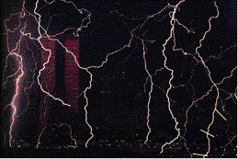
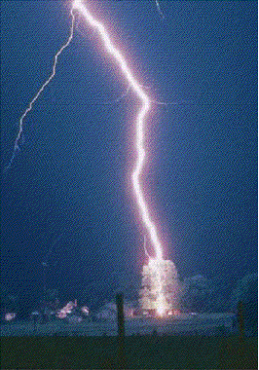
3 Gauss’ Law

Slide 3
How wide is a lightning strike ?

Slide 4
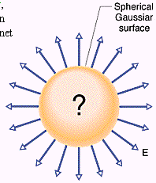
3-1 A New Look at Coulomb’s Law
Using Gauss’s law to take advantage of special symmetry situations
Gaussian surfaces
高斯面上各點電場與面內總電荷相關

Slide 5
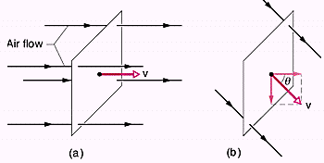
3-2 Flux (通量/流量)
For a fluid
m/s × m² = m³/s

Slide 6
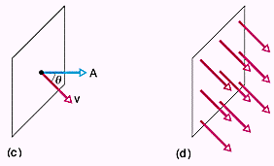

Slide 7
3-3 Flux of an Electric Field
For a flat surface
For a arbitrary (asymmetric) surface

Slide 8
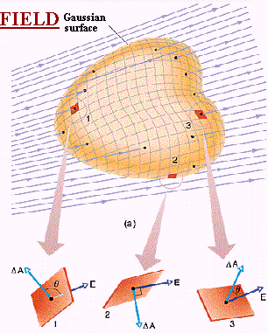
An arbitrary Gaussian surface

Slide 9
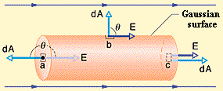
Ex.3-1 A cylindrical Gaussian surface

Slide 10
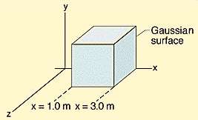
Ex.3-2 A nonuniform electric field and a Gaussian cube

Slide 13
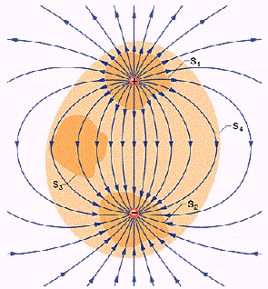
3-4 Gauss’ Law
Flux ↔ enclosed charge

Slide 14
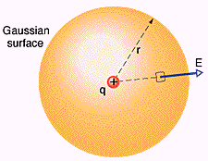
3-5 Gauss’ Law and Coulomb’ Law
From G.L. to C.L.

Slide 15
3-6 A Charged Isolated Conductor
同號電荷相斥
導體內部無電場
The external electric field

Slide 16
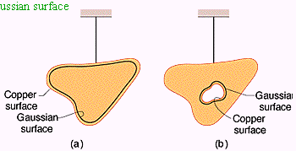
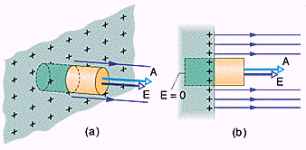

Slide 17
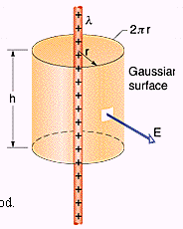
3-7 Applying Gauss’ Law: Cylindrical Symmetry

Slide 18
Ex.3-5 A lightning strike

Slide 19
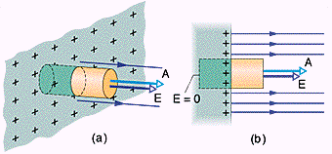
3-8 Applying Gauss’ Law: Planar Symmetry

Slide 20
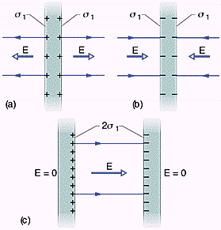
Two Conducting Plates

Slide 21
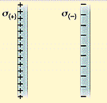
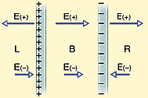
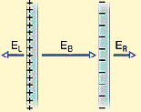
ex.3-6 Two‖nonconducting sheets

Slide 22
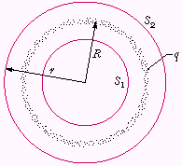
3-9 Applying Gauss’ Law: Spherical Symmetry
The Shell Theorems

Slide 23
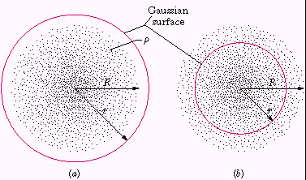
A spherical distribution

Slide 24
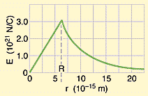
Ex.3-7 The electric field vs. r

