Slide 1
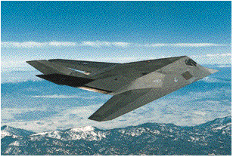
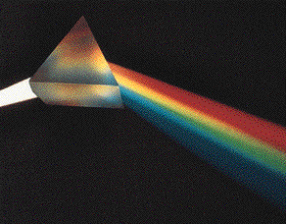
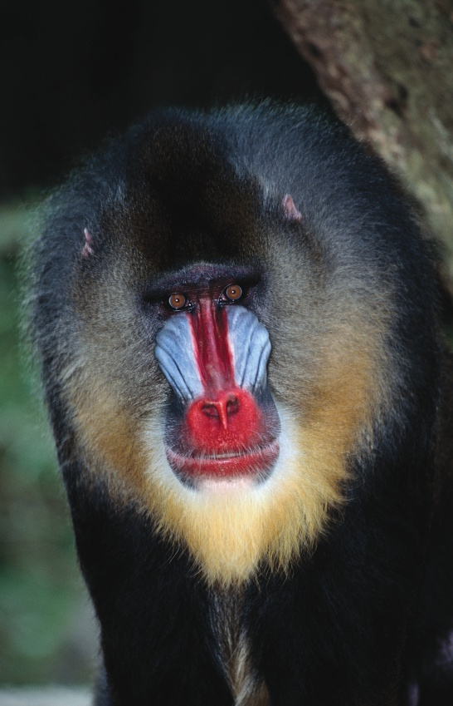
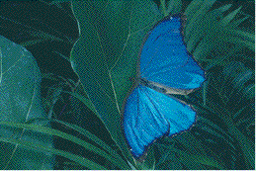
11 反射、折射、干涉、繞射

Slide 2
Sections
  反射 (reflection)與折射 (refraction)
  干涉 (interference)
  繞射 (diffraction)

Slide 3
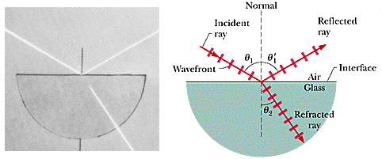
11-1 Reflection and Refraction (反射與折射)

Slide 4
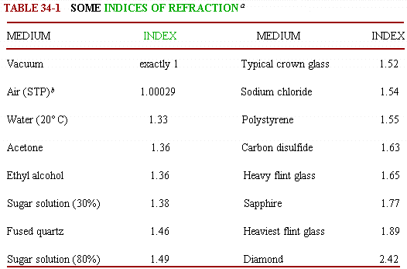
折射率

Slide 5
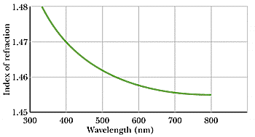
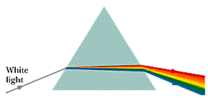
Chromatic Dispersion – prisms and gratings

Slide 6
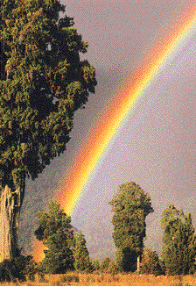
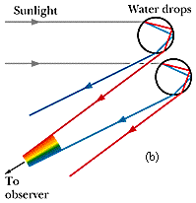
Rainbows
Notes:
當太陽光線平行於地面時，可以在仰角40-42°附近看到「虹」，
更微弱的「霓」則可能在仰角51-54°附近被察覺。
背對太陽時，所有同時進入眼中成固定夾角的光線（如上圖中42°的紅光）是一個圓椎，
因此所看到的彩虹是圓弧形。

Slide 7

11-2 Interference – (干涉)
What produces the blue-green of a Morpho’s wing?
How do colorshifting inks shift colors?
Notes:
Top: 金屬藍色, bottom: 暗棕色

Slide 8
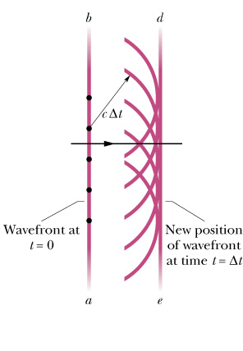
Huygens’ principle
All points on a wavefront serve as point sources of spherical secondary wavelets.
After a time t, the new position of the wavefront will be that of a surface tangent to these secondary wavelets.
Fig. 35-2
Notes:
․Young’s Double-Slit interference Exp.
◊ Constructive interference/maxima/bright fringes
◊ Destructive interference/minima/dark fringes

Slide 9
Law of Refraction from Huygens’ principle
Notes:
․Young’s Double-Slit interference Exp.
◊ Constructive interference/maxima/bright fringes
◊ Destructive interference/minima/dark fringes

Slide 10
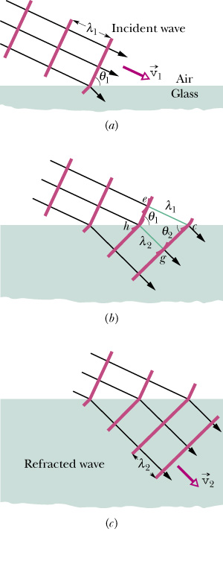
Fig. 35-3
35-

Slide 11
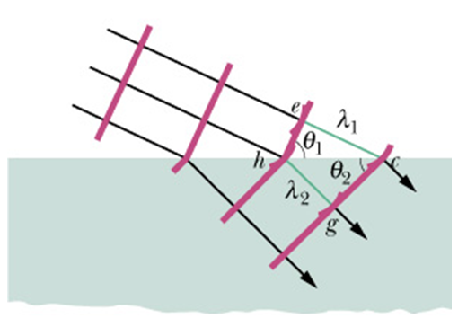
Index of Refraction:
Law of Refraction:
35-
Notes:
Time of travel tec = thg

Slide 12
Phase Difference, Wavelength and Index of Refraction
Notes:
․Young’s Double-Slit interference Exp.
◊ Constructive interference/maxima/bright fringes
◊ Destructive interference/minima/dark fringes

Slide 13
Wavelength and Index of Refraction
The frequency of light in a medium is the same as it is in vacuum
35-

Slide 14
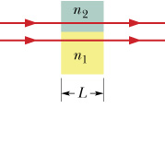
Phase Difference
Since wavelengths in n1 and n2 are different, the two beams may no longer be in phase
Fig. 35-4
35-

Slide 15
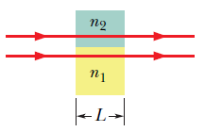
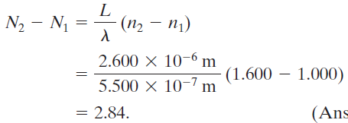
Ex.11-1 35-1
wavelength 550.0 nm
n₂=1.600 and
L = 2.600 m

Slide 16
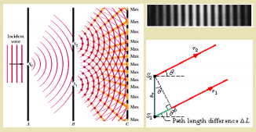
Young’s Experiment
Notes:
․Young’s Double-Slit interference Exp.
◊ Constructive interference/maxima/bright fringes
◊ Destructive interference/minima/dark fringes

Slide 17
Coherence
Two sources to produce an interference that is stable over time, if their light has a phase relationship that does not change with time: E(t)=E₀cos(ωt+φ)
Coherent sources: Phase φ must be well defined and constant. When waves from coherent sources meet, stable interference can occur － laser light (produced by cooperative behavior of atoms)
Incoherent sources: φ jitters randomly in time, no stable interference occurs － sunlight
35-

Slide 18
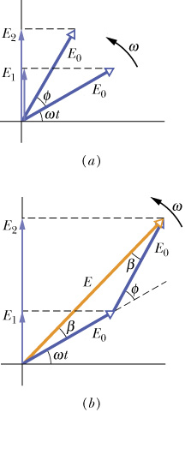
Intensity and phase
Eq. 35-22
Fig. 35-13
Eq. 35-23
35-

Slide 19
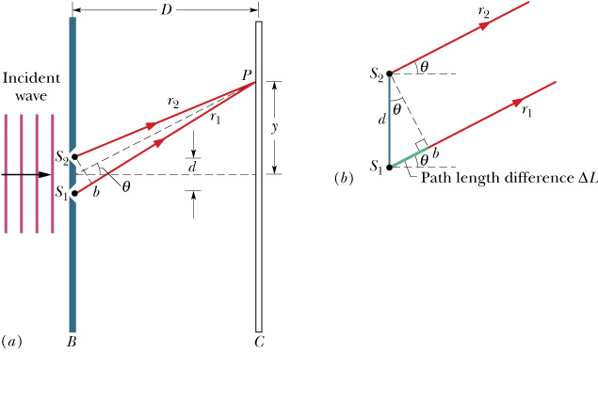
Intensity in Double-Slit Interference
E₂
E₁
35-

Slide 20
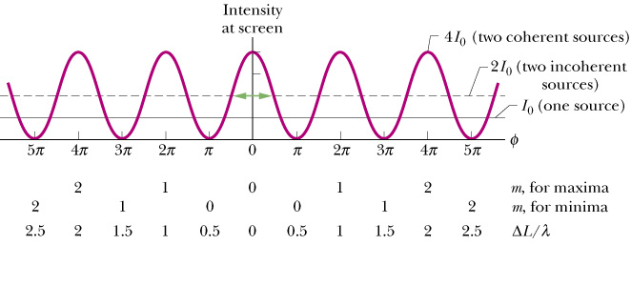
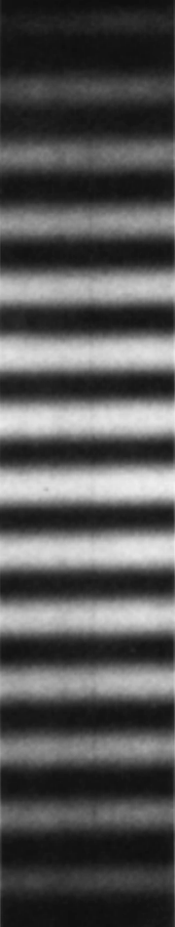
Intensity in Double-Slit Interference
Fig. 35-12
35-

Slide 21
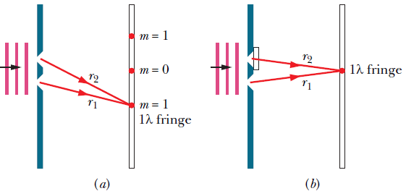

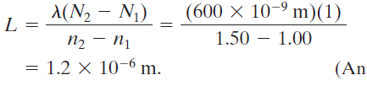
Ex.11-2 35-2
wavelength 600 nm
n₂=1.5 and
m = 1 → m = 0

Slide 22
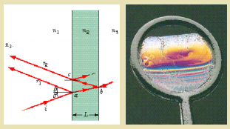
Interference form Thin Films
Notes:
․Interference from Thin Films - soap bubbles, morpho’s wing, peacock’s tail

Slide 23
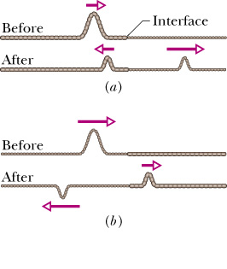
Reflection Phase Shifts
n₁ > n₂
n₁
n₂
Reflection Reflection Phase Shift
Off lower index 0
Off higher index 0.5 wavelength
n₁ < n₂
n₁
n₂
Fig. 35-16
35-

Slide 24
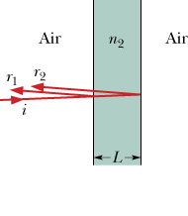
Phase Difference in Thin-Film Interference
Three effects can contribute to the phase difference between r₁ and r₂.
Differences in reflection conditions
Difference in path length traveled.
Differences in the media in which the waves travel. One must use the wavelength in each medium (λ / n), to calculate the phase.
Fig. 35-17
35-

Slide 25
Equations for Thin-Film Interference
½ wavelength phase difference to difference in reflection of r₁ and r₂
35-

Slide 26
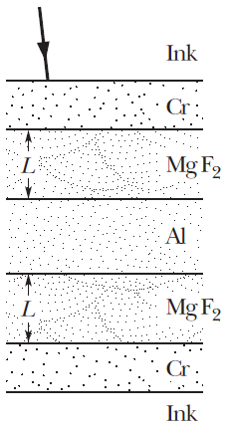
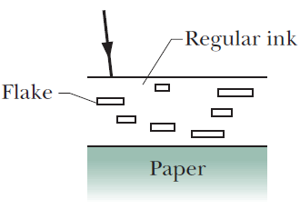
Color Shifting by Paper Currencies,paints and Morpho Butterflies
weak mirror
soap film
better mirror
looking directly down ： red or red-yellow
tilting ：green
35-
Notes:
For the same path difference, different wavelengths (colors) of light will interfere differently. For example,
2L could be an integer number of wavelengths for red light but a half integer wavelengths for blue.
Furthermore, the path difference 2L will change when light strikes the surface at different angles, again changing the interference condition for the different wavelengths of light.

Slide 27
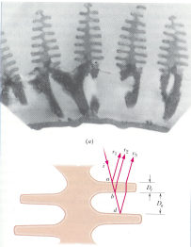
大藍魔爾蝴蝶
Notes:
Iridescence 彩虹色, 真珠光 terrace 階梯 cuticle角質層

Slide 28
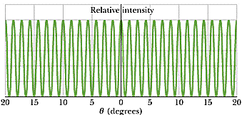
雙狹縫干涉之強度

Slide 29



Ex.11-3 35-3 water film
thickness 320 nm
n₂=1.33
m = 0, 1700 nm, infrared
m = 1, 567 nm, yellow-green
m = 2, 340 nm, ultraviolet

Slide 30
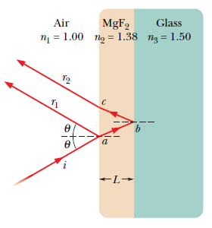
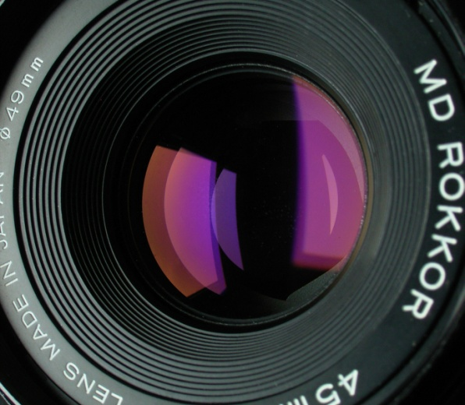



Ex.11-4 35-4 anti-reflection coating

Slide 31
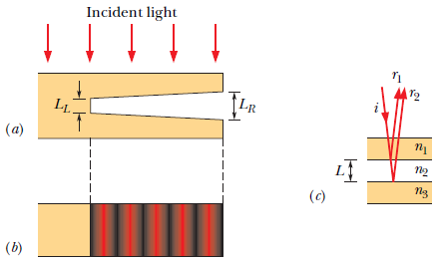




Ex.11-5 35-5 thin air wedge

Slide 32
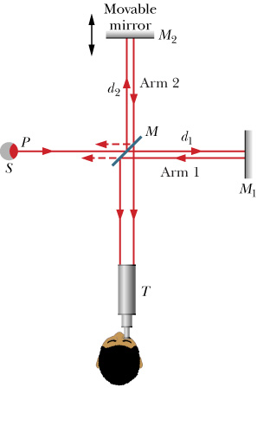
Michelson Interferometer
Fig. 35-23
35-

Slide 33
Determining Material thickness L
35-
Notes:
For each change in path by 1λ, the interference pattern shifts by one fringe at T. By counting the fringe change, one determines N_{m}- N_{a} and can then solve for L in terms of λ and n

Slide 34
11-3 Diffraction and the Wave Theory of Light
Diffraction Pattern from a single narrow slit.
Side or secondary
maxima
Light
Central
maximum
Fresnel Bright Spot.
These patterns cannot be explained using geometrical optics (Ch. 34)!
Light
Bright
spot
36-

Slide 35
The Fresnel Bright Spot (1819)
Newton
    corpuscle
Poisson
Fresnel
wave

Slide 36
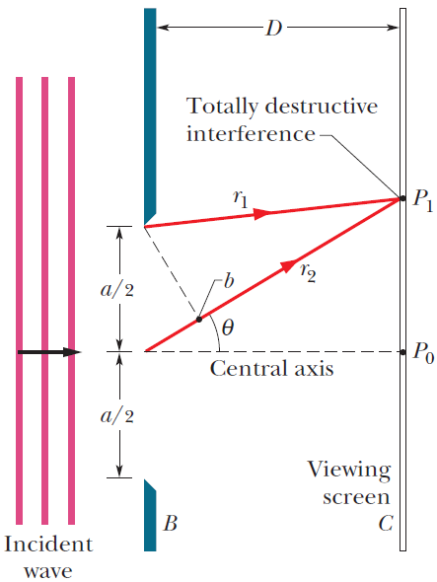
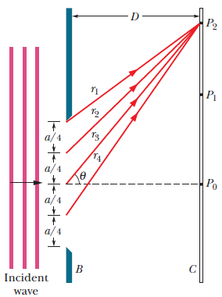
Diffraction by a single slit

Slide 37
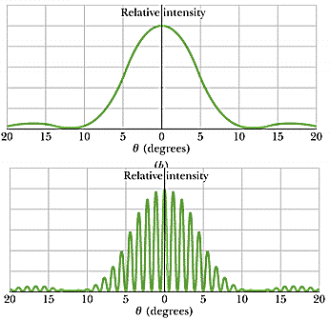
單狹縫繞射之強度

Slide 38
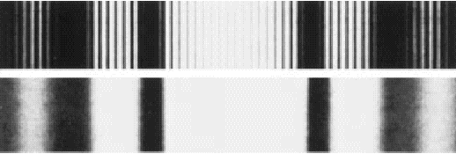
雙狹縫與單狹縫
Double-slit diffraction (with interference)
Single-slit diffraction

Slide 39
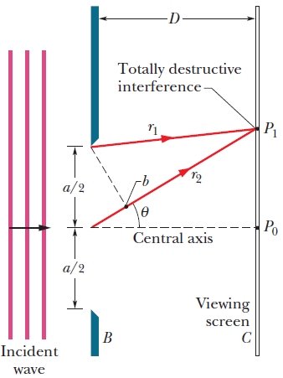
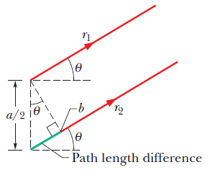
Diffraction by a Single Slit: Locating the first minimum
(first minimum)
36-

Slide 40
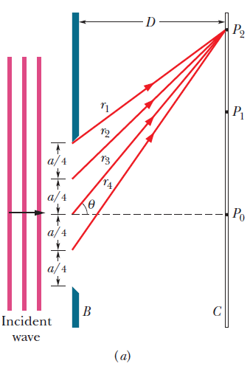
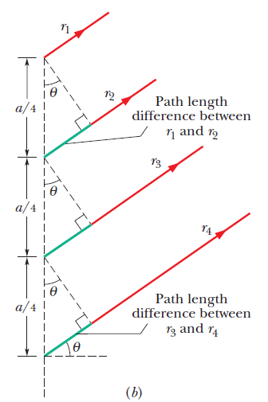
Diffraction by a Single Slit:
Locating the Minima
(second minimum)
(minima-dark fringes)
36-

Slide 41




Ex.11-6 36-1 thin air wedge

Slide 42
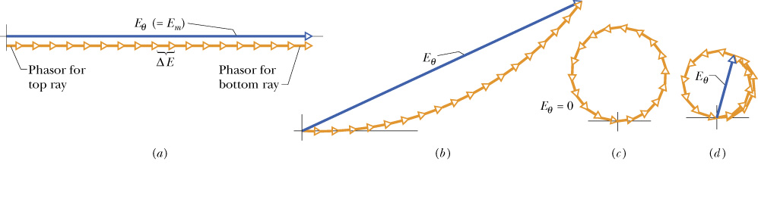
Intensity in Single-Slit Diffraction, Qualitatively
1st side
max.
N=18
θ = 0
θ small
1st min.
Fig. 36-7
36-
Notes:
To obtain the locations of the minima, the slit was equally divided into N zones, each with width Δx. Each zone acts as a source of Huygens wavelets. Now these zones can be superimposed at the screen to obtain the intensity as function of θ, the angle to the central axis.

Slide 43
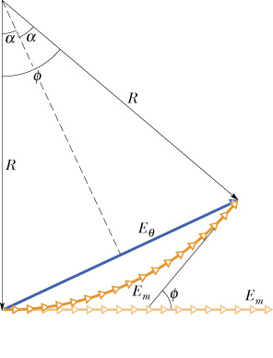

Intensity and path length difference
Fig. 36-9
36-
Notes:
If we divide slit into infinitesimally wide zones Δx, the arc of the phasors approaches the arc of a circle. The length of the arc is E_{m}. φ is the difference in phase between the infinitesimal vectors at the left and right ends of the arc. φ is also the angle between the 2 radii marked R.

Slide 44
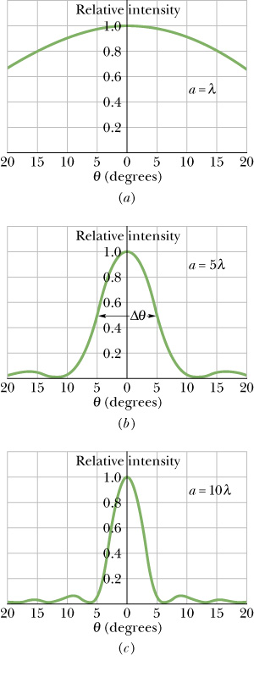
Intensity in Single-Slit Diffraction, Quantitatively
Here we will show that the intensity at the screen due to a single slit is:
In Eq. 36-5, minima occur when:
If we put this into Eq. 36-6 we find:
Fig. 36-8
36-

Slide 45
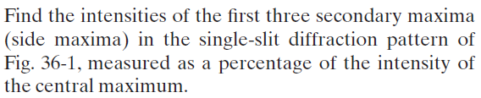

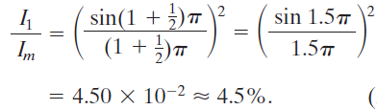

Ex.11-7 36-2

Slide 46
Diffraction by a Circular Aperture
Distant point
source, e,g., star
d
θ
Image is not a point, as expected from geometrical optics! Diffraction is responsible for this image pattern
lens
a
a
Light
Light
θ
θ
36-

Slide 47
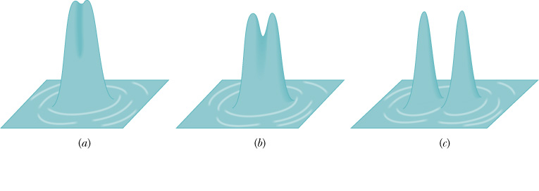
Resolvability
Rayleigh’s Criterion: two point sources are barely resolvable if their angular separation q_{R} results in the central maximum of the diffraction pattern of one source’s image is centered on the first minimum of the diffraction pattern of the other source’s image.
Fig. 36-11
36-

Slide 48
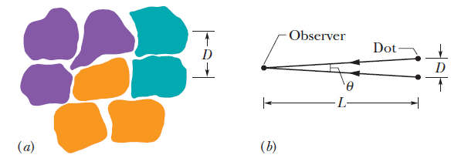




Ex.11-8 36-3
D = 2.0 mm
d = 1.5 mm

Slide 49
11-4.9 Diffraction – (繞射)

Slide 50
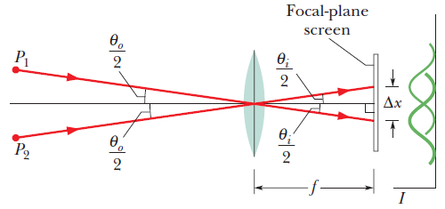

Ex.11-9 36-4
d = 32 mm
f = 24 cm
λ= 550 nm

Slide 51

Diffraction by a Double Slit
Single slit a~λ
Two vanishingly narrow slits a<<λ
Two Single slits a~λ
36-
Notes:
Double slit experiment described in Ch. 35 where assumed that the slit width a<<λ.

Slide 52



Ex.11-10 36-5
d = 32 mm
f = 24 cm
λ= 550 nm
Notes:
How many bright interference fringes are w ithin the central peak of the diffraction envelope?
(b) How many bright fringes are within either of the first side peaks of the diffraction envelope?

Slide 53



Diffraction Gratings
Fig. 36-18
Fig. 36-19
Fig. 36-20
36-
Notes:
Device with N slits (rulings) can be used to manipulate light, such as separate different wavelengths of light that are contained in a single beam. Double-slit interference can not be used because its fringes overlap too much.

Slide 54


Width of Lines
Fig. 36-21
Fig. 36-22
36-

Slide 55



Grating Spectroscope
Separates different wavelengths (colors) of light into distinct diffraction lines
Fig. 36-24
Fig. 36-23
36-
Notes:
Separates different wavelengths (colors) of light into distinct diffraction lines

Slide 56

Compact Disc
Notes:
2t is ½ of a wavelength, Grating used in tracking, pit 0.1 μm

Slide 57


Optically Variable Graphics
Fig. 36-27
36-
Notes:
Gratings embedded in device send out hundreds or even thousands of diffraction orders to produce virtual images that vary with viewing angle. Complicated to design and extremely difficult to counterfeit, so makes an excellent security graphic.

Slide 58
Gratings: Dispersion
Angular position of maxima
Differential of first equation (what change in angle does a change in wavelength produce?)
For small angles
36-
Notes:
Dispersion: the angular spreading of different wavelengths by a grating

Slide 59
Gratings: Resolving Power
Rayleigh's criterion for half-width to resolve two lines
Substituting for Δθ in calculation on previous slide
36-

Slide 60


Dispersion and Resolving Power Compared
36-

Slide 61

X-Ray Diffraction
X-rays are electromagnetic radiation with wavelength ~1 Å = 10⁻¹⁰ m (visible light ~5.5x10⁻⁷ m)
X-ray generation
X-ray wavelengths to short to be resolved by a standard optical grating
Fig. 36-29
36-

Slide 62

Diffraction of x-rays by crystal
d ~ 0.1 nm
→ three-dimensional diffraction grating
Fig. 36-30
36-

Slide 63


X-Ray Diffraction, cont’d
Fig. 36-31
36-

Slide 64

Structural Coloring by Diffraction

Slide 65


