Slide 1
10 Magnetism of Matter
How can a clay-walled kiln reveal Earth’s magnetic field of the past?
Notes:
磁鐵礦(0.3μm)和赤鐵礦(1mm)

Slide 2
Sections
  物質的磁性 Magnetism
  麥斯威爾方程式 Maxwell’s Equations
  電磁波 Electromagnetic Waves
  偏振 Polarization

Slide 3
The Magnetic field of the Earth
The earth’s dipole field
The mid-atlantic ridge
Notes:
Tectonic plates a few cm per year

Slide 4
10-1 Magnetic Materials
Diamagnetism (逆磁性)
Paramagnetism (順磁性)
Ferromagnetism (鐵磁性)

Slide 5
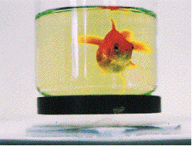
10-1.1 Diamagnetism
逆磁性材料產生之磁矩與外磁場逆向，如外磁場非均勻，其將受到由強磁場區到弱磁場區之斥力。

Slide 6
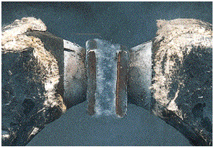
10-1.2 Paramagnetism
順磁性材料產生之磁矩與外磁場順向，如外磁場非均勻，其將受到由弱磁場區到強磁場區之吸力。
液態氧被吸在兩個磁極之間

Slide 7


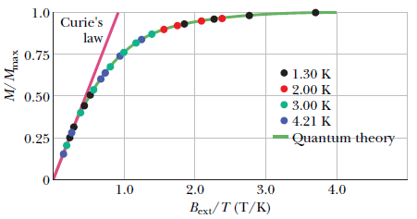
10-1.2.1 Curie’s Law
M：Magnetization
A magnetization curve for
potassium chromium sulfate

Slide 8
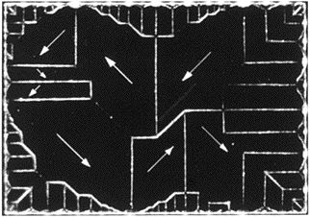
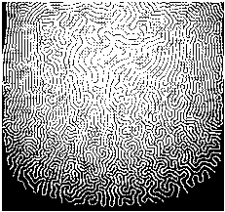
10-1.3 Ferromagnetism
鎳的磁域(magnetic domain)

Slide 9
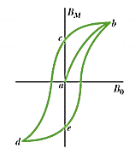
10-1.3.1 Hysteresis (磁滯)
殘餘磁通密度
Residual Flux Density
矯頑磁力
coercive force

Slide 10
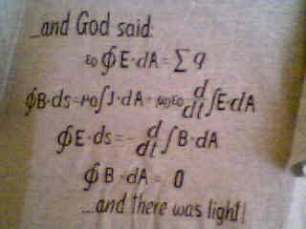
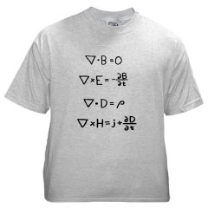
10-2 Maxwell’s Equations
Notes:
FIELD

Slide 11
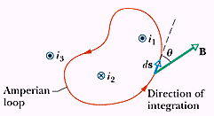
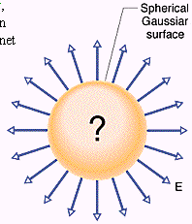
10-2.1 線積分與面積分
(安培迴路和高斯面)
磁場環流量 (安培定律) 電場通量
電場環流量 磁場通量
法拉第定律

Slide 12
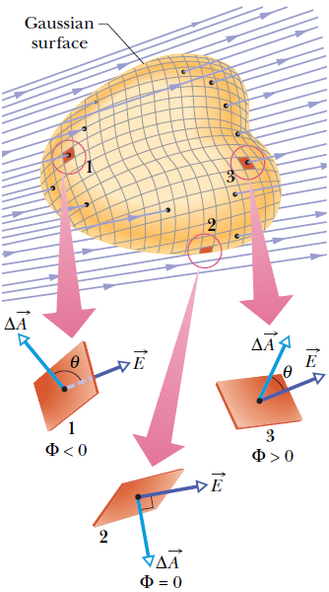
高斯面

Slide 13

10-2.2 Magnets and magnetic flux (磁鐵和磁通量)
Magnetic dipole: north/south pole

Slide 14
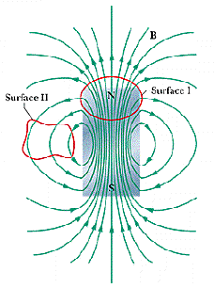
10-2.3 Gauss’ Law for
Magnetic Fields
The net magnetic flux thru any closed Gaussian surface is zero.

Slide 15
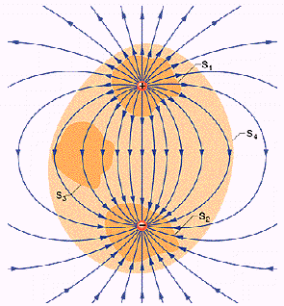
10-2.4 Gauss’ Law for electric Fields
Flux  enclosed charge

Slide 16
10-2.5 Induced Magnetic Fields
3 ways to produce a magnetic field:
by an electric current, by a magnetic
material, and by induction.

Slide 17
10-2.6 Ampere-Maxwell Law
induced B field
induced E field

Slide 18
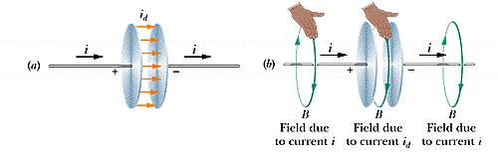
10-2.7 Displacement Current

Slide 19
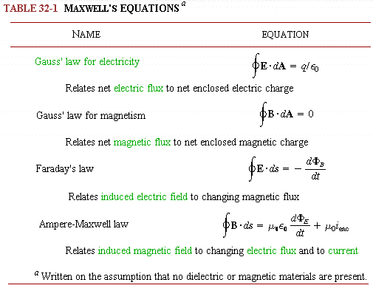
10-2.8 Maxwell’s Equations

Slide 20
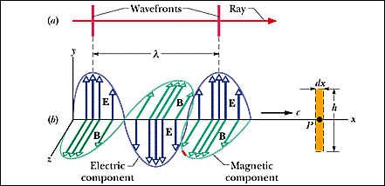
10-3 Electromagnetic Waves
The oscillating E and B Fields
A Most Curious Wave
–The ether (以太)

Slide 21
10-3.1 Characteristics
    Light  Electromagnetic Waves
    Hertz (赫茲)– Radio Waves
    The Electromagnetic Spectrum
    The Relative Sensitivity of Human eyes 430nm – 690nm

Slide 22
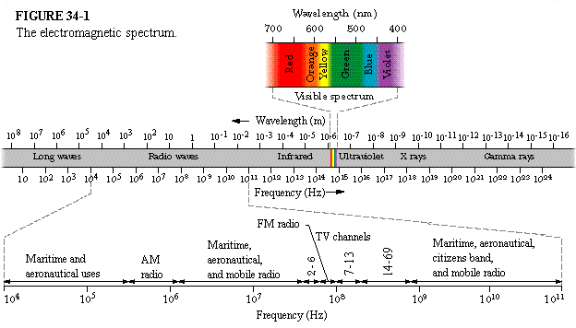
10-3.2 Maxwell’s Rainbow
Notes:
0.3-300GHz

Slide 23
10-3.3 Comets
What shapes the curved dust tail of a comet?

Slide 24
光壓
Notes:
dust particle b:balanced, c: larger (greater gravitation) , a: smaller (greater light pressure)
gravitationαR³ light pressureαR²

Slide 25
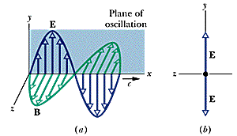
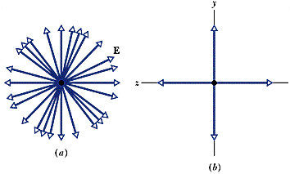
10-4 Polarization (偏振)
Polarized Light
The Plane of Polarization
Linear, Circular and Elliptical
polarization

Slide 26
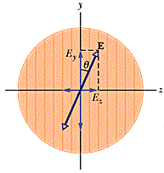
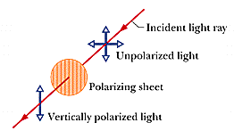
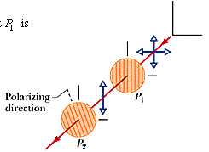
偏振片
Notes:
1932 polaroid Edwin Land

Slide 27
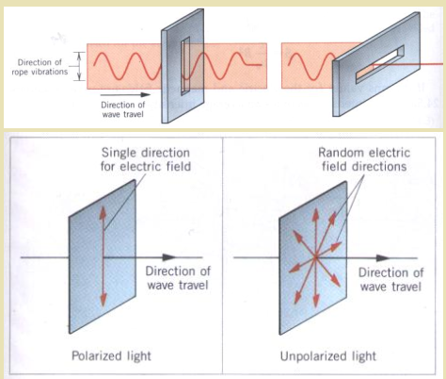
Polarization of Light

Slide 28
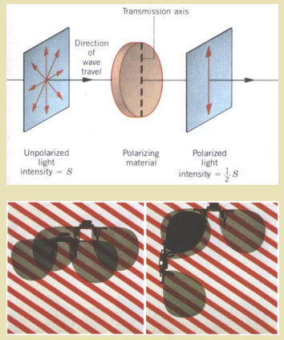
偏振與太陽眼鏡

Slide 29
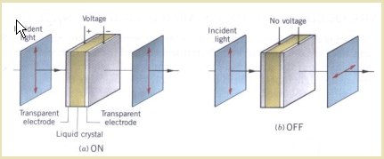
10-4.1 Liquid Crystal - I

Slide 30
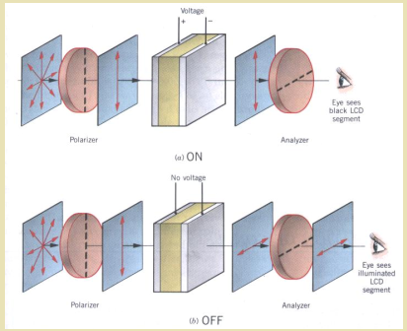
Liquid Crystal - II

Slide 31
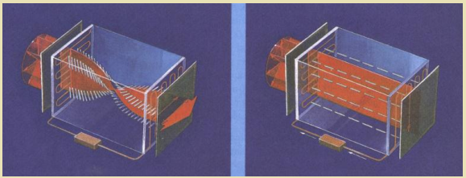
Liquid Crystal - III

Slide 32
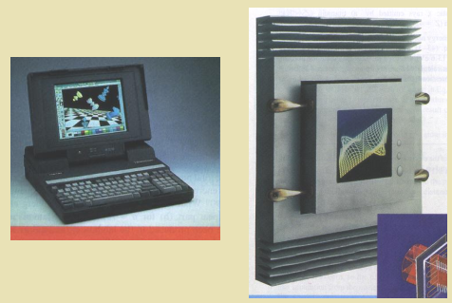
LCD –Liquid Crystal Display

Slide 33


