Slide 1
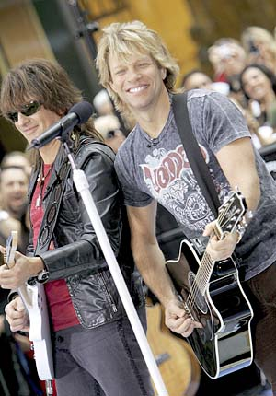
9 電磁感應
How did the electric guitar revolutionize rock?
From acoustic to electric guitars

Slide 2
9-1 Two symmetric Situations
  current loop + magnetic field → torque
  torque + magnetic field → current

Slide 3
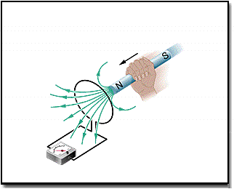
9-2 Two Experiments
First Experiment
A Magnet is moving with respect to the loop.

Slide 4
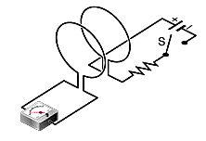
Second Experiment
The switch S is closed or opend.

Slide 5
9-3 Faraday’s Law of
Induction
Electromotive force
An emf is induced when the number of magnetic field lines that pass through the loop is changing.
– A Quantitative Treatment
– The magnetic flux

Slide 6
Faraday’s law
magnetic flux
emf
induced emf
induced electric field

Slide 7
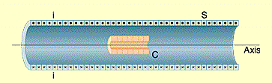
例1 A solenoid contains a coil
i =1.5 A n_{s} = 2.2×10⁴ turns / m
A = 3.46 ×10⁻⁴m² N_{c} = 130 turns
電流在25ms內穩定降至0

Slide 8
計算
i =1.5 A n = 2.2×10⁴ turns / m
A = 3.46 ×10⁻⁴m² N = 130 turns
電流在25ms內穩定降至0
e

Slide 9
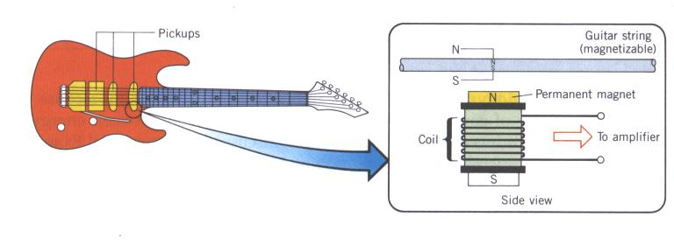
9-4 Lenz’s Law
感應電流所生的磁場與感應出該電流的磁場反向
Opposition to pole Movement
Opposition to flux change
Electric Guitars

Slide 10
例2 B = 4.0 t² +2.0 t + 3.0
Ebat = 2.0V r = 0.20m R = 2.0Ω
increasing
e
clockwise

Slide 11
例3 B = 4 t² x²
W = 3.0m H = 2.0m t = 0.1s
increasing
e
counterclockwise

Slide 12
9-5 Induction and Energy
Transfers
The work done by the applied force and the thermal energy produced in the wire.
e
e

Slide 13
The Power

Slide 14
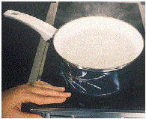
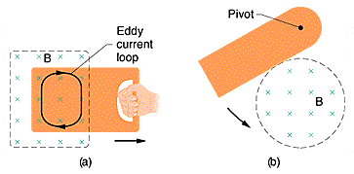
Eddy currents – induction stoves and EM braking

Slide 15
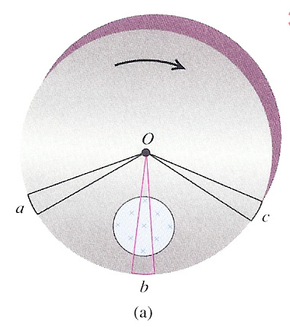
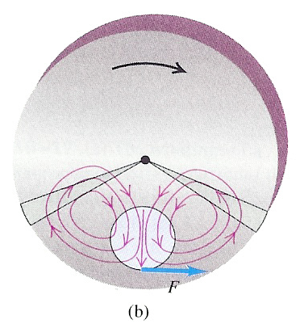
Eddy currents –EM braking

Slide 16
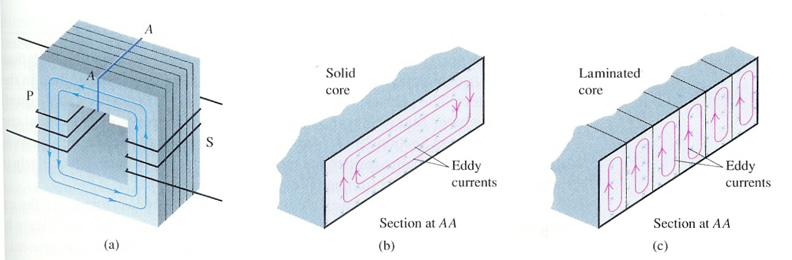
Eddy currents – transformers

Slide 17
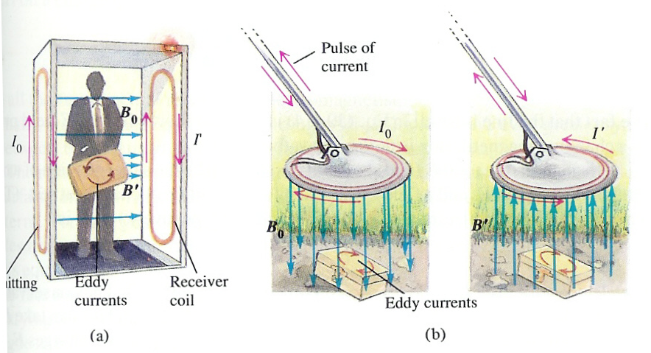
Eddy currents – metal detectors

Slide 18
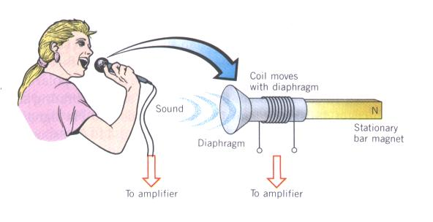
The microphone

Slide 19
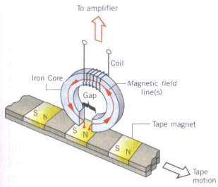
The tape recorder

Slide 20
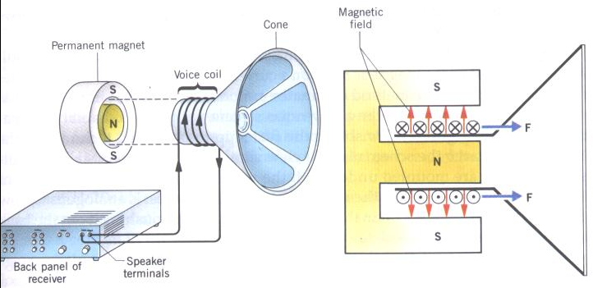
Speaker

Slide 21
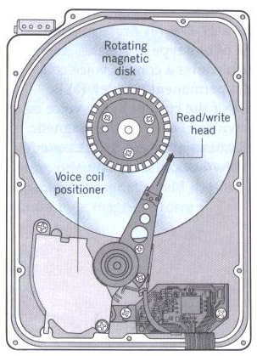
Voice-coil positioner of a HDD

Slide 22
9-6 Inductors and Inductance

Slide 23
Inductance of a solenoid:

Slide 24
Inductance of a toroid

Slide 25
9-7 Self-Induction
An induced emf appears in any coil in which the current is changing.

Slide 26
9-8 Mutual Induction

Slide 27
Two circular close-packed coils

Slide 28


