Slide 1
8 電流與磁場、安培定律 Magnetic Fields due to Currents
Conventional rocket EM Rail Gun
Notes:
2,800tonnes first stage fuel 2100 tonnes
Space shuttle 105 tonnes LH₂ and LO₂ 720 tonnes total 2010 tonnes
Acc from rest to 10 km/s within 1ms

Slide 2
8-1 Calculating the Magnetic Field due to a current
=
1
dq
dE
pe
2
4
r
0
v
1
dq
v
d
=
E
r
pe
3
4
r
0
m
ids
sin
q
dB
=
0
p
2
4
r
m
v
v
id

=
s
r
dB
0
p
3
4
r
The law of Biot and Savart

Slide 3
Magnetic Field Due to a Current in a Long Straight Wire

Slide 4
Integration

Slide 5
Magnetic Field Due to a Current in a Circular Arc of Wire

Slide 6
例 1 What B does the current produce?

Slide 7
8-2 Two Parallel Currents

Slide 8
例 2 The Field Between Two wires

Slide 9
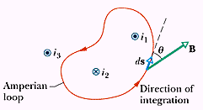
8-3 Ampere’s Law
Comparing Gauss’ law and Ampere’s law
Ampere’s law

Slide 10
The Magnetic Field Outside a Long Straight Wire with Current

Slide 11
The Magnetic Field Inside a Long Straight Wire with Current

Slide 12
例 3 A hollow conducting cylinder

Slide 13
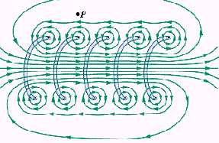
8-4 Solenoids and Toroids
Magnetic Field of a Solenoid (螺線管)
Magnetic Field of a Toroid (螺線環)

Slide 14
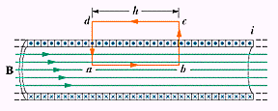
Magnetic Field of a Solenoid

Slide 15
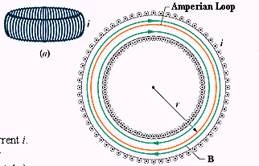
Magnetic Field of a Toroid

Slide 16
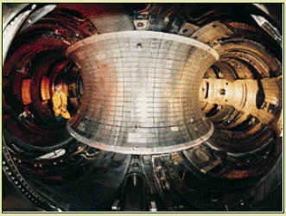
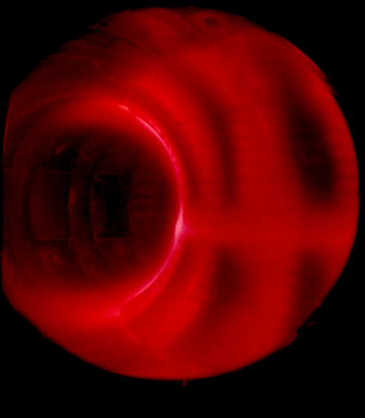
磁圍阻核融合反應器
Tokamak Fusion Test Reactor

Slide 17
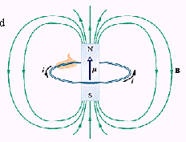
8-5 A Current Carrying Coil as a Magnetic Dipole
A current loop and a bar magnet

Slide 18
Magnetic Field of a Coil

Slide 19
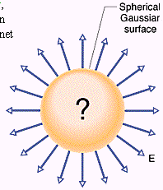
Coulomb’s Law
Using Gauss’s law to take advantage of special symmetry situations
Gaussian surfaces
高斯面上各點電場與面內總電荷相關

Slide 20
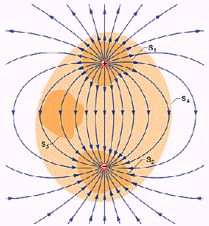
Gauss’ Law
Flux  enclosed charge

Slide 21
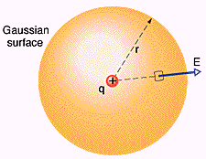
Gauss’Law and Coulomb’Law
From G.L. to C.L.

Slide 22
敬請期待 電磁 IV

