Slide 1

7 磁場
How is an aurora so thin yet so tall and wide?

Slide 2
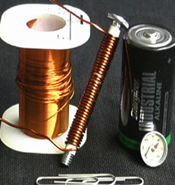
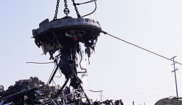

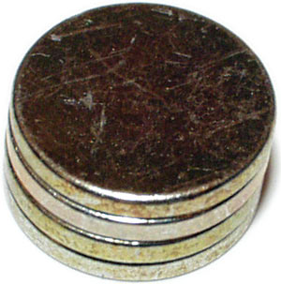
The magnetic field
  The electric field and the magnetic field
  Electromagnets and permanent magnets
Notes:
稀土族強磁元素Neodymium - 釹 (ㄋㄩ √)
The Manufacturers Rating (Magnetic Remanence (Br)) of the magnetic material is a property of the magnet when measured in the manufactures original magnetising equipment, in what's called a closed circuit. It indicates the magnetic field strength remaining inside the magnet and represents a grade of magnetic material (N48 ~ 13,800 gauss; N45 ~ 13,300 gauss and N40 ~ 13,000 gauss).
Neodymium magnets are graded by the magnetic material they are made from. In general, the higher the grade of material, the stronger the magnet. Neodymium magnets currently range in commercial grades from N27 to N54. The theoretical limit for Neodymium magnets is grade N64. The grade of most of our stock magnets is N48.
The grade of a magnet directly refers to the Maximum Energy Product of the material that composes the magnet. It in no way refers to the physical properties of the magnet. Simplistically, grade is generally used to describe how "strong" a permanent magnet material is. The energy product is specified in the units Gauss Oersted. One MGOe is 1,000,000 Gauss Oersted. A grade forty (N40) would have a Maximum Energy Product of 40 MGOe. The higher the grade the "stronger" the magnet

Slide 3
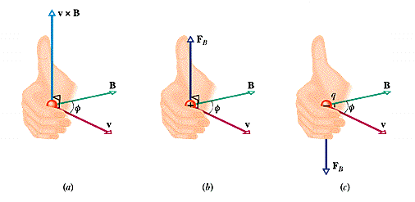
7-1 The definition of B
Notes:
PET shows computer reconstructed transversal sections of the brain, showing in vivid color the level of metabolic activity of neurons. This is achieved by injecting radioactivity-marked glucose molecules into the patient's blood flow and seeing how much of it is incorporated into living brain cells. The more active the cells are (when they are processing information, for example), more intense will be the image at that point

Slide 4
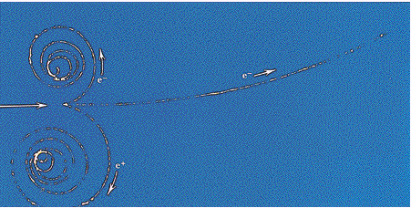
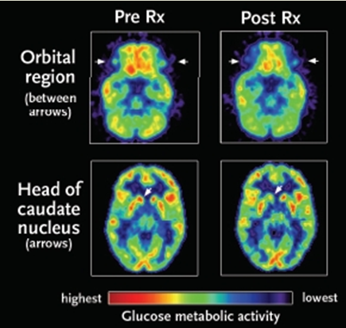
The tracks in a bubble chamber
Notes:
A gamma ray transforms into an electron and a positron while it knocks an e out of a hydrogen atom
Positron emitted-isotopes (C,N,O)
P annihilates with e, emits 2 gamma
Glucose usage in brain, schizophrenics（精神分裂症）
http://www.the-scientist.com/article/display/15121/

Slide 5
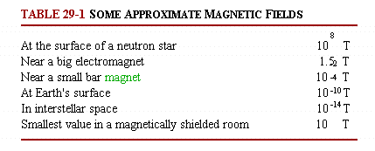
The SI unit for B
1 tesla = 1T =1 N/A‧m=10⁴ gauss
10⁸ T
1.5 T
10⁻² T
10⁻⁴ T
10⁻¹⁰ T
10⁻¹⁴ T
Notes:
bubble chambe
Typical pressures and temperatures in a liquid hydrogen bubble chamber were six atmospheres and -246 °C (only 27 °C above absolute zero but still above the normal boiling point of hydrogen). Pressure kept the liquid in its superheated state until particles entered the chamber and it was momentarily released to allow the vapor bubbles to grow. The great advantage of liquid hydrogen over all other liquids is that it contains only protons and electrons, making it possible to study the fundamental interactions between
http://www.daviddarling.info/encyclopedia/B/bubble_chamber.html

Slide 6
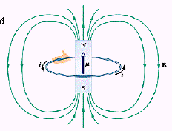
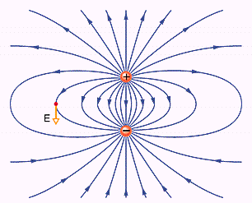
Magnetic Field Lines
Magnetic vs. electric dipoles

Slide 7
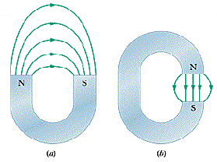
A horseshoe and a C-shaped magnets

Slide 8
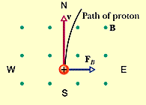
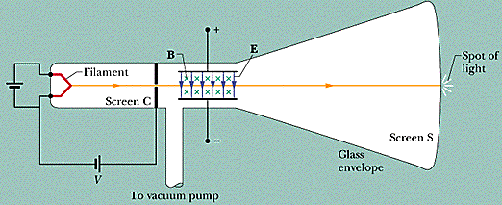
例 1 A 5.3 MeV proton
B = 1.2 mT
Notes:
938 MeV
The rest mass energy of an electron is 0.511 MeV

Slide 9
7-2 Crossed Fields:
Discovery of the Electron
A cathode ray tube
Thomson’s procedure:
  設定E = 0, B = 0, 並記錄光點位置
  開啟電場
  開啟磁場,並調至與電場相等
Notes:
1897 by JJ Thomson at Cambridge

Slide 10
Calculation
the charge-to-mass ratio of the electron
1.7588196×10¹¹ C·kg⁻¹

Slide 11
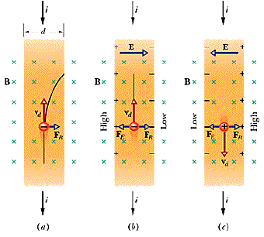
7-3 Crossed Fields: The Hall Effect
By the conduction electrons in copper:
Notes:
1879 by Hall (24) John Hopkins
In 1880, Hall's experimentation was published as a doctoral thesis in the American Journal of Science and in the Philosophical Magazine.
It was only in 1980 that Klaus von Klitzing, working with samples developed by Michael Pepper and Gerhard Dorda, made the unexpected discovery that the Hall conductivity was exactly quantized. For this finding, von Klitzing was awarded the 1985 Nobel Prize in Physics.
Robert B. Laughlin, a longtime Laboratory employee and a professor of physics at Stanford University, received the 1998 Nobel Prize for physics. Laughlin shared the prize with Horst Stormer of Columbia University and Daniel Tsui of Princeton University.

Slide 12
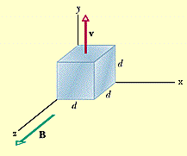
例 2 A cube generator
d = 1.5 cm, v = 4.0m/s, B = 0.05T
Notes:
Electrons shifted to the left, making the left side at lower potential

Slide 13
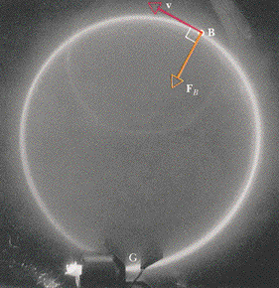
7-4 A Circulating Charged Particle
Notes:
B out of the page

Slide 14

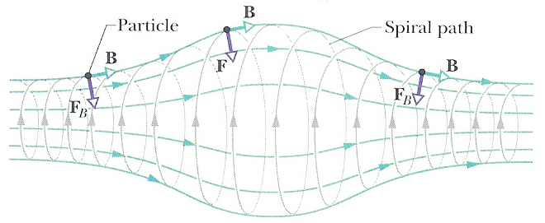
頻率與軌跡
The frequency and angular frequency
The magnetic bottle machine

Slide 15
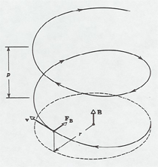
Helical Paths
V∥ and V⊥
The pitch (螺距) of the helical path

Slide 16
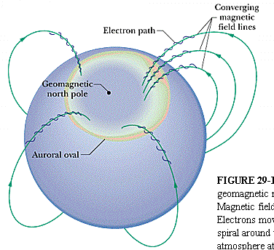
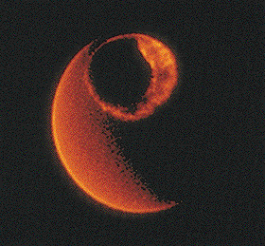
極光橢圓圈
Notes:
Pink by N, green by O

Slide 17
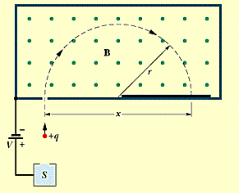
例 3 The Mass Spectrometer (質譜儀)

Slide 18
質譜儀
x = 1.6254m, V = 1000.0V, B = 80.000mT
Isotope Separation
Centrifuge and diffusion chamber

Slide 19
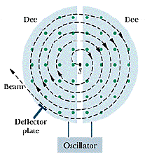
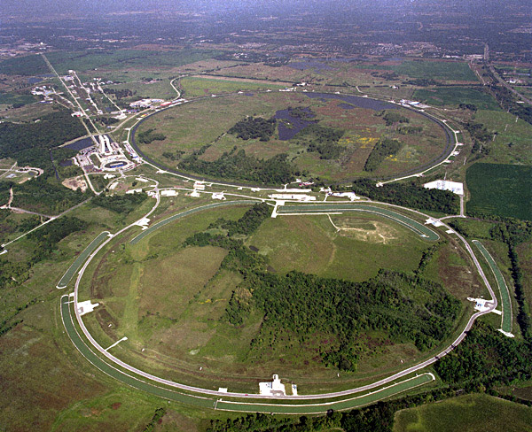
7-5 Cyclotrons and
Synchrotrons
(迴旋加速器與同步加速器)
Fermilab: 6.3km ring
Notes:
Main Injector(lower circle) and Tevatron Collider
LHC 27km ring (circumference)

Slide 20
Synchrotrons
The resonance condition:
When proton energy > 50Mev:
  Out of resonance (relativistic effect)
  A huge magnet (4×10⁶ m²) is needed for high energy (500Gev) protons
The proton sychrotron at Fermilab can produces 1Tev proton

Slide 21
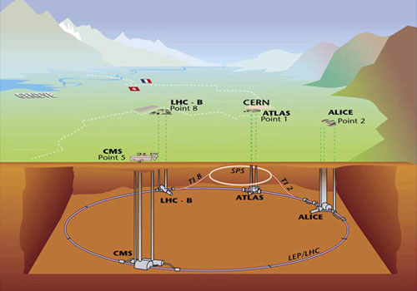
CERN LHC
The LHC is 27km long and sits 100m below the surface.
Notes:
Geneva / France
Hadrons are divided into two classes:
Baryons, strongly interacting fermions such as a neutron or a proton, made up of three quarks.
Mesons, strongly interacting bosons such as pions and kaons consisting of a quark and an antiquark.

Slide 22
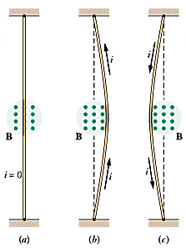
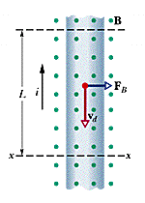
7-6 Magnetic Force on a Current-Carrying Wire

Slide 23
Magnetic Force
For a wire segment:

Slide 24
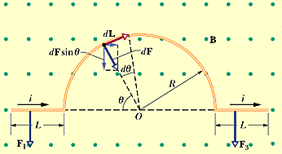
例 4 A length of wire with a semicircular arc

Slide 25
Calculation

Slide 26
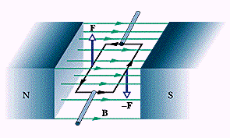
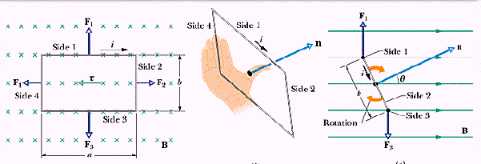
線圈

Slide 27
7-7 Torque on A Current Loop
F₂ and F₄ cancel
F₁ and F₃ form a force couple

Slide 28
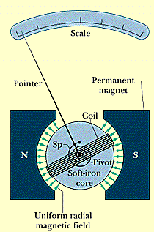
例 5 A galvanometer for analog meters

Slide 29
7-8 The Magnetic Dipole
The magnetic dipole moments
The magnetic potential energy

Slide 30
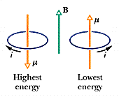
磁能

Slide 31
敬請期待
電磁 IV

