Slide 1
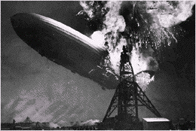
6 電流、電阻與電路
The Hindenburg disaster

Slide 2
Outline
電流、電流密度與漂移速度
電阻與電阻率
歐姆定律
半導體與超導體
電路

Slide 3
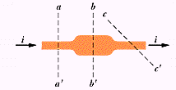
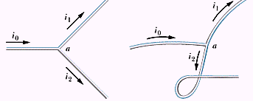
6-1 電流
電荷守恆
克希荷夫電流(節點)定理

Slide 4
電流密度
J: A/m²

Slide 5
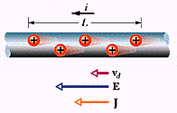
電流密度與漂移速度

Slide 6
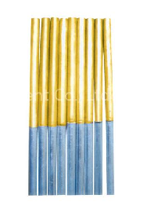
銅的漂移速度
d_{Al}=2.5mm, d_{cu}=1.8mm
i=17mA, ρ=9×10³kg/m³,M=64×10⁻³kg/m³

Slide 7
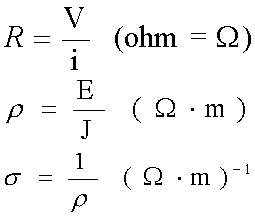
6-2 電阻與電阻率
Resistance
Resistivity
Conductivity

Slide 8
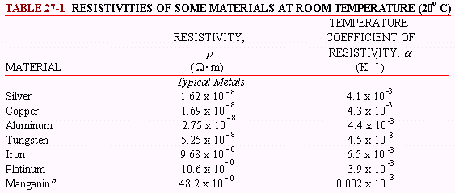
電阻率
Notes:
a 銅為主的合金,包含了12%的錳和4%的鎳 ammeter shunts the legal standard for the ohm
b [磷] doped to 10²³ c [鋁] 10²³ as an electrical conductor in cryogenic systems

Slide 9
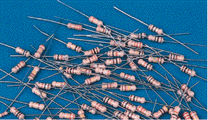
電阻的計算
Notes:
Bad Boys Ravish Only Young Girls But Violet Gives Willingly

Slide 10
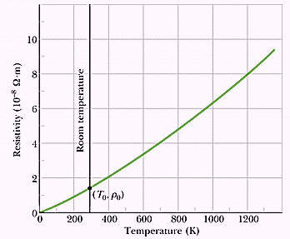
溫度效應
Notes:
293K-1.69x10⁻⁸

Slide 11
The effect of temperature

Slide 12
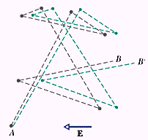
電阻的微觀意義

Slide 13
6-3 Ohm’s Law
流過一電路元件之電流與該元件之電位差成正比
電阻率與電場的大小及方向無關

Slide 14
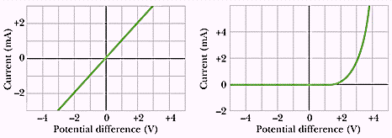
I-V curves
conductor
pn junction diode

Slide 15
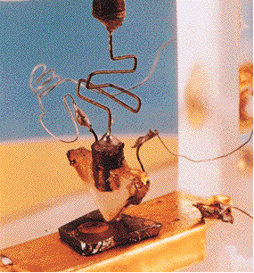
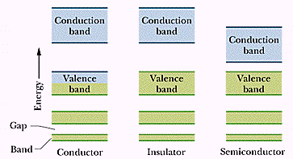
6-4 Semiconductors
半導體

Slide 16
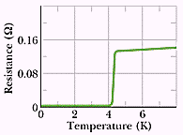
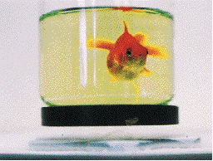
Superconductors
超導體
Notes:
1911

Slide 17
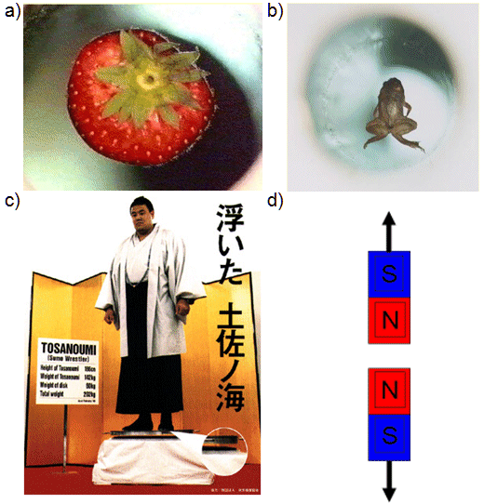
More Maglev - magnetic levitation
http://web.mit.edu/physics/hudson/ResearchBackground.htm

Slide 18
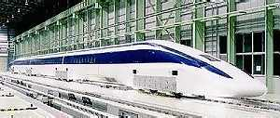
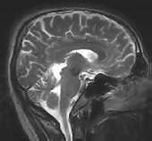
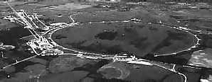
Maglev、MRI and Tevatron
Notes:
1. The new test line called the Yamanashi Maglev Test Line opened on April 3, 1997
On April 14, 1999, this five-car train set surpassed the speed record of the three-car train set, attaining a maximum speed of 552 km/h in a manned vehicle run.
On December 2, 2003, a three-car train set (JR-Maglev MLX01) attained a maximum speed of 581 km/h (361 mph) in a manned vehicle run.
2. Fermilab: 6.5 kM 1 TeV

Slide 19
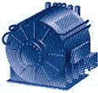
Power line and motor
Notes:
1. In May of 2001 some 150,000 residents of Copenhagen, Denmark, began receiving their electricity through HTS (high-temperature superconducting) material. That cable was only 30 meters long, but proved adequate for testing purposes. In the summer of 2001 Pirelli completed installation of three 400-foot HTS cables for Detroit Edison at the Frisbie Substation capable of delivering 100 million watts of power.
2. 5000 horse-power motor

Slide 20
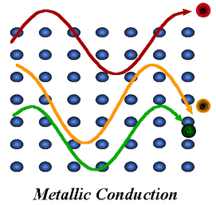
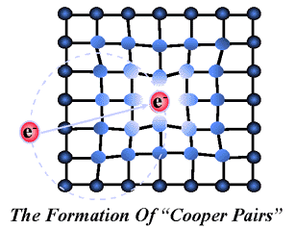
BCS Theory - The Cooper pairs
Notes:
the Nobel Prize in 1972
BCS theory predicted a theoretical maximum to Tc of around 30-40K

Slide 21
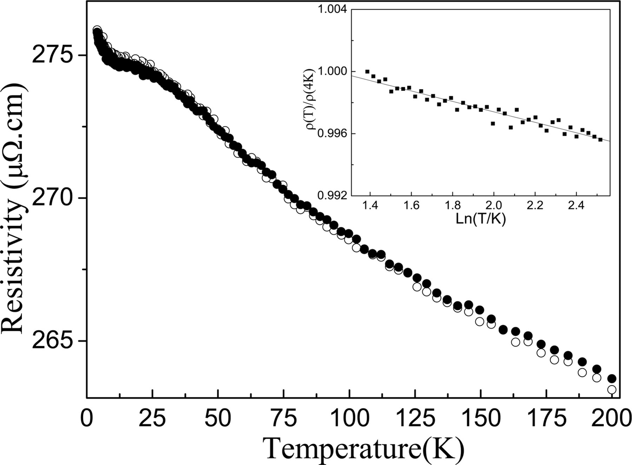
Negative Temperature Coefficient of Resistivity
http://www.pnas.org/content/104/34/13565/F5.expansion

Slide 22
6-5 電路
6-5.1 直流電路
6-5.2 串聯電阻
6-5.3 並聯電阻
6-5.4 交流電路
6-5.5 虛擬電路實驗

Slide 23
6-5.1直流電路
Direct Current Circuit
A bimetallic strip flasher
以電阻電熱絲加熱bimetallic strip，約一秒啟閉一次，可用作警示裝置。

Slide 24
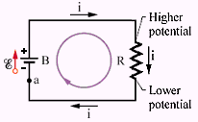
Ex.8 簡單直流電路內之電位（電壓）升降
克希荷夫 Kirchhoff 迴路定理

Slide 25
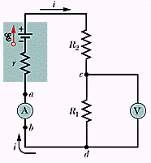
Ex.9 The Ammeter and the Voltmeter

Slide 26
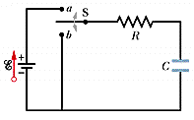
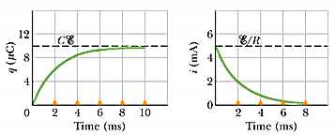
Ex.10 RC電路
電阻－電容電路

Slide 27
Ex.10 (cont) Charging a Capacitor

Slide 28
Ex.10 (cont)

Slide 29
Ex.10 (cont)

Slide 30
Ex.10 (cont)
如果 R = 10MΩ C = 1μF
經過46s後，e= 0.01，充電達99﹪
可用作間歇式雨刷等電路控制。

Slide 31
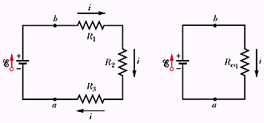
6-5.2 Resistance in series

Slide 32
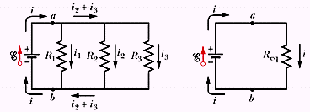
6-5.3 Resistors in parallel

Slide 33
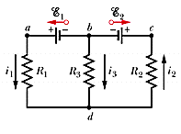
Multiloop Circuits
The Junction rule: 流入接點之電流必等於流出者
(Kirchhoff’s junction/current rule)

Slide 34
解System of equations (聯立方程組)

Slide 35
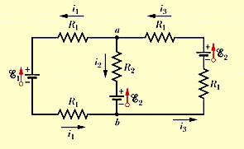
Ex.11 What are the currents?

Slide 36
解聯立方程組
pivot equation

Slide 37
高斯消去法
pivot equation
upper triangle
Forward Elimination and Back substitution

Slide 38
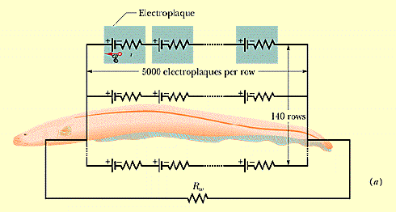
Ex.12 The electric eel
Notes:
Electroplaque 0.15V 0.25Ω電斑

Slide 39
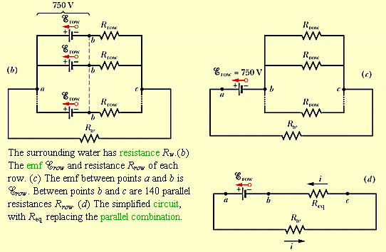
The Equivalent circuit

Slide 40
The current
0.15V
0.25V
R_{w}=800Ω

Slide 41
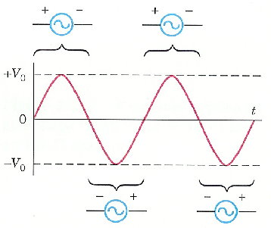
6-5.4交流電路
Alternating Current Circuit
V( t ) = V₀Sin2πf t
f 頻率 = 60H（赫）
V₀ 尖峰值，
一般家庭約170V

Slide 42
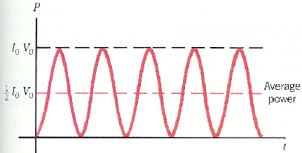
功率
P（t）= I₀V₀Sin² 2π f t，取時間平均值
對交流電而言，歐姆定律變成

Slide 43
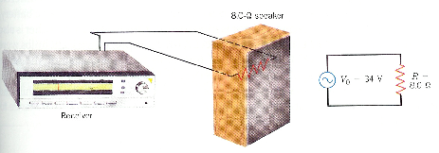
Ex.13 72W 音箱

Slide 44
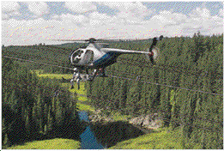
Ex.14 A practical example Quebec →Montreal

Slide 45
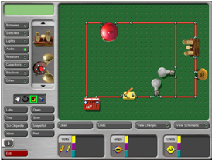
6-5.5虛擬電路實驗

