Slide 1
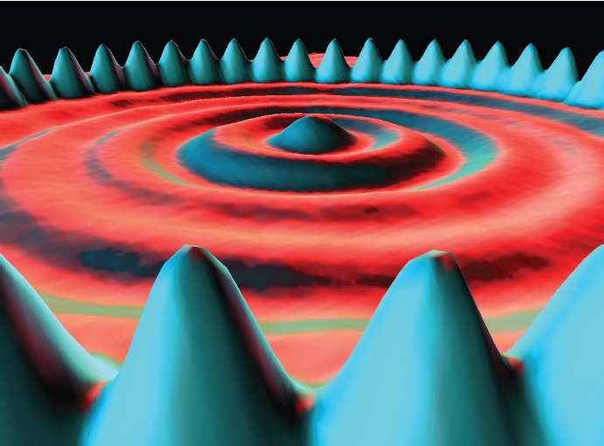
12 量子物理

Slide 2
Sections
  Photon and Matter Waves
  Compton Effect
  Light as a Probability Wave
  Electrons and Matter Waves
  Schrodinger’s Equation
  Waves on Strings and Matter Waves
  Trapping an Electron
  Three Electron Traps
  The Hydrogen Atom

Slide 3
12-1.1 Photon and Matter Waves (光子和物質波)
Light Waves and Photons

Slide 4
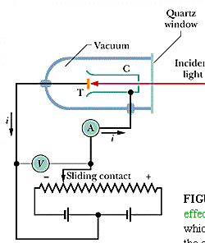
The Photoelectric Effect
光電效應

Slide 5
The experiment
First Experiment (adjusting V)–
the stopping potential V_{stop}
Second Experiment (adjusting f)–
the cutoff frequency f₀
光電子的最大動能與光強度無關
低於截止頻率時即使光再強也不會有光電效應

Slide 6
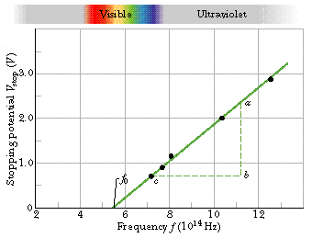
The plot of V_{stop} against f

Slide 7
The Photoelectric Equation
Work function

Slide 8
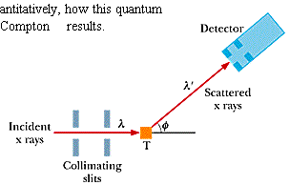
12-1.2 Compton Effect

Slide 9
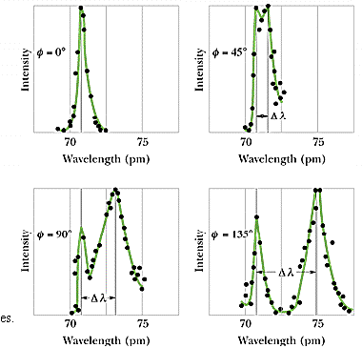
康普吞效應實驗圖表
Notes:
The loose end: the peak at the incident wavelength is due to the tightly bound electrons.

Slide 10
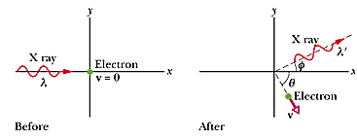
康普吞效應圖示

Slide 11
Energy and momentum conservation

Slide 12
Frequency shift
Compton wavelength

Slide 13
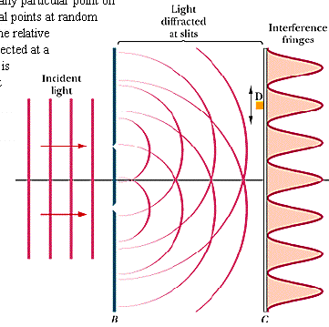
12-1.3 Light as a Probability Wave
The standard version

Slide 14
The Single-Photon Version
First by Taylor in 1909
The single-photon, double-slit experiment is a phenomenon which is impossible, absolutely impossible to explain in any classical way, and which has in it the heart of quantum mechanics - Richard Feynman
Notes:
Several months for Taylor’s experiment

Slide 15
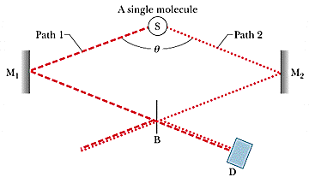
The Single-Photon, Wide-Angle Version (1992)
Notes:
Journal of the Optical Society of America B (U. of New Mexico)

Slide 16
The postulate
Light is generated in the source as photons
Light is absorbed in the detector as photons
Light travels between source and detector as a probability wave

Slide 17
12-1.4 Electrons and
Matter Waves
The de Broglie wave length
Experimental verification in 1927
Iodine molecule beam in 1994
Notes:
Iodine 500,000 times more massive than electrons

Slide 18
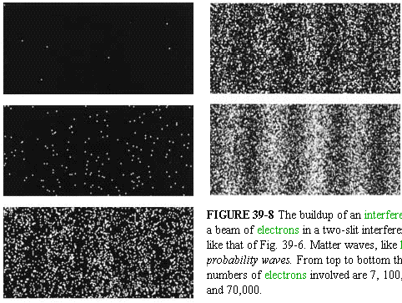
1989 double-slit experiment
7,100,3000, 20,000 and 70,000 electrons

Slide 19
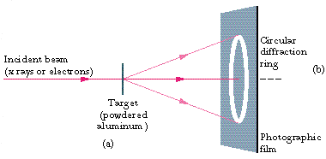
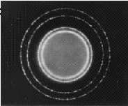
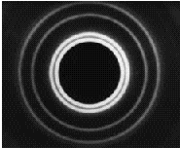
Experimental Verifications
Electron beam
X-ray
Notes:
1927/1989/1994

Slide 20
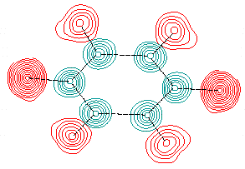
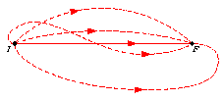
苯環的中子繞射

Slide 21
12-1.5 Schrodinger’s
Equation
Matter waves and the wave function
The probability (per unit time) is ∝
Complex conjugate
共軛複數

Slide 22
The Schrodinger Equation from A Simple Wave Function

Slide 23
1D Time-independent SE

Slide 24
3D Time-dependent SE

Slide 25

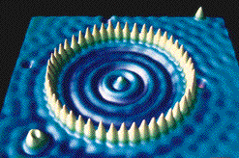
12-1.6 Waves on Strings and Matter Waves
Notes:
1993 IBM’s Almaden Research Center in California

Slide 26
駐波與量子化 Quantization
駐波：
Confinement of a Wave leads to Quantization – discrete states and discrete energies

Slide 27
12-1.7 Trapping an Electron
For a string：

Slide 28

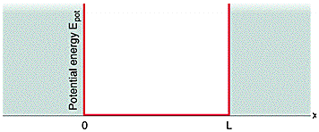
Finding the Quantized Energies of an infinitely deep potential energy well

Slide 29
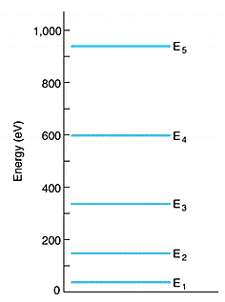
The Energy Levels 能階
The ground state and excited states
The Zero-Point Energy
n can’t be 0
Notes:
n = 0 implies no wave function or no electron

Slide 30
The Wave Function and Probability Density
For a string

Slide 31
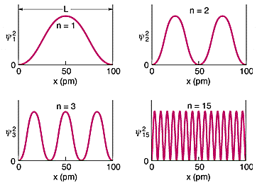
The Probability Density

Slide 32
Correspondence principle
(對應原理)
At large enough quantum numbers, the predictions of quantum mechanics merge smoothly with those of classical physics
Normalization (歸一化)

Slide 33
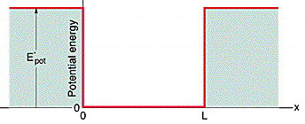
A Finite Well 有限位能井

Slide 34
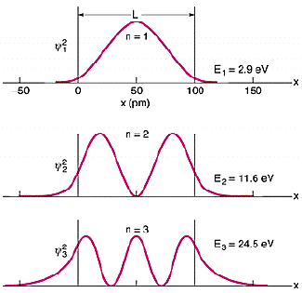
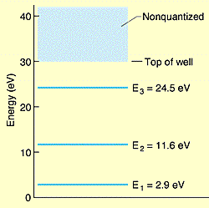
The probability densities and energy levels
Notes:
The three states are the only states allowed for qith E <the well depth

Slide 35
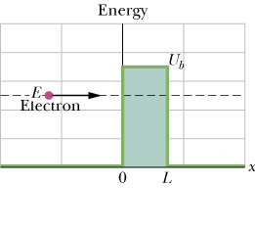
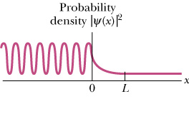
Barrier Tunneling
穿隧效應

Slide 36
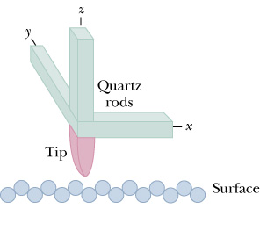
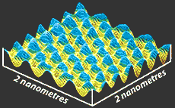
STM 掃描式穿隧顯微鏡
Piezoelectricity
of quartz
Notes:
所謂壓電效應有兩種：正壓電效應(direct piezoelectric effect)及逆壓電效應(converse piezoelectric effect)。當壓電體受到電場作用時，電偶極矩會被拉長，壓電體會沿電場方向伸長，此即將電能轉換為機械能。反之，對壓電體施加壓力，則體內之電偶極矩會隨材質之壓縮而變短，此時壓電體內為扺抗此種趨勢，將產生電壓以保持原狀態。壓電材料的特點在於其可當作感測器，亦可當作致動器。

Slide 37
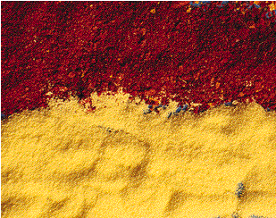
12-1.8 Three Electron Traps
Nanocrystallites 硒化鎘奈米晶粒
那種顏色的顆粒比較小

Slide 38
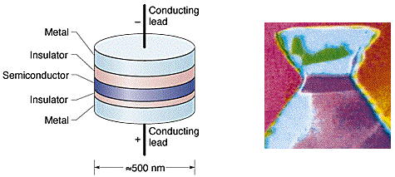
A Quantum Dot
An Artificial Atom
The number of electrons can be controlled

Slide 39
Quantum Corral
量子圍欄
Notes:
48 iron atoms (14 nm diameter) on copper surface

Slide 40
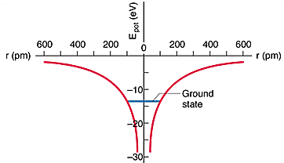
12-1.9 The Hydrogen Atom
The Energies

Slide 41
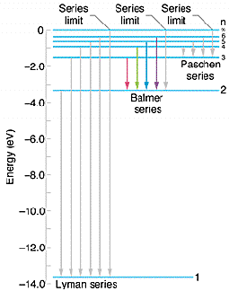
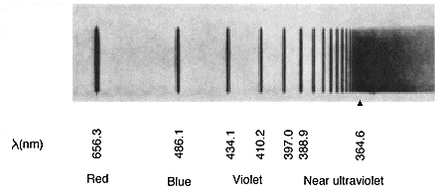
氫原子能階與光譜線

Slide 42
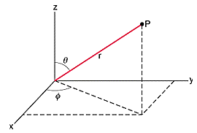
Bohr’s Theory of the Hydrogen Atom

Slide 43
The Ground State Wave Function

Slide 44
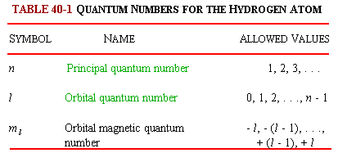
Quantum Numbers for the Hydrogen Atom

Slide 45
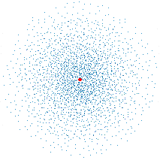
The Ground State Dot Plot

Slide 46
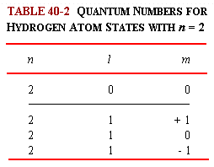
氫原子的量子數

Slide 47
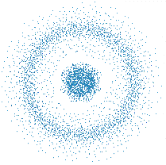
N=2, l=0, m_{l}=0

Slide 48
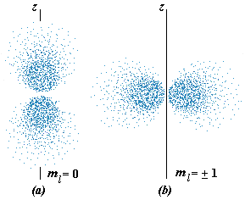
N=2, l=1

Slide 49




