Slide 1
7.6 引擎與致冷機
熱與功
引擎的效率 沒有完美的引擎
致冷機的效能係數 沒有完美的致冷機
絕熱Adiabatic Process
等溫Isothermal Process
定壓Isobaric process
定容Isochoric process

Slide 2
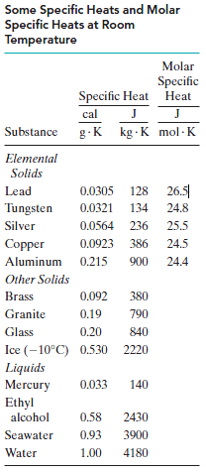
熱(heat)
The absorption of heat by solids and liquids
Heat capacity
Specific heat

Slide 3
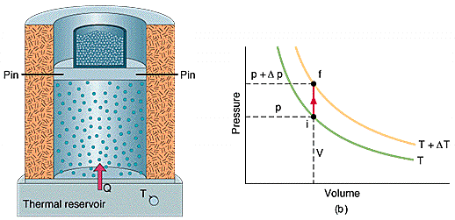
Molar specific heat at constant volume C_{V}

Slide 4
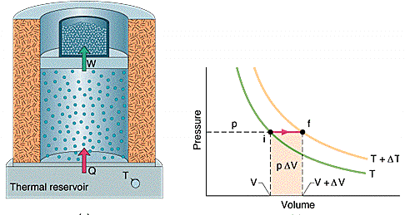
Molar specific heat at constant pressure C_{P}

Slide 5
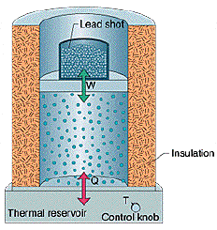
功(work)
理想氣體進行等溫
程序所作的功
理想氣體的狀態方程式
Notes:
Work Done by an ideal gas at constant temperature

Slide 6
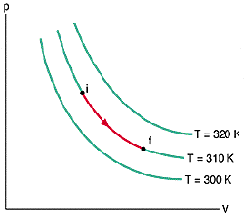
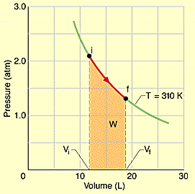
程序與等溫線
Process and Isotherms

Slide 7
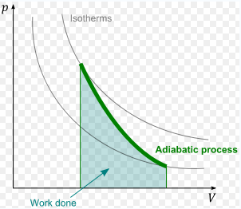
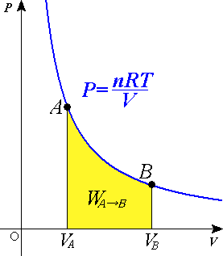
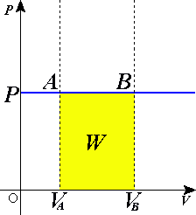
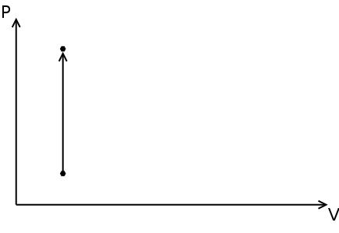
Process
絕熱Adiabatic Process
等溫Isothermal Process
定壓Isobaric process
定容Isochoric process

Slide 8
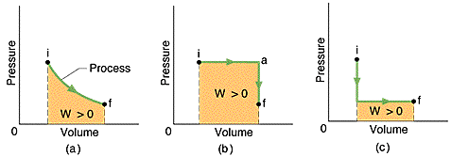
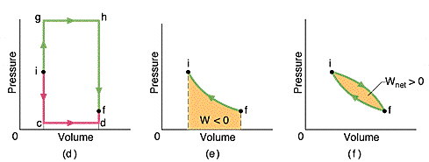
其他程序

Slide 9

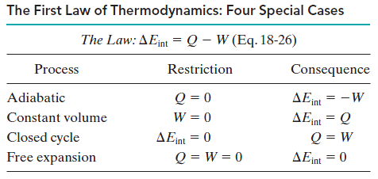
The First Law of Thermodynamics

Slide 10
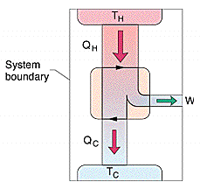
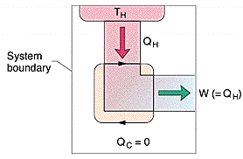
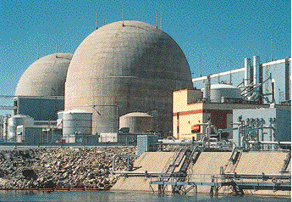
引擎
Notes:
美國維吉尼亞州的North Anna核電廠
核三發電容量 1900MW
核四發電容量 2700MW

Slide 11
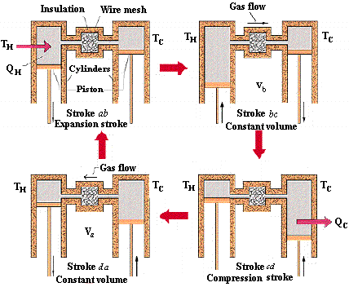
The Stirling Engine

Slide 12
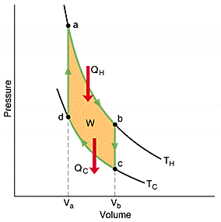
The PV diagram
An isothermal expansion (ab)
A constant-volume process (bc)
An isothermal compression (cd)
A constant-volume process (da)
efficiency

Slide 13
引擎的效率
efficiency η = =
一般摩托車之效率22﹪，所做功為2510 J，則廢熱Q為

Slide 14
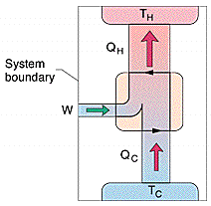
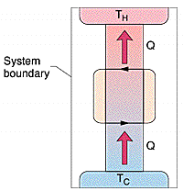
致冷機

Slide 15
致冷機的效能係數
coefficient of performance
K =

Slide 16
例二十 家用冰箱
K = 4.7，Q = 250 J（每循環）
電功
廢熱

Slide 17
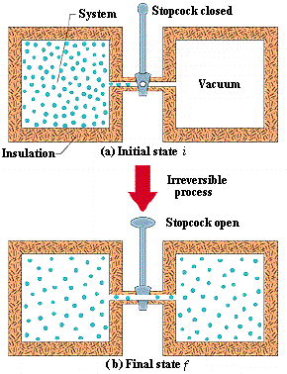
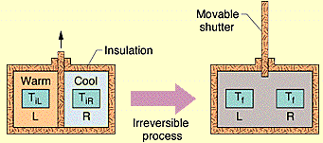

Entropy 熵
Some one-way processes

Slide 18
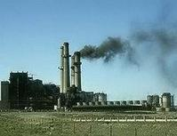
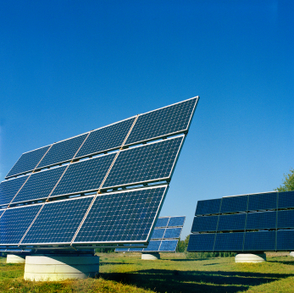
7.6 傳統能源與再生能源

Slide 19
Cost - Effect
Type of energy | Capital cost cents/kWh
PV cells | 25
windmill | 7
Coal-fired | 5
Notes:
The average price of wind power, including the production tax credit, was about 4 cents per kilowatt hour in 2008—a price that competes with fossil fuel-generated electricity
Geothermal energy generates power for between 6 and 10 cents / kilowatt-hour

Slide 20
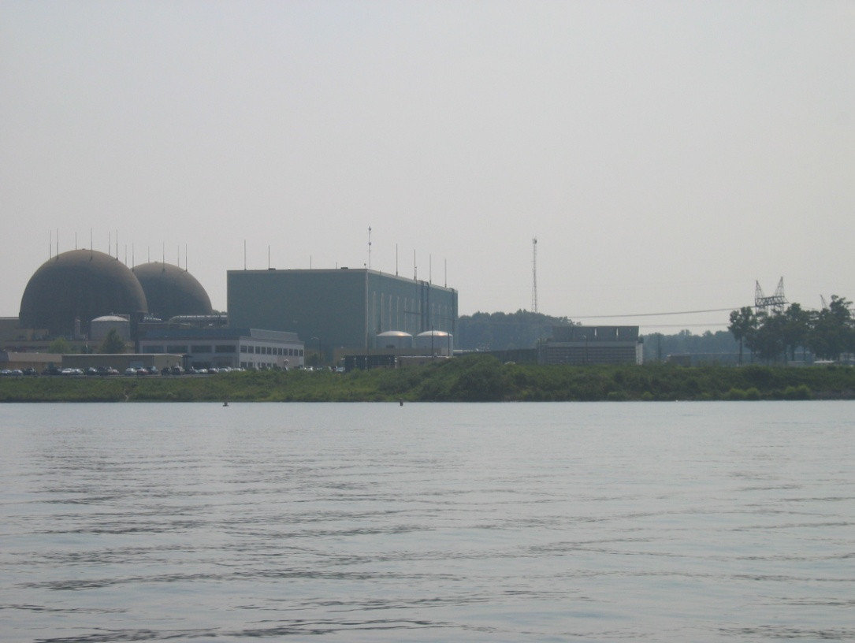
美國維吉尼亞州的North Anna核電廠

Slide 21
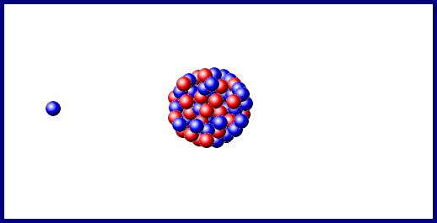
A nuclear fission

Slide 22
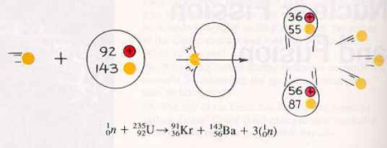
核分裂反應
中子 + 鈾235 → 氪 + 鋇 + 中子

Slide 23
nuclear fission (chain reaction)

Slide 24
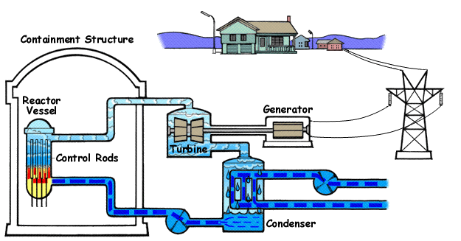
Boiling Water Reactor Diagram

Slide 25
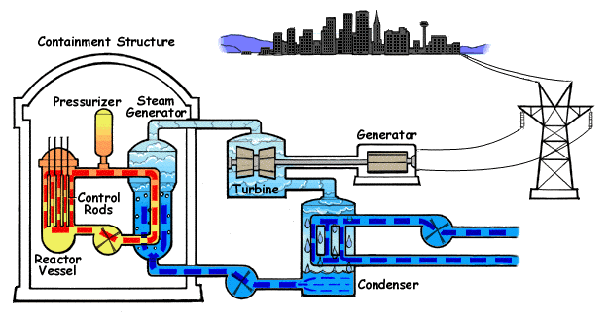
Pressurized Water Reactor Diagram

Slide 26
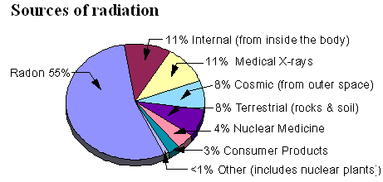
輻射源
Notes:
Radiation is energy emitted as invisible particles, waves, or rays. Radioactive atoms produce radiation as they disintegrate. Everyone is exposed to small amounts of radiation each day. Air, water, food, and sunshine are a few sources of natural background radiation. Radiation also comes from other sources, such as color televisions and medical x-rays.
Radon is a radioactive gas. It is formed by the natural radioactive decay of uranium in rock, soil, and water. Naturally existing, low levels of uranium occur widely in Earth's crust. Radon is colorless, odorless, tasteless, and chemically inert. Once produced, radon moves through the ground to the air above. It can be found in all 50 states. Unless you test for it, there is no way of telling how much is present. The Surgeon General has warned that radon is the second leading cause of lung cancer in the United States.
Half-life 3.82 days
http://library.kmsh.tnc.edu.tw/science/content/1985/00030183/0014.htm
http://www.newscientist.com/article.ns?id=dn3968
氡可測地震及火星是否含水

Slide 27
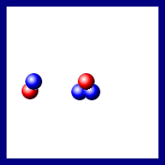
A nuclear fusion

Slide 28
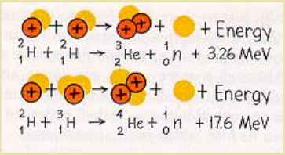
核融合反應
氘 + 氘 → 氦3 + 中子 + 能量
氘 + 氚 → 氦4 + 中子 + 能量

Slide 29
nuclear fusion (the d-d cycle)

Slide 30
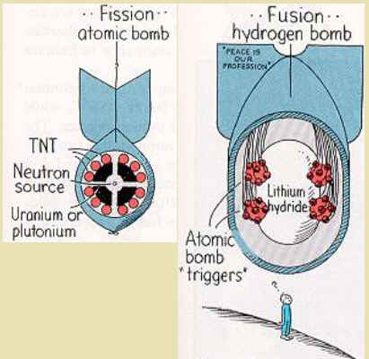
氫彈

Slide 31
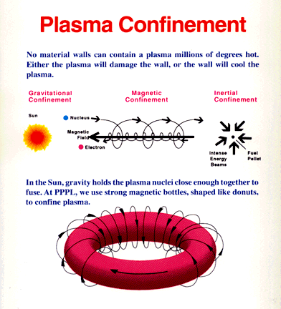
電漿圍阻

Slide 32
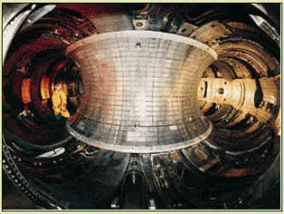
磁圍阻核融合反應器
Tokamak Fusion Test Reactor

Slide 33
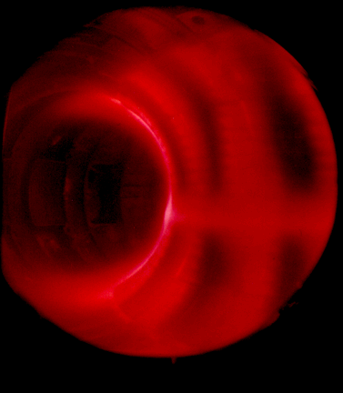
Glowing Plasma inside TFTR

Slide 34
Plasma Heating
Ohmic Heating
Neutral-Beam Injection
Magnetic Compression
Radio-frequency Heating

Slide 35
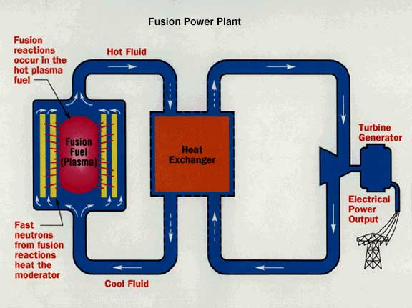
Fusion Power Plant
Notes:
In the most likely scenario for a fusion power plant, a deuterium-tritium (D-T) mixture is admitted to the evacuated reactor chamber and there ionized and heated to thermonuclear temperatures. The fuel is held away from the chamber walls by magnetic forces long enough for a useful number of reactions to take place. The charged helium nuclei which are formed give up energy of motion by colliding with newly injected cold fuel atoms which are then ionized and heated, thus sustaining the fusion reaction. The neutrons, having no charge, move in straight lines through the thin walls of the vacuum chamber with little loss of energy.
The neutrons and their 14 MeV of energy are absorbed in a "blanket" containing lithium which surrounds the fusion chamber. The neutrons' energy of motion is given up through many collisions with lithium nuclei, thus creating heat that is removed by a heat exchanger which conveys it to a conventional steam electric plant. The neutrons themselves ultimately enter into nuclear reactions with lithium to generate tritium which is separated and fed back into the reactor as a fuel.
The successful operation of a fusion power plant will require the use of materials resistant to energetic neutron bombardment, thermal stress and magnetic forces. Additional work also needs to be done on the design of fuel injection systems and systems for removing spent gas.

Slide 36
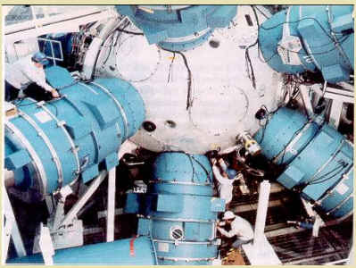
新星核融合反應器
Notes:
2 × 10¹⁴W, 100 times of the world/200kJ, 1 ns

Slide 37

Fuel pellets
Notes:
Smaller that sand

Slide 38
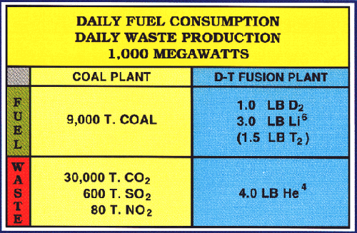
Comparison of Coal and Fusion Power
Notes:
At the Kingston Fossil Plant near Knoxville, Tennessee, for example, each boiler heats the water to about 1,000 degrees Fahrenheit (540 degrees Celsius) to create steam. The steam is sent into the turbines at pressures of more than 1,800 pounds per square inch (130 kilograms per square centimeter) (122 atm)
This one plant generates about 10 billion kilowatt-hours a year, or enough electricity to supply 700,000 homes. To meet this demand, Kingston burns about 14,000 tons of coal a day, an amount that would fill 140 railroad cars.

Slide 39
The Advantage of Fusion Energy
Abundant Fuel Supply
No Risk of a Nuclear Accident
No Air Pollution
No High-level Nuclear Waste
No Generation of Weapons Material

Slide 40
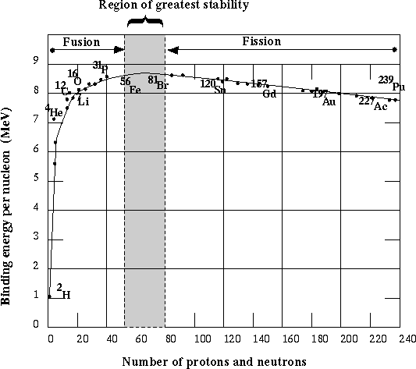
Nuclear Binding Energy

Slide 41
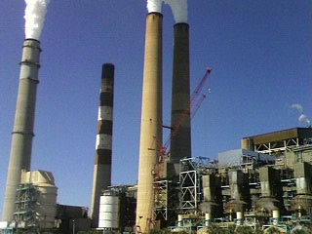
美國佛羅里達州Tampa的Big Bend 燃煤發電廠

Slide 42
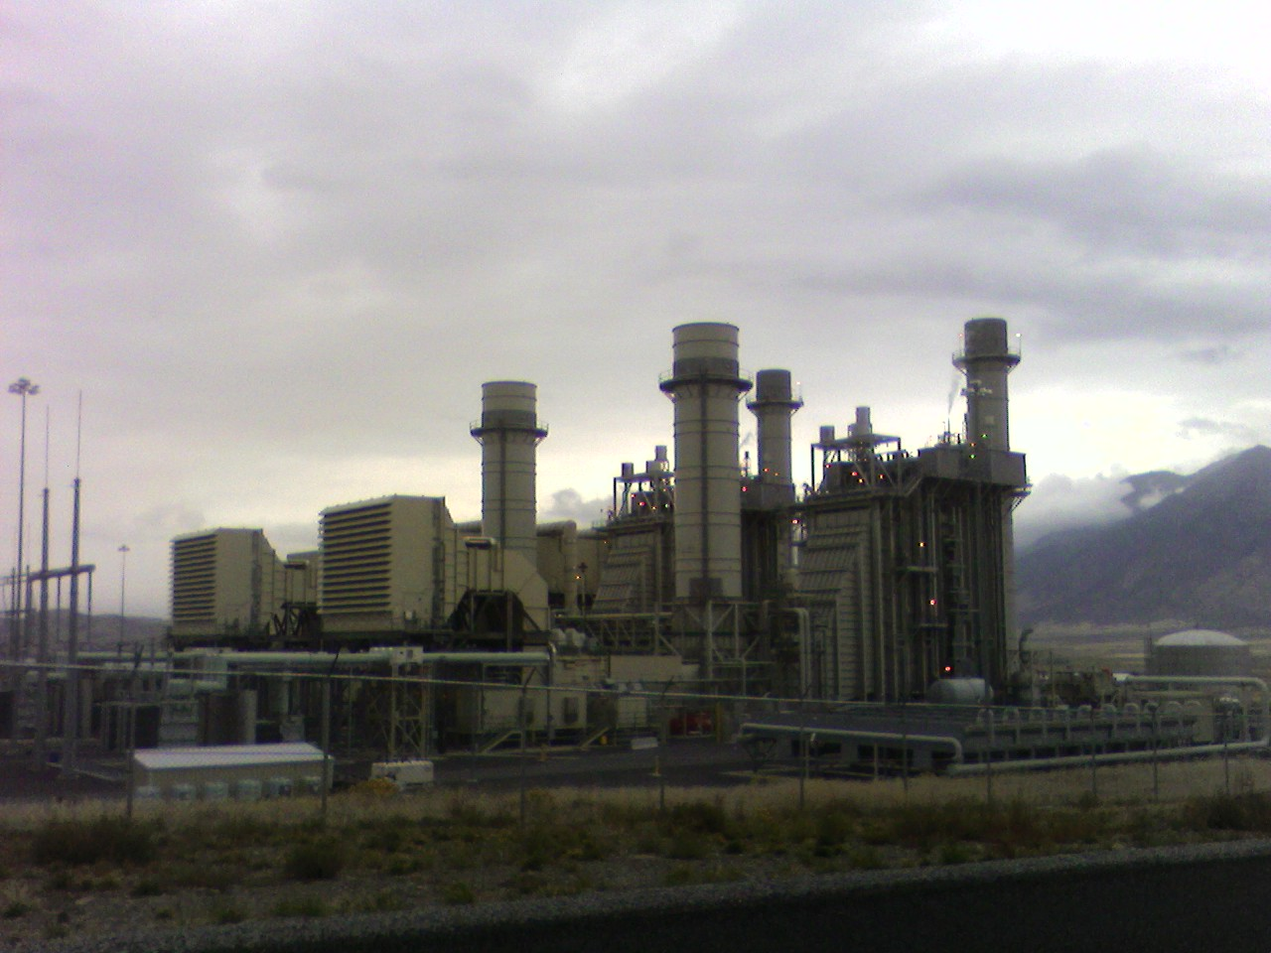
美國猶他州Mona的Currant Creek 燃氣發電廠

Slide 43
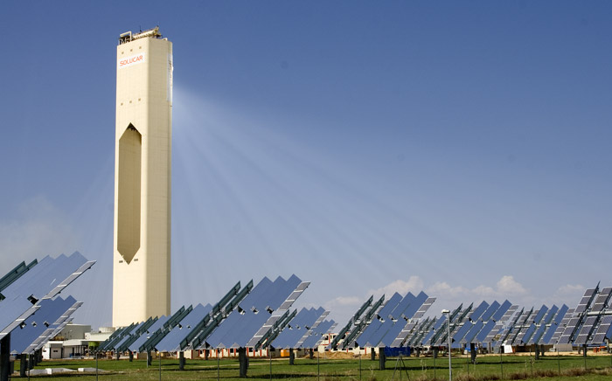
西班牙雪維爾的PS10太陽能塔
Notes:
西班牙雪維爾的PS10太陽能塔，它利用624座面積120平方公尺的可移式鏡子把太陽光反射到115公尺高的塔上加熱蒸氣，推動渦輪機，可提供11MW電力。
43

Slide 44
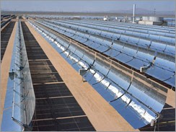
太陽能槽

Slide 45
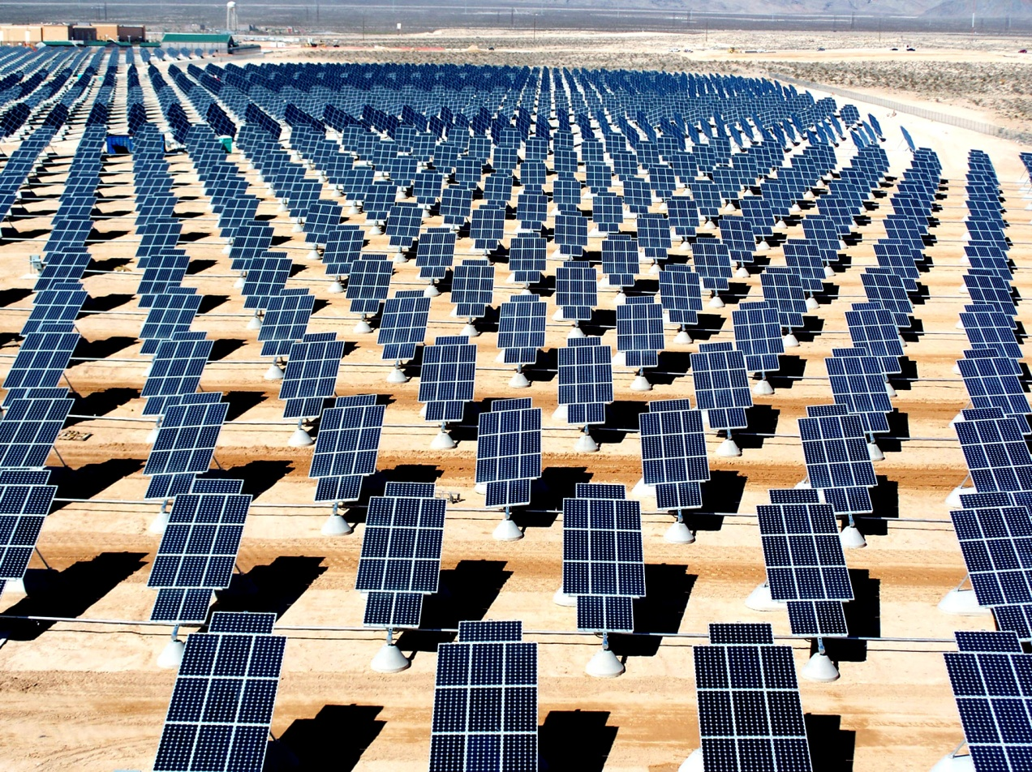
太陽光能發電廠
Notes:
奈利斯太陽能發電廠是北美最大的光伏打發電廠，位於內華達空軍基地，占地140英畝，它透過70000片太陽能板，為這個基地提供15MW電力
45

Slide 46
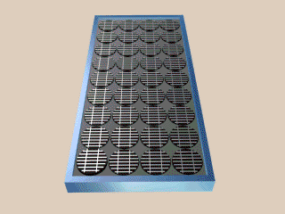
How a PV cell works
Notes:
This animation depicts the inside of a silicon photovoltaic cell, and demonstrates how a photon excites an electron. Let's look inside a cell, many of which make up a photovoltaic module. The top layer is a grid of wires that collects freed electrons for use. Inside the cell, phosphorous and boron are doped into the silicon to create an electrical field, represented by the top red, or positive, and blue; bottom, negative. Each of the billions of silicon atoms has a lightly held electron, shown as one of the tetrahedral (pyramid) electron orbits. A photon of sunlight (the gold sphere) enters the cell and is absorbed by a silicon atom, allowing one electron to be freed, which enters the electrical field and is whisked away to the top grid. This freeded electron, represented by the green sphere, is used to do your electrical work, then returns to the cell from the back of the cell to be reunited with its silicon atom.

Slide 47
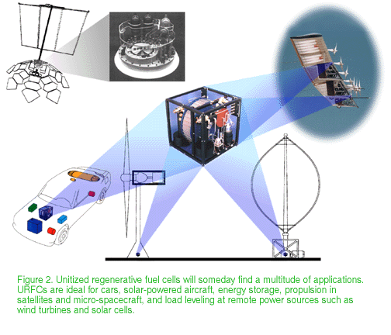
URFC

Slide 48


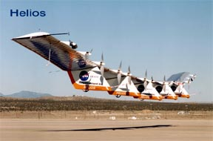
Regenerative Fuel Cells in UAV
Notes:
The Helios Prototype is an enlarged version of the Centurion flying wing, which flew a series of test flights at Dryden in late 1998. The craft has a wingspan of 247 feet, 41 feet greater than the Centurion, 2 1/2 times that of its solar-powered Pathfinder flying wing, and longer than either the Boeing 747 jetliner or Lockheed C-5 transport aircraft. It is one of several remotely-piloted aircraft, also known as uninhabited aerial vehicles or UAV's, being developed as technology demonstrators by several small airframe manufacturers under NASA's Environmental Research Aircraft and Sensor Technology (ERAST) project.
UAV: unmanned aerial vehicles Proteus

Slide 49
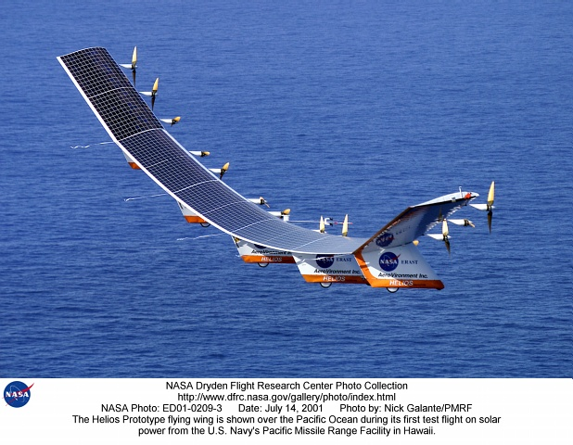
Helios

Slide 50
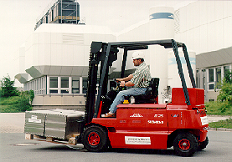
Siemens PEM Fuel Cell Powered Forklift

Slide 51


Proton Exchange Membrane
Notes:
Proton Exchange Membrane Fuel Cell is also called as solid macromelecule style, and it is on the way to practical use in very near future. Buildings and houses would also enjoy practical use. However, vehicle would enjoy more due to its small-sized and light weight.
a fuel cell stack composed of about 60 cells

Slide 52

Electrochemistry

Slide 53

Phosphoric Acid (PAFC)
200kW PAFC power plant built by UTC Fuel Cells
Notes:
More than 200 fuel cell systems have been installed all over the world - in hospitals, nursing homes, hotels, office buildings, schools, utility power plants, an airport terminal, landfills and waste water treatment plants. PAFCs generate electricity at more than 40% efficiency -- and nearly 85% of the steam this fuel cell produces is used for cogeneration (汽電共生)-- this compares to about 35% for the utility power grid in the United States.
Operating temperatures are in the range of 300 to 400 degrees F (150 - 200 degrees C).
Existing PAFCs have outputs up to 200 kW, and 1 MW units have been tested.

Slide 54



Alkaline
Notes:
Alkaline. Long used by NASA on space missions, these cells can achieve power generating efficiencies of up to 70 percent. They were used on the Apollo spacecraft to provide both electricity and drinking water. Their operating temperature is 150 to 200 degrees C

Slide 55

The Solar Hydrogen Cycle
Notes:
Still a very young member of the fuel cell family, regenerative fuel cells would be attractive as a closed-loop form of power generation. Water is separated into hydrogen and oxygen by a solar-powered electrolyser. The hydrogen and oxygen are fed into the fuel cell which generates electricity, heat and water. The water is then recirculated back to the solar-powered electrolyser and the process begins again. These types of fuel cells are currently being researched by NASA and others worldwide.

Slide 56

海洋溫差發電廠
Notes:
溫差(1000m)約介於攝氏20～25度之間，低蒸發溫度之工作流體如氨、丙烷或氟利昂，
發電效率僅約傳統發電方式的十分之一。
Ocean Thermal Energy Conversion (OTEC) Keahole Point, Hawaii Island
Although the theoretical efficiency of OTEC is small (~2%), there are vast quantities of sea water available for use in power generation. It has been estimated that there could be as much as 10⁷MW power available worldwide.

Slide 57

夏威夷科娜灣的Keahole Pointe海洋溫差發電廠

Slide 58

海洋溫差
Notes:
The concept of OTEC dates back to 1881, when Jacque's D'Arsonval envisioned the idea. However, D'Arsonval did not live to see his idea to fruition, a task completed by his student Georges Claude in 1930.

Slide 59

Closed Cycle OTEC
Notes:
D‘Arsonval’s original concept used a working fluid with a low boiling point, such as ammonia, which is vaporised using the heat extracted from the warm surface water. The heated working fluid is used to turn a turbine to produce electricity. Cold deep sea water is used to condense the working fluid in a second heat exchanger prior to being recirculated to the first heat exchanger.

Slide 60

Open Cycle OTEC
Notes:
1. The first operational OTEC trialled by Georges Claude used warm surface water as the working fluid, instead of the low boiling point fluid proposed by D'Arsonval. In Open Cycle OTEC systems, the sea water is evaporated under a partial vacuum, creating low pressure steam which can be used to drive a turbine. The steam is then condensed either by a second heat exchanger, as in the closed cycle, or by mixing with the deep cold water.
2. Fresh water could be extracted successfully from the open cycle system.

Slide 61

Wave Power
Notes:
A 25-yard-wide concrete bunker built on a shoreline has an underwater opening that allows water to slosh back and forth inside. The resulting air currents are strong enough to turn a turbine, which in turn generates electricity. It’s the same concept as a dam that uses water to turn turbines, except in this case it’s the air.
WAVE POWER isn’t exactly new, but what’s changed since it was first researched during the 1970s energy crisis is that costs have come down to where it could be profitable.

Slide 62

Wavegen Scotland
Notes:
it’s been producing enough electricity to light 400 homes.
The facility cost $1.6 million to build but “our next power stations will be cheaper — half the cost for the same output,”

Slide 63


生質能

Slide 64

The Carbon Cycle

Slide 65

Types of Biomass
Notes:
wood, wood waste, straw, manure, sugar cane, and many other byproducts from a variety of agricultural processes.

Slide 66

Nesjavellir-冰島最大的地熱發電廠
Notes:
Nesjavellir是冰島最大的地熱發電廠，可提供120MW電力及每秒1800公升的熱水。
66

Slide 67

水力發電廠剖面圖

Slide 68

水力渦輪機與發電機剖面圖

Slide 69

英國威爾斯石礦村落抽蓄式水力發電廠

Slide 70

潮汐發電廠示意圖
Notes:
目前運轉中最大的潮汐發電廠在法國倫斯河，最大發電容量達240MW。潮差最高時可達13.4公尺，平均潮差在9公尺左右
70

Slide 71

法國倫斯河的潮汐發電廠
Notes:
在漲潮時，外部的海面較高，海水自然流入蓄水池，啟動發電設備；待退潮時，蓄水池內的水面較高，可再將蓄水放出，再次發電。如此一來，一天將能提供漲落潮共四次的發電機會。不過，因為海水的流向不若河水般固定，以及受不同地形地貌的影響，並不是所有的潮汐電廠均能提供四次的發電機會；而潮汐發電廠的電力輸出，也會因為上述因素而呈現不穩定的狀況。

Slide 72

英國貝克夏格林公園
工業園區的風力發電廠
Notes:
英國貝克夏格林公園工業園區的風力發電廠；這座風車支柱高88公尺，扇葉長達33公尺，最大發電容量可達2.05MW，足以供應1500個用戶。
72

Slide 73
敬請期待
電、磁、近代物理

Slide 74

人體等溫線

