Slide 1
7.3 相變化（phase changes）
固態 –> 液態 –> 氣態 –> 電漿態
-----------------溫度上升-------------->
solid liquid vapor plasma
(冰) (水) (水蒸氣) (H、O、e)

Slide 2
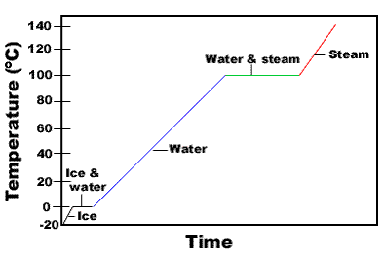
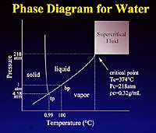
Phase diagram of water
水在一大氣壓下，以恆定率加熱時，其溫度隨時間之變化。

Slide 3
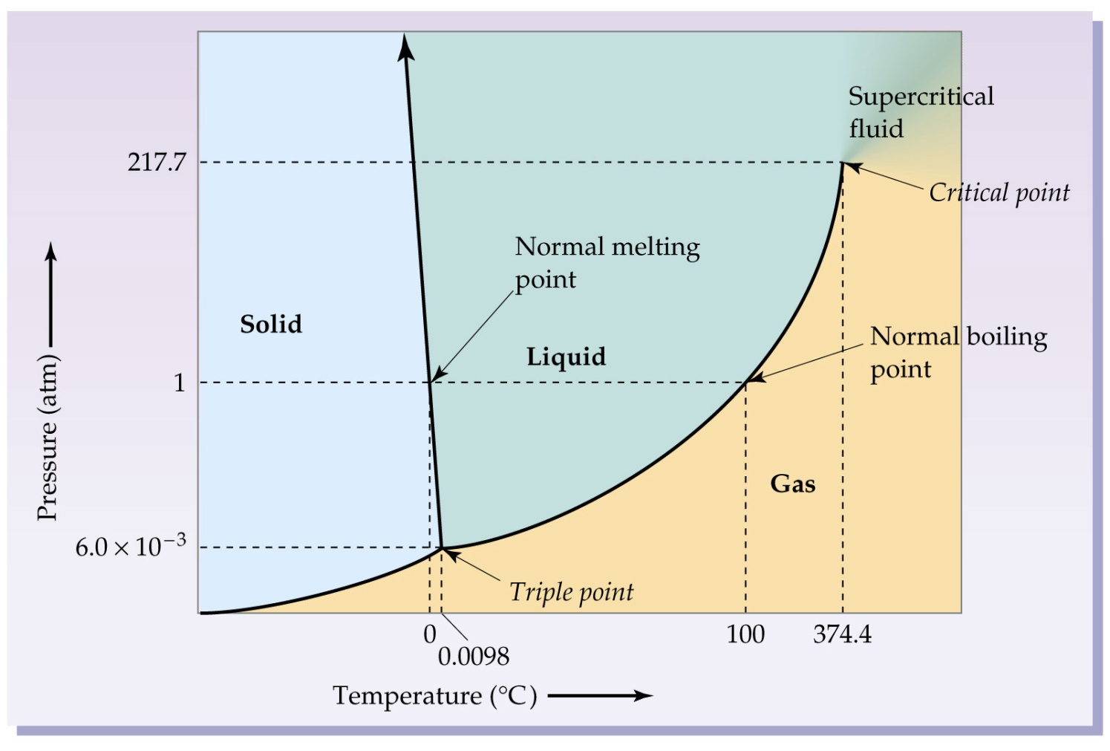
Phase diagram of water
Notes:
The liquid and vapor densities become closer and closer to each other until the critical temperature is reached where the two densities are equal and the liquid-gas line or phase boundary disappears.
A supercritical liquid posesses liquid-like solvating properties and gas-like diffusion and viscosity
It can diffuse through solids like a gas, and dissolve materials like a liquid.

Slide 4
比熱和潛熱
比熱（specific heat capacity）：使每公斤物質溫度上升1K或1℃所需之熱。
潛熱（latent heat）：相變化中，每公斤物質所吸收或釋出之熱。

Slide 5
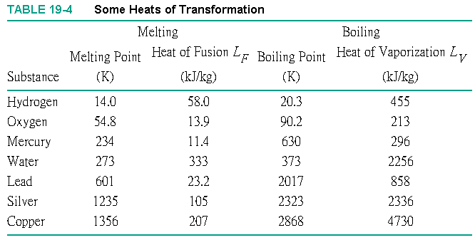
潛熱表

Slide 6
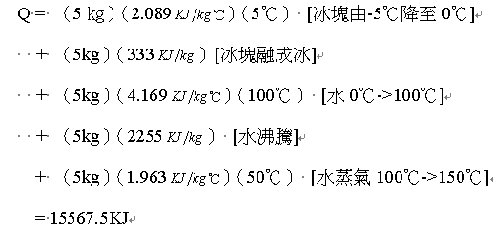
例五 使-5℃，5公斤的冰塊變成150℃的水蒸氣所需的熱量Q

Slide 7
7.4 熱傳遞（Heat transfer）
傳導（conduction）
對流（convection）
輻射（Radiation）

Slide 8
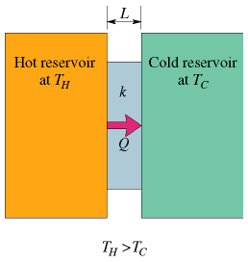
傳導（conduction）
H（Heat flow熱流）= KA ΔT /L
K：導熱率
A：截面積
ΔT：溫差
L ：長度

Slide 9
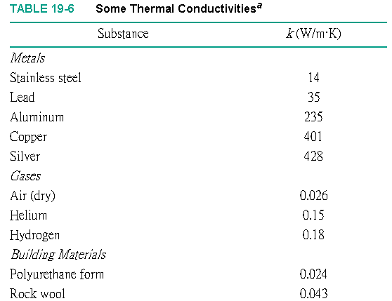
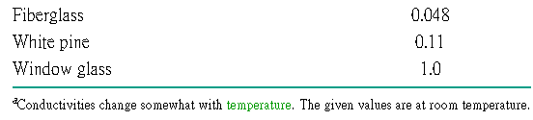
導熱率

Slide 10
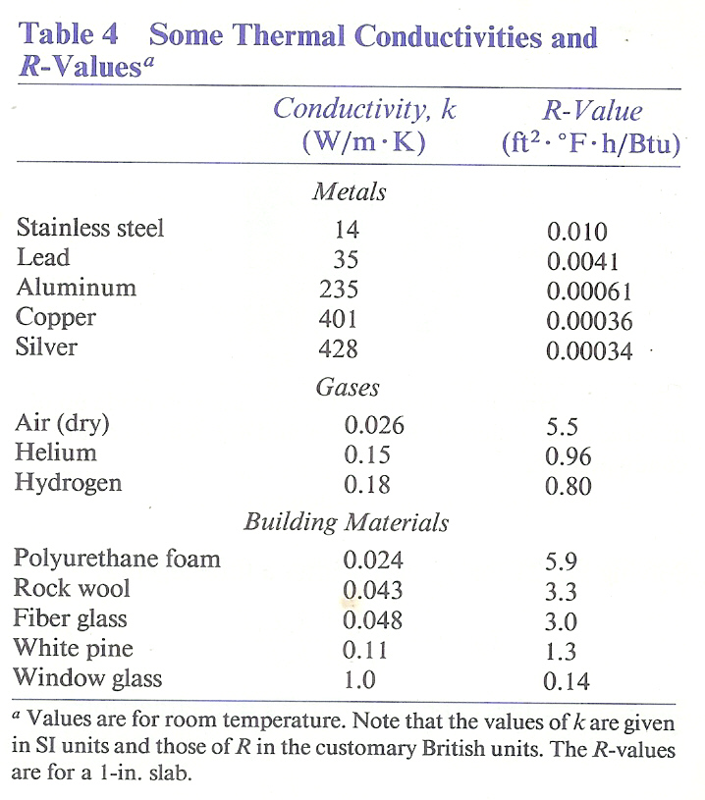
R-value
R．30 insulating
slab
5.1 in PU foam
23 in white pine
180 in glass
1.4 mi silver
R=L/k –>
H = A ΔT /R

Slide 11
例六 人體組織的熱傳導
人以普通速度步行時，產生之熱流 為280W
人體表面積約1.5m²，且平均而言，熱係於皮膚之下0.03m處產生
導熱率則約與動物肌肉相同，為
0.2 W/mK

Slide 12
熱流
皮膚與體內之溫差僅數度，因此熱並非經由組織之傳導，而係經由血液輸送。

Slide 13
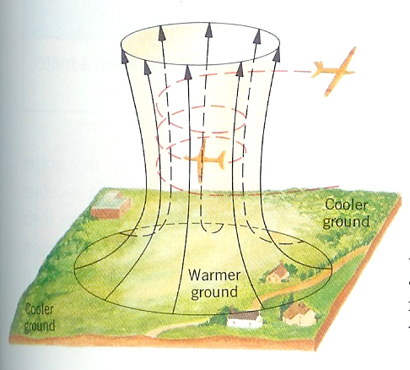
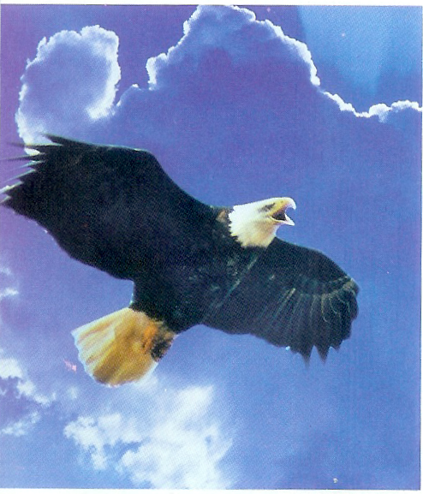
對流（convection）

Slide 14
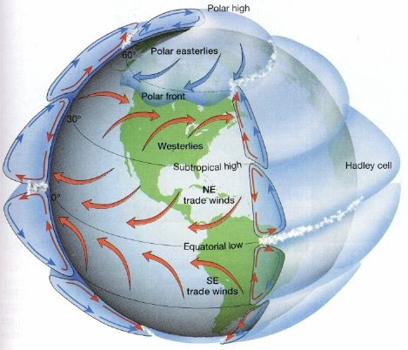
Global Circulation
Notes:
Horse lattitude: Spanish ships to west Indies
North Africa, Arabia, southern Australia and American southwest

Slide 15
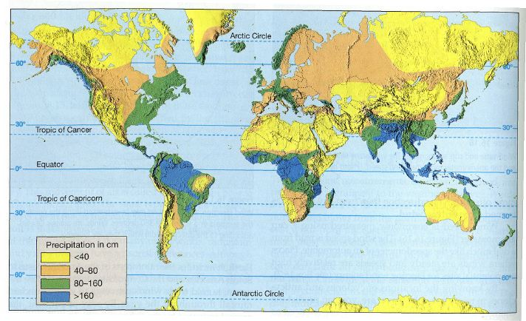
Climate

Slide 16
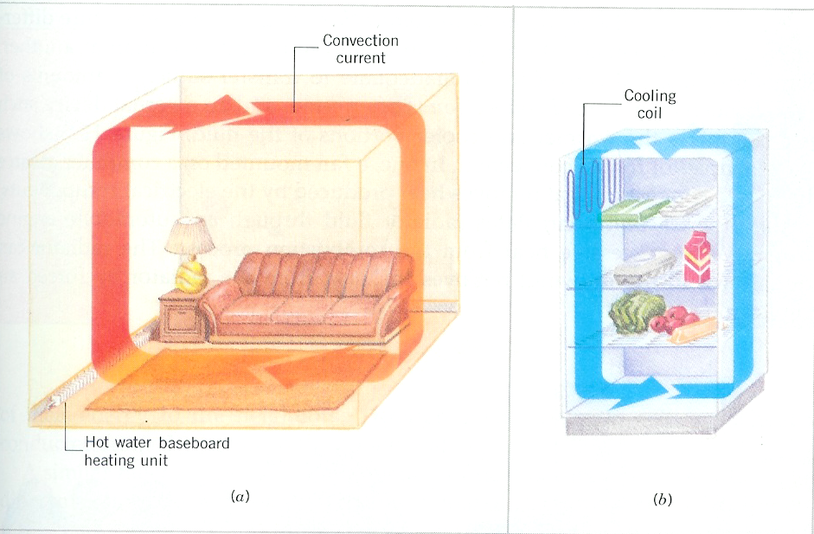
例七 暖氣與冰箱

Slide 17
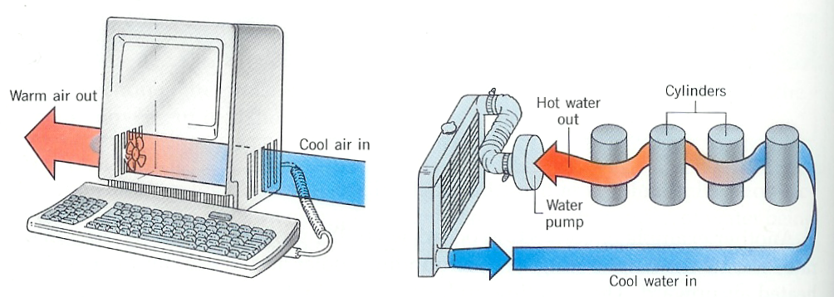
例八 forced convection

Slide 18
例九 Sauna
皮膚溫度 = 33℃，室溫 = 29℃ 人體表面積 = 1.5m²
此人所產生之熱流約為2倍；另一半藉由輻射散失。

Slide 19
輻射（Radiation）
良輻射體亦為良吸收體
Stefan-Boltzmann Law
輻射功率 H = eσAT⁴
  e：輻射率 0 ≦ e ≦ 1
e = 1－完美輻射體(吸收體)－black body
光亮表面之e則極小

Slide 20
例十 人體的輻射
人體在紅外線波長範圍e ~1
人體在可見光波長範圍e = 0.82~0.65
皮膚溫度33℃ = 306K
室內牆壁溫度29℃ = 302K

Slide 21
例十一獵戶座的紅巨星
Betelgeuse
表面溫度2900 K，輻射功率4 ×10³⁰
（太陽的一半） （太陽的10000倍）
火星軌道半徑

Slide 22
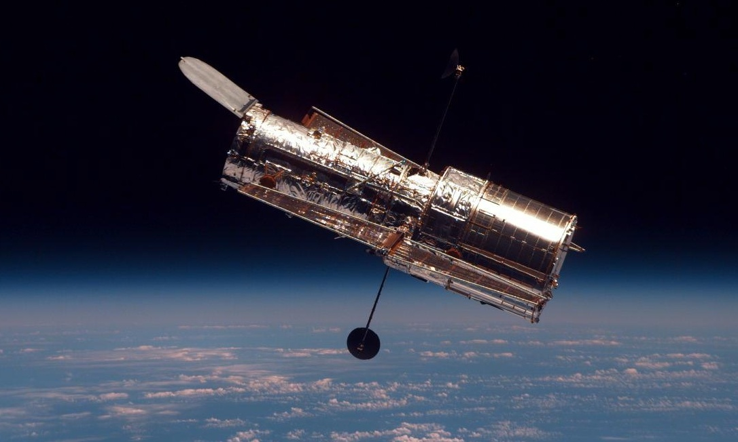
例十二 Hubble 望遠鏡的溫度調節設計
軌道衛星之日照被地球屏蔽時，其溫度與未被屏蔽時，有極大差異。
衛星表面的高反射金屬膜在日照下，可反射大部分來自太陽的輻射，把溫昇降至最低；而當其在地球陰影內時，亦可降低本身輻射之熱損耗。（poor absorber = poor emitter）
Notes:
Launched in 1990 and greatly extended in its scientific powers through new instrumentation installed during four servicing missions with the Space Shuttle, the Hubble, in its sixteen years of operations, has validated Lyman Spitzer Jr.'s (1914-1997) original concept of a diversely instrumented observatory orbiting far above the distorting effects of the Earth’s atmosphere and returning data of unique scientific value.
Hubble's coverage of light of different colors (its "spectral range") extends from the ultraviolet, through the visible (to which our eyes are sensitive), and into the near-infrared. Hubble's primary mirror is 2.4 meters (94.5 inches) in diameter. Hubble is not large by ground-based standards but it achieves heroically in space. Hubble orbits Earth every 97 minutes, 575 kilometers (360 miles) above the Earth's surface.

Slide 23
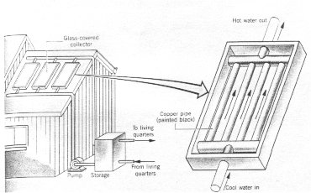
例十三 太陽能熱水器
收集器內部，包括水管均漆有高吸收黑漆，提昇其對太陽輻射之吸收。
水管以銅製，提昇水管水的熱傳導。
收集器之玻璃蓋降低因空氣對流之熱損耗。

Slide 24
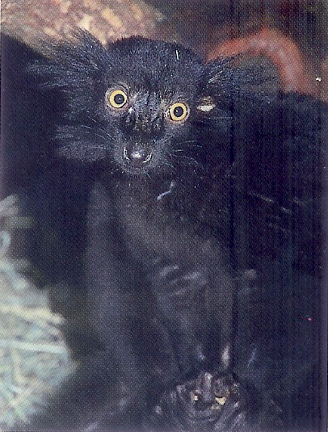
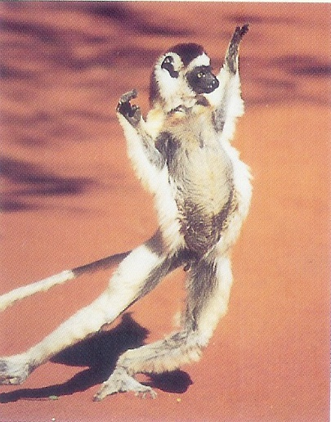
例十四輻射與動物的活動－狐猿（lemur）
white sifaka

Slide 25
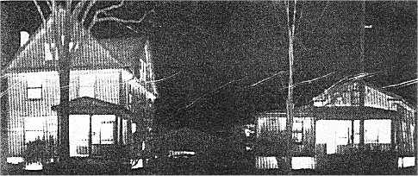
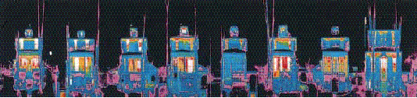
例十五紅外線照相能源分析（thermogram）

Slide 26
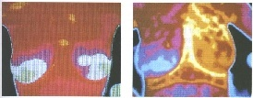
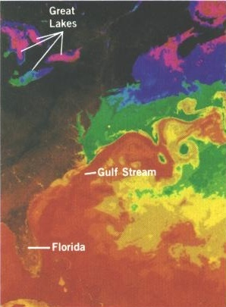
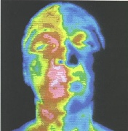
醫學、環境
Notes:
交感神經因局部麻醉而阻斷 (35.75 vs 33.25 °C )

Slide 27
7.5 氣體動力論
壓力、溫度與方均根速度
氣體的狀態方程式
（equation of state）
氣體分子的速率
Notes:
Kinetic Theory of Gases

Slide 28
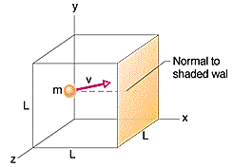
壓力、溫度與方均根速度
微觀與巨觀
Microscopic and macroscopic
Notes:
Pressure, temperature and RMS speed

Slide 29
動量、力與壓力

Slide 30
方均根速度

Slide 31
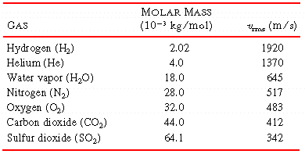
各種氣體的方均根速度

Slide 32
氣體的狀態方程式
PV = nRT –> P = nRT /V + C/V² ……
  P：壓力 V：體積
  n：莫耳數（mole） T：溫度
  R：氣體常數 = 8.31

Slide 33
例十六 1 mole氣體的體積
STP: Standard Temperature and Pressure Conditions –>
0℃（273K） 1 atm = 1.013×10⁵Pa (N/m2)

Slide 34
mole and N_{A}
Avogadro’s number
1 mole 物質，包含N = 6.022 ×10²³個原子

Slide 35
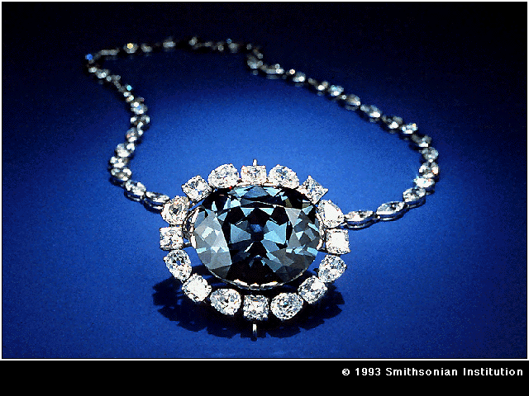
例十七 Hope Diamond
112 3/16 - carat
Golconda,
India, 1688
Smithsonian
Notes:
http://groups.google.com/group/talk.politics.misc/browse_thread/thread/bf820ef369a141f/8bbb8c46ee5a36c8?lnk=st&q=Hope+Diamond&rnum=1&hl=en#8bbb8c46ee5a36c8
WASHINGTON (AP) -- Researchers using computer analysis have traced the
origin of the famed Hope Diamond, concluding that it was cut from a
larger stone that was once part of the crown jewels of France.
A French connection had been suspected for the Hope, but the new study
shows just how it would have fit inside the larger French Blue Diamond
and how that gem was cut, Smithsonian gem curator Jeffrey Post
explained.
The deep blue Hope Diamond is the centerpiece of the gem collection at
the Smithsonian's National Museum of Natural History, famed for its
claimed history of bad luck for its owners. It's been good fortune for
the museum, though, drawing millions of visitors.
Post said the new analysis of the diamond took a year, with
researchers using sketches from pre-Revolutionary France, scientific
studies of the French crown jewels and computer models.
"This new Hope Diamond research would not have been possible 10 years
ago," said Post. "What is exciting is that we are constantly learning
new information about our collections as we apply new high-tech
research methods. Even the Hope Diamond is grudgingly giving up some
of its secrets."
The research helps confirm the Hope Diamond as originating with a
115-carat stone found in India in 1668. That stone was sold to King
Louis XIV of France who had it cut into the 69-carat French Blue. The
French Blue was stolen during the French Revolution.
Just over twenty years later, after the statute of limitations
expired, a large blue diamond was quietly put up for sale in London,
and eventually Henry Philip Hope purchased it.
Finally donated to the Smithsonian by jeweler Harry Winston, the now
45.52 carat stone is the world's largest blue diamond.
The team of researchers led by Post and Steven Attaway, engineer and
gem cutter; as well as Scott Sucher and Nancy Attaway, gem cutting
experts, compiled the new analysis.
While the French Blue no longer exists, Post said the sketches of it
from France were quite detailed and allowed preparation of a computer
model of that stone.
In 1700, French scientists had also studied several stones from the
royal collection, determining their specific gravity and other
details.
Their analysis of other stones that still exist was quite accurate,
Post said in a telephone interview, so the researchers felt the data
on the French Blue was also probably accurate.
After using the sketches and analysis to make the computer model of
the French Blue, and at the same time measuring the Hope Diamond and
entering that data into the computer, the researchers "virtually
placed the Hope back inside the French Blue" Post said.
"It turns out it actually fits perfectly in only one way, but at that
orientation, when you saw how it fit, you could see why it was cut the
way it is," Post said.
"They cut he corners off the French Blue, changed slightly the angle
of the bottom facets, and that produced the Hope Diamond," he said.
Indeed, some of the facets of the current diamond may even be left
over from the French Blue.

Slide 36
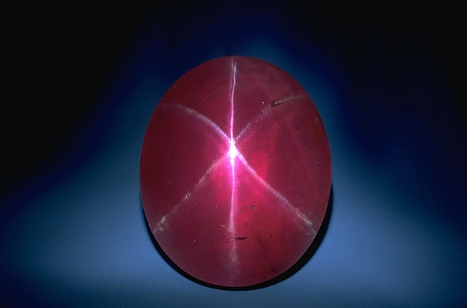
例十八 Rosser Reeves Ruby
Sri Lanka
Smithsonian
1 mole of Al₂O₃ = 2(26.9815g)＋
3(15.9994g) =101.9612g
Notes:
Sri Lanka

Slide 37
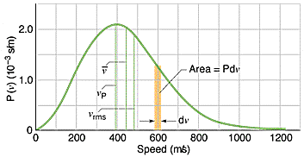
氣體分子的速率
Maxwell’s speed distribution

Slide 38
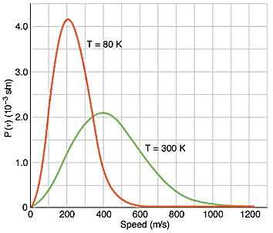
不同溫度時之速率分布

Slide 39
例十九 Maxwell’s speed distribution
(a) The average speed
(b) The root-mean-square speed
(c) The most probable speed

