Slide 1
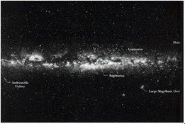
5 Gravitation

Slide 2
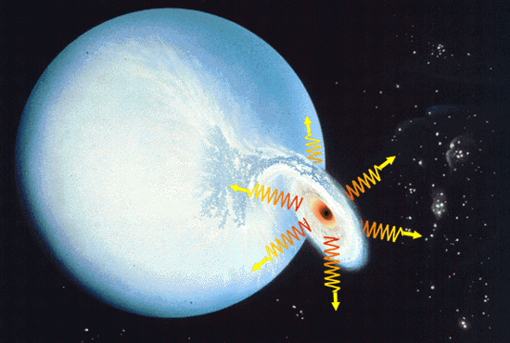
The Milky Way galaxy and the black hole

Slide 3
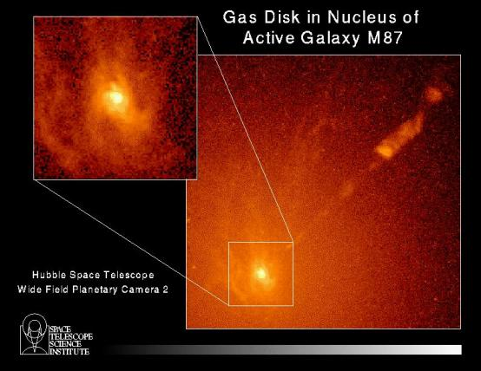
www.ifa.hawaii.edu/~barnes/ast110_06/bhaq.html

Slide 4
5-1 The world and the gravitational force
The Local Supercluster
The Local Group
The Milky Way and the Andromeda galaxy
Cluster: Hydra and Centaurus

Slide 5
5-2 Newton's law of gravitation
Newton (23) —1665

Slide 6
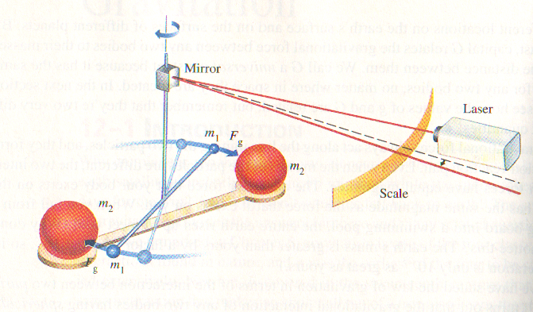
Cavendish’s experiment

Slide 7
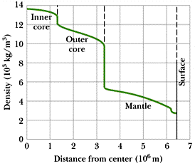
Density Profile

Slide 8
14-3 Gravitation and the principle of superposition

Slide 9
例5-1 A discrete system (5 particles)

Slide 10
例5-2 A particle and a uniform rod

Slide 11
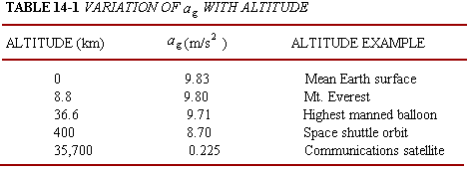
14-4 Gravitation near earth’s surface

Slide 12
Three reasons that
1. Earth is not uniform.
2. Earth is not a sphere.
3. Earth is rotating.

Slide 13
例 5-3 A pulsar
例 5-4 The difference in a_{g}
(a) In the vicinity of Earth

Slide 14
(b) A black hole – The tidal force

Slide 15
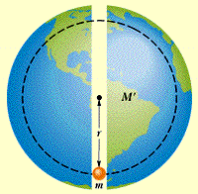
5-5 Gravitation inside Earth
A uniform shell of matter exerts no net gravitational force on a particle inside it.
例 5-5 Express delivery

Slide 17
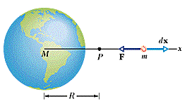
5-6 Gravitational potential energy

Slide 19
Potential energy and force
Escape velocity

Slide 20
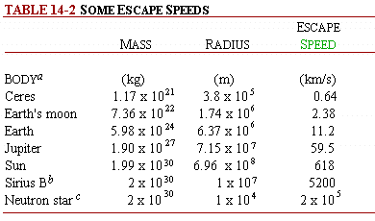
Some Escape Speeds

Slide 21
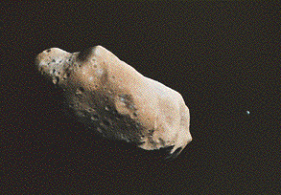
例 5-6 Asteroids
Notes:
5m: 500M, 500m: 1M near Earth’s orbit, one 5m exploded at 20km near a remote south pacific island, set off 6 military satellites in 1994
Ida and Dactyl
The name is derived from the Dactyli, a group of mythological beings who lived on Mount Ida, where the infant Zeus was hidden -- and raised.

Slide 22
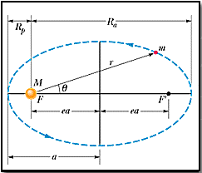
5-7 Planets and Satellites: Kepler’s Laws
1. The law of orbits.
elliptical orbits eccentricity semimajor(semiminor) axis

Slide 23
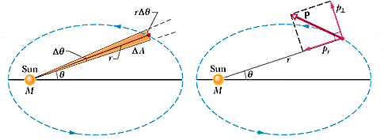
2. The law of areas.

Slide 25
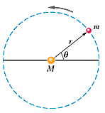
3. The law of periods.

Slide 26
例 5-7 Finding the mass:
例 5-8 Comet Halley

Slide 27
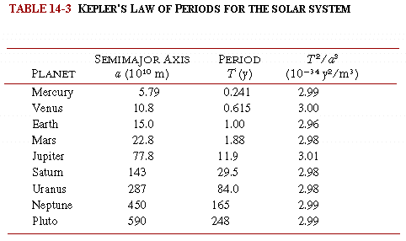

Slide 28
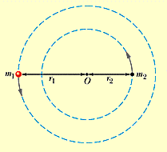
例 5-8 A binary system and a black hole

Slide 30
14-8 Satellites: Orbits and Energy
The potential energy
The kinetic energy

Slide 31
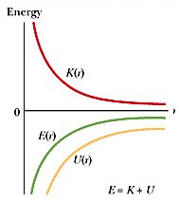
The total energy

Slide 32
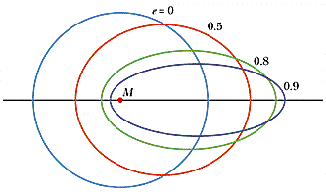
The elliptic orbits:

Slide 33
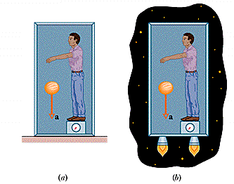
5-9 Einstein and Gravitation
General/special theory of relativity
Principle of equivalence:
gravitation and acceleration are equivalent.

Slide 34
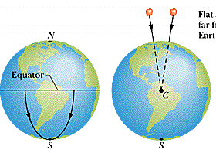
Curvature of Space
Gravitation is due to a curvature of spacetime that is caused by the masses.

Slide 35
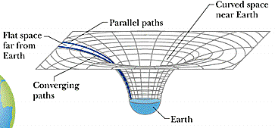
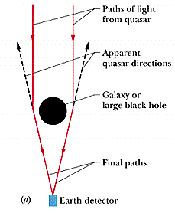
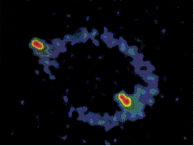

Slide 36
敬請期待 物理 VI–流力

