Slide 1
自由振盪、阻滯振盪、共振、非簡諧振盪與混沌擺

Slide 2
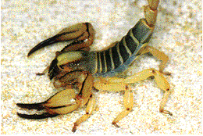
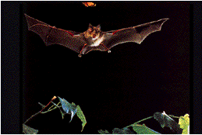
4 波動與聲波
A sand scorpion
How does a horseshoe bat detect a moth in total darkness?

Slide 3
4.1 波與粒子
波的類型
  機械波
    governed by Newton’s laws, exist only within a material medium (介質)
  電磁波
    governed by Maxwell’s laws, require no material medium to exist
    all travel at c = 299,792,458m/s
  物質波

Slide 4
4.2 橫波與縱波
transverse
  displacement ⊥wave (橫波)
longitudinal
  displacement ∥wave (縱波)

Slide 5
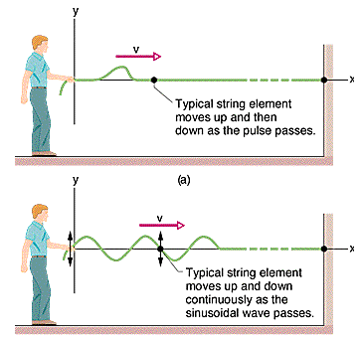
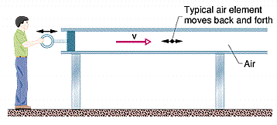
脈波、正弦波與縱波
pulse
Wave train

Slide 6
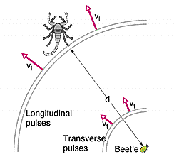
沙蠍的定位
Notes:
An earthquake. radiates energy in the form of. P-waves, which are longitudinal vibrations like sound, S-waves, which are transverse vibrations
P (primary) waves, which are similar to sound waves, and S (secondary) waves, which are a kind of shear wave.
P waves travel between 6 and 13 km/sec. S waves are slower and travel between 3.5 and 7.5 km/sec.

Slide 7
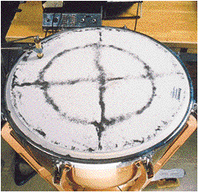
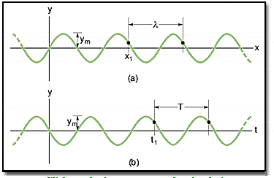
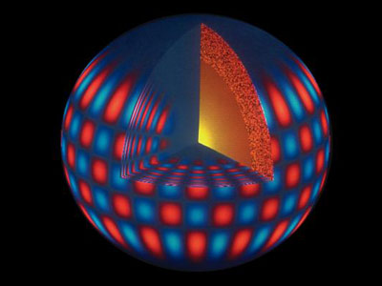
4.3 波長與頻率
一維波函數具有兩個變數:
2D
3D

Slide 8
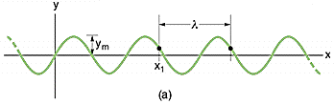
瞬間快照
Snapshot at t = 0 (or any other instant)

Slide 9
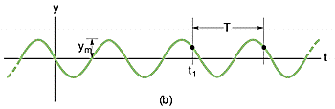
定點變化
y = y(t) at a fixed position

Slide 10
波長λ與角波數 k
Why picking the sine wave？
Need a videotape to show it in real time.
Wavelength and angular wave number – wavelength (λ):
Angular wave number(k):

Slide 11
週期T與角頻率 ω
Period, angular frequency, and frequency f

Slide 12
4.4 行進波的波速
Traveling Wave
The wave speed

Slide 13
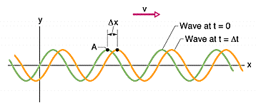
A left-going wave

Slide 14
例一 A sinusoidal wave

Slide 15
例二 橫向速率與加速度

Slide 16
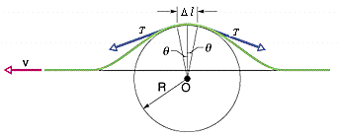
4.5 繩波的波速
由牛頓第二定律推導

Slide 17
繩波的波速–II

Slide 18
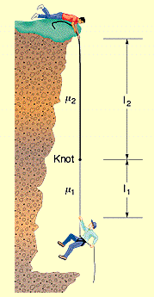
例三 山難救援

Slide 19
山難救援–II

Slide 20
4.6 波的重疊原理
The Principle of Superposition
for Waves
Fourier Analysis

Slide 21
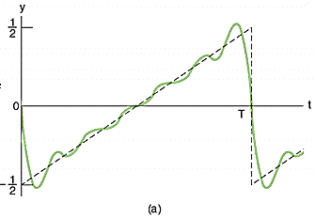
例四 鋸齒波

Slide 22
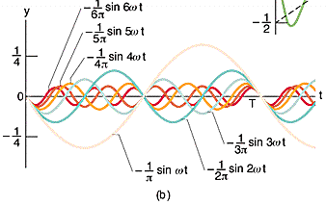
鋸齒波–II

Slide 23
4.7 波的干涉
  合成波

Slide 24
完全建設性與完全破壞性干涉
Fully constructive and fully destructive interference

Slide 25
同相與異相
(exactly in phase/out of phase)

Slide 26
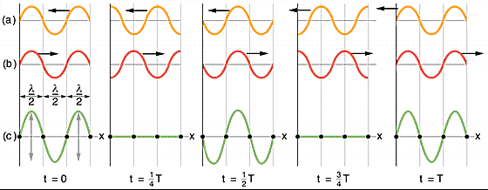
4.8 駐波
節點/反節點 node/antinode

Slide 27
數學分析

Slide 28
數學分析–II

Slide 29
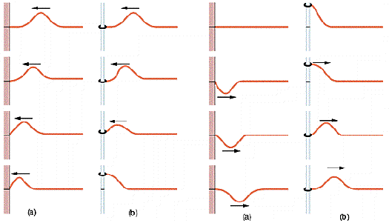
在邊界反射之相位變化

Slide 30
4.9 駐波與共振
A string of length L
n: harmonic number

Slide 31

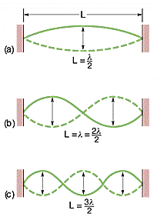
例五 共振例

Slide 32



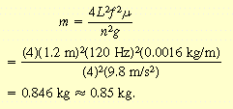
例六 波長與張力的實驗

Slide 33
一維、二維與三維波函數
2D
3D

Slide 34
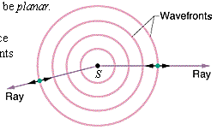
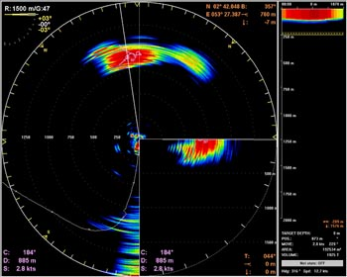
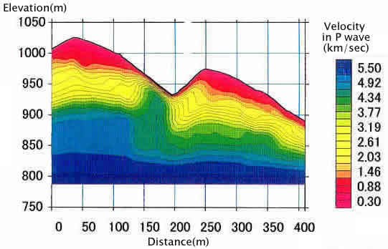
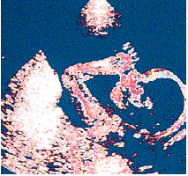
4.10 縱波
Sonar, Seismic Waves and Ultrasound

Slide 35
4.11 聲速
Bulk Modulus：B
容積彈性模數

Slide 36
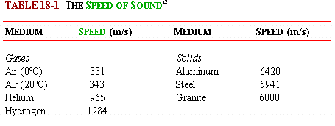

氣體、液體與固體中的聲速

Slide 37
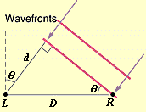
例一 聲源的方向
空氣中
水中
apparent angle

Slide 38
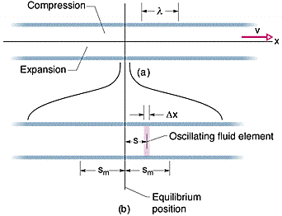
4.12 行進聲波
Displacement amplitude of an air element
位移

Slide 39
位移與壓力

Slide 40
例二 人耳耳膜可感知的最大與最小壓力差與位移

Slide 41
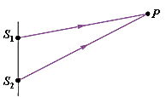
4.13 干涉
光程差和相位差
Fully constructive
destructive interference

Slide 42
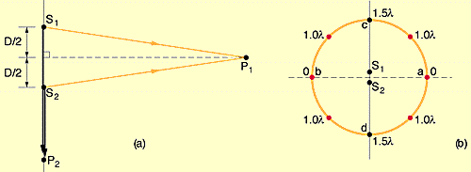
例三 圓上有幾個完全建設性
干涉點？
(a)λ_{P1}= 0, λ_{P2}= D =1.5λ
φ_{P1} = 0, φ_{P2}= (1.5λ/λ)2π= 3π
(b) N = 6 around the circle

Slide 43
4.14 強度與聲級
The Sound Level
• 通過單位面積之平均功率
Intensity

Slide 44
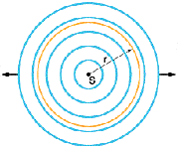
強度隨距離之變化

Slide 45
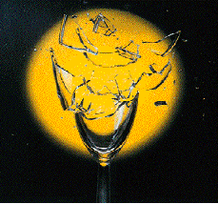
分貝
• The Decibel Scale

Slide 46
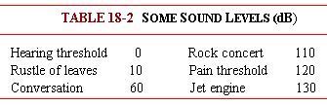
聲級β

Slide 47
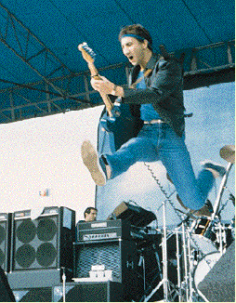
例四 The WHO –the loudest concert
The Who: 120 dB
鑽孔機 : 92 dB
I₁: I₂ = 630!

Slide 48
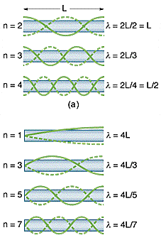
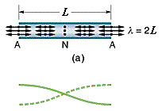
4.15 音樂聲源
pipe

Slide 49
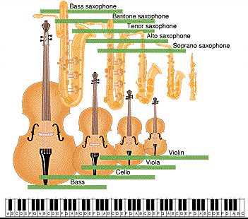
駐波與共振

Slide 50
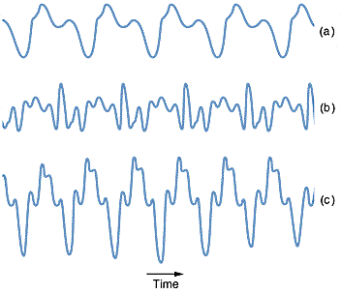
橫笛、雙簧管和薩克斯風

Slide 51
例五 紙筒的聲音
(a) 靠近耳朵
(b) 離開耳朵

Slide 52
4.16 Beats 拍
Notes:
For the difference frequency you can just say that you get a minimum when the modulating term reaches zero, which it does twice per cycle.

Slide 53
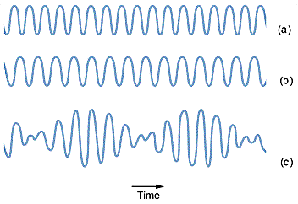
6.17 Beats 拍 - II

Slide 54
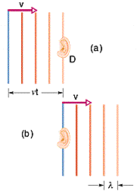
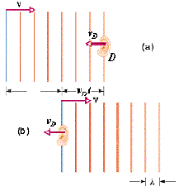
4.18 The Dopper Effect
(a) Detector moving; source stationary

Slide 55
頻率變化 –(a)

Slide 56
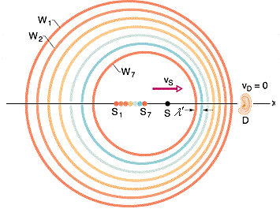
Source moving; detector stationary

Slide 57
頻率變化 – (b)
(general) (low speed)

Slide 58
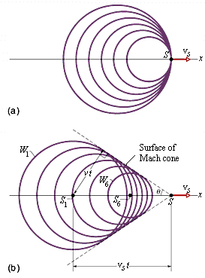
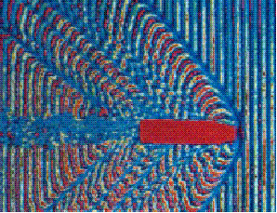
4.19 超聲速–震波
Mach Cone/Shock Wave Mach Number

Slide 59
例六 玩具火箭發射聲波 f = 1250Hz v = 242m/s
  (a) f ’ 偵測器接收的頻率
(b) f ’’ 火箭偵測到反射波的頻率

Slide 60
例七 蝙蝠和飛蛾
V_{b} = 9 m/s v_{m}= 8 m/s
  (a) f_{m} when f_{bd} = 83kHz
(b) f_{be} when f_{bd} = 83kHz

Slide 61
4.20光的都卜勒效應
magnitude

Slide 62
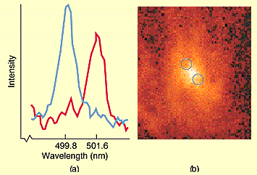
例八 The M87 galaxy
200 ly

Slide 63
超大黑洞

Slide 64
敬請期待
物理 V–重力

Slide 65
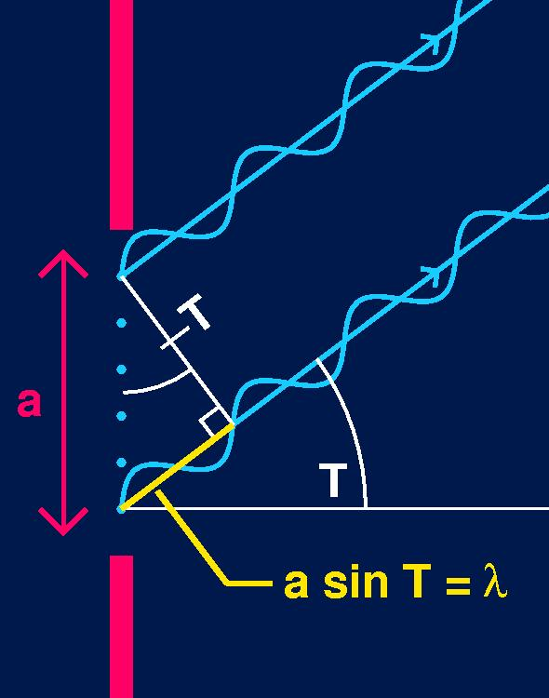
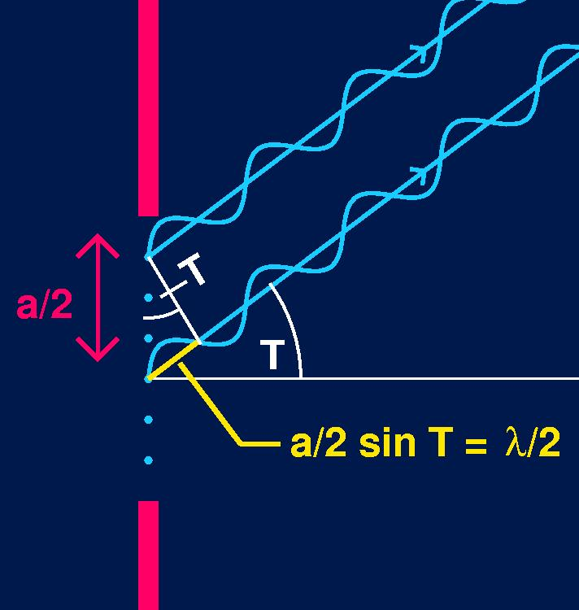
Path difference vs. phase difference

Slide 66
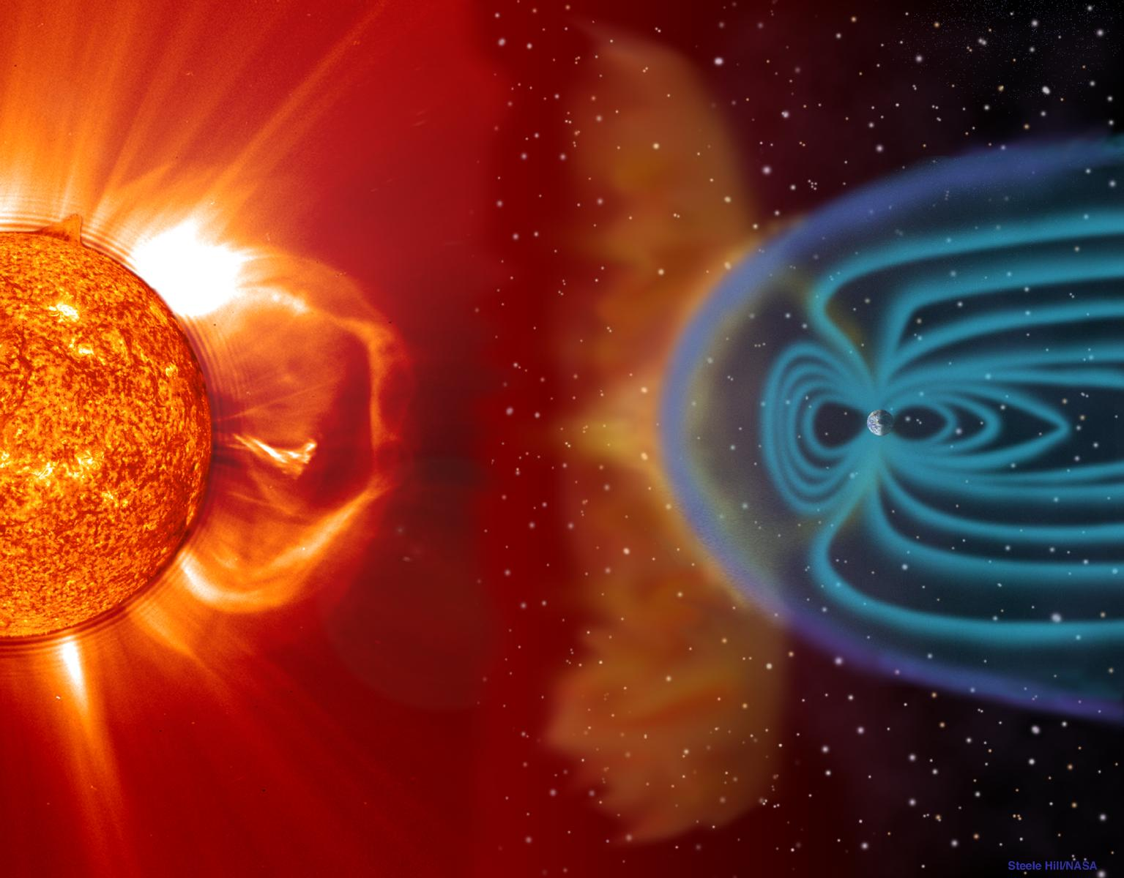
The earth’s bow shock

