Slide 1

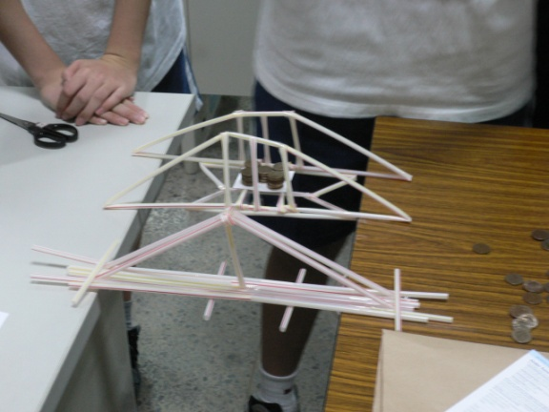
設計橋樑/結構與強度
http://bridgecontest.usma.edu/download.htm
材料: 20根吸管，1m膠帶
橋長: 25cm
除兩端之外不能用橋墩

Slide 2
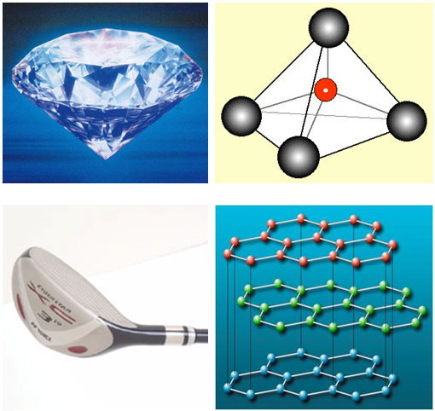
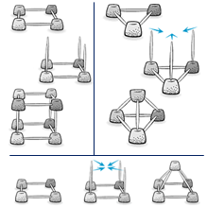
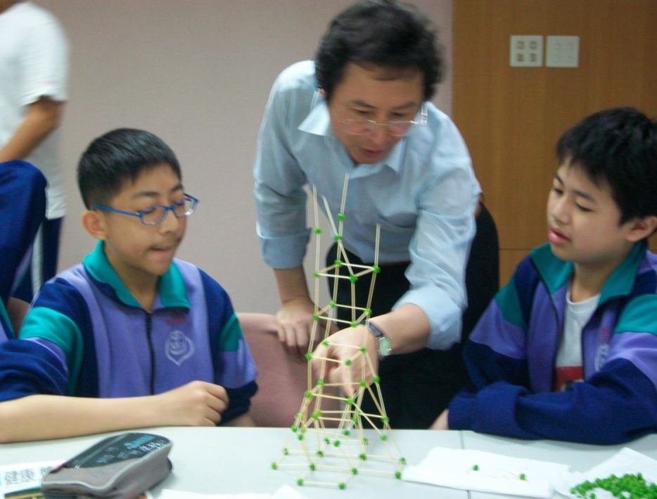
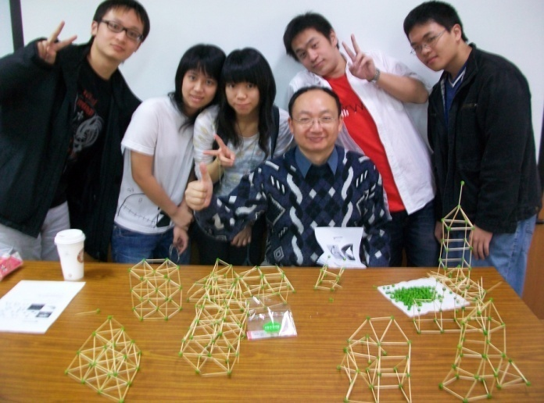

Slide 3
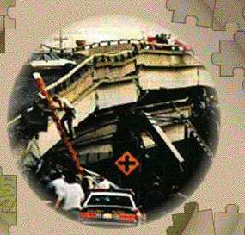
3 振盪
尼米茲公路上的悲劇
Notes:
1989 The Loma Prieta Earthquake, 7.1 on the Richter scale, causes the double-decked Nimitz Freeway (I-880) in Oakland, CA, to collapse, killing 67, and damages the Embarcadero Freeway, the San Francisco-Oakland Bay Bridge, and other roads in the Bay Area. The death toll is less than at first expected--although the earthquake occurred during evening rush hour, many residents had gone home early to watch the Oakland A's and the San Francisco Giants in the World Series.

Slide 4
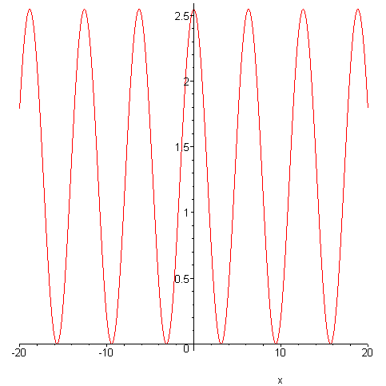
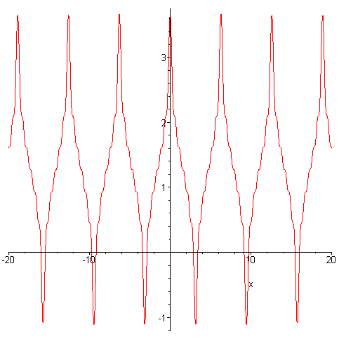
3.1 簡協運動
Simple Harmonic Motion (SHM)
Frequency (頻率) [hertz(Hz)] - f
Period (週期) - T
Periodic/harmonic motion
displacement

Slide 5
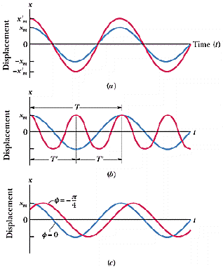
振幅、週期、相位、角頻率
角頻率
Notes:
Amplitude, phase, and angular frequency

Slide 6
速度、加速度

Slide 7
3.2 SHM 中的作用力

Slide 8
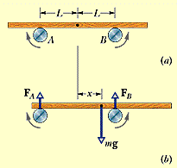
例一 板子+二逆向轉軸
力平衡方程式

Slide 9
μ_{k} = 0.40 L = 2.0cm
力矩平衡方程式

Slide 10
3.3 SHM 中的能量

Slide 11
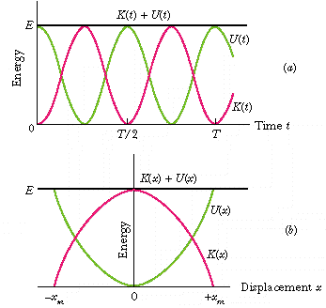
圖示

Slide 12
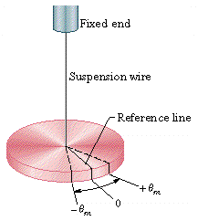
3.4 An Angular SHM
扭擺

Slide 13
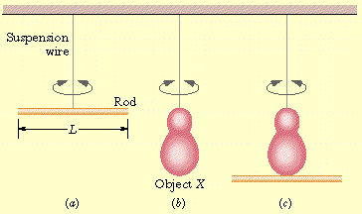
例二由扭擺求轉動慣量

Slide 14
由扭擺求週期

Slide 15
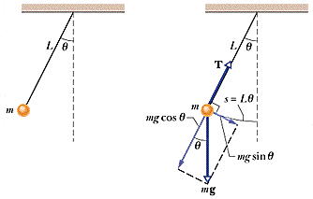
3.5 Pendulum
單擺 The Simple Pendulum

Slide 16
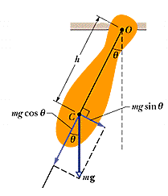
物理擺
單擺

Slide 17
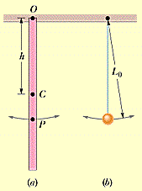
測量g值

Slide 18
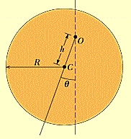
例三 圓盤物理擺求週期
h = R/2

Slide 19
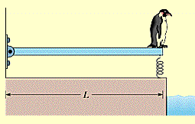
例四 企鵝跳水
m = 12kg
k = 1300N/m

Slide 20
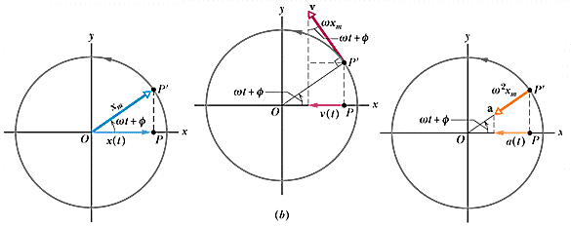
3.6 SHM 和等速率圓周運動
SHM 是等速率圓周運動在其圓周直徑之投影

Slide 21

有阻滯 S H M
Damped (阻尼)
阻滯力
微分方程式

Slide 22
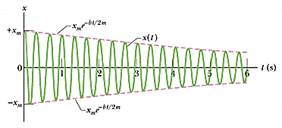
指數衰減

Slide 23
3.7 強迫振盪與共振
自然頻率與外來驅動頻率
共振條件
共振例
  Radio and TV tuning
  The collapse of the Nimitz freeway
  The Tacoma narrow bridge
  The bay of Fundy

Slide 24
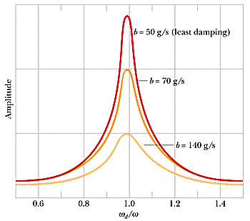
共振圖示

Slide 25
共振圖示

Slide 26
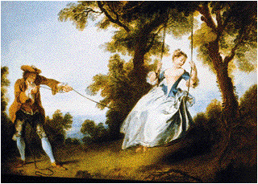
例五 盪秋千

Slide 27
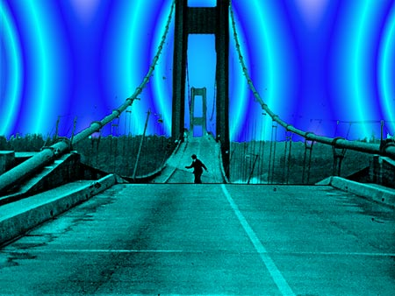
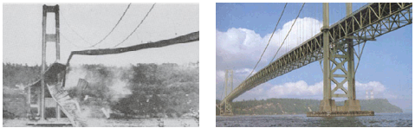
例六 The Tacoma narrow bridge
Notes:
Howard Clifford

Slide 28
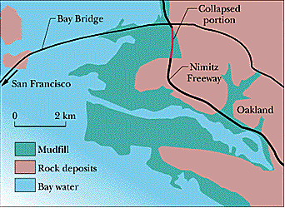
例七 The collapse of the
Nimitz freeway

Slide 29

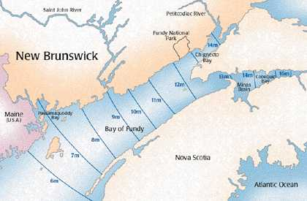
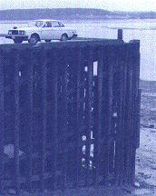
例八 全球最大的潮差
Bay of Fundy
Notes:
the average tide range is 12 metres and can reach 16 metres when the various factors affecting the tides are in phase
Earth's mid-ocean tide reaches an average height of 0.51 meters

Slide 30
敬請期待
物理 V–波動

Slide 31
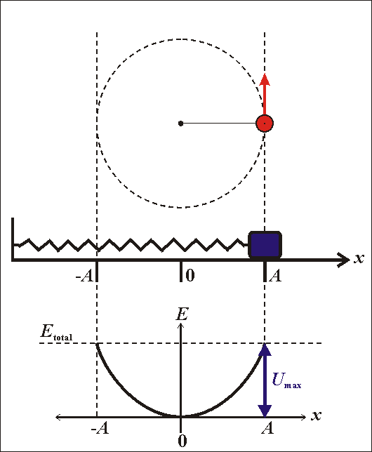
簡協運動的動畫

Slide 32
Simple Harmonic Motion

Slide 33
Harmonic Motion

